Slide 1
Art Reception
A | We are Bradley Barton Our First Nativity | Reach for the Stars A Journey to Space Healthy bodies, healthy minds |  | Oh, the Places You Will Go Moving on up
B | We are family Christmas Spectacular! | Reach for the Stars Reach for the Stars Let’s Get Physical |  | Our Planet Moving on up
Prior
Knowledge and Skills | I know things change over time. I can talk about similarities and differences. I know that this is season is called autumn and I can spot the signs of autumn. I can talk about what I can see, hear and feel whilst outside at my school. I know that we are moving into winter and I can make suggestions about what I should wear to keep me warm. | I can talk about similarities and differences. I can talk about how to keep my body healthy and safe. I can name ways to stay safe around medicines. I know who Neil Armstrong is and what he achieved. I can name other astronauts and talk about why they were important. I can name the planets in the solar system. I know I live on Earth. I know the world is round. I know that a globe represents the world. I know that this is season is called winter and I can spot the signs of winter. I can talk about how I can make an impact on the natural world. I can consider how to make healthy choices. I know that we are moving into spring and I can spot the signs of this. I can compare spring to winter and I know that spring is warmer. I know that a human is a mammal. |  | I can talk about similarities and differences. I understand that I can make healthy choices. I can name and recognise how healthy choices can keep us well. I understand that a globe represents earth. I know how to ask questions about the world using my senses- feeling, hearing and seeing. I know that we are now into summer and I can make suggestions about what I should wear to keep me protected from the sun. I can name the 4 seasons and make comparisons between them. I understand that there are changes in nature and humans. I can name the different stages in childhood and growing up. I can understand that babies are made by a man and a woman. I can use the correct vocabulary when naming the different parts of the body.
END POINT | Early Learning Goals:
Next

Slide 2
Science Year 1
Biology Plants and seasonal change |  |  | Chemistry Physics Everyday materials and seasonal change | Biology Animals including humans and all living things and their habitats
Prior | Understand seasons; notice differences in environments; know how to keep healthy and make healthy choices; enjoy spending time in different outside environments; use nature to learn; take part in experiments
Knowledge (substantive and disciplinary) | Lesson 1 – Explore the local environment and name the plants seen. Lesson 2 – Name the different parts of plants Lesson 3 – Name the different parts of a tree Lesson 4 – Sorting deciduous and evergreen trees Lesson 5 – Recognise different plants and flowers in the local area Lesson 6 – TAPS plants flower model¬– Structure of a plant Lesson 7- TAPS- dig and label plants Lesson 8 – Seasonal Change – identify features of Autumn and how this differs to other seasons Lesson 9 - Retrieval lesson Lesson 10 –- Revisit the local environment to notice how the plants have changed throughout autumn. Resources – Velcro parts of a flower (under tray G10) | Lesson 1 – name some every day materials Lesson 2 - TAPS materials sorting - Sorting materials based on their properties Lesson 3 – Planning how to create the most effective umbrella for a teddy Lesson 4 – Creating an umbrella for a teddy and testing Lesson 5 – reviewing the effectiveness of our teddy experiment Lesson 1 – Name seasons and know main events which occur within them Lesson 2 – Identifying similarities and differences between seasons (set up data logger to measure sunlight) Lesson 3 –Identify weather changes in the seasons (review last week’s data loggers) Lesson 4 –Know how what I need to wear in different seasons Lesson 5 – Describe how the seasons affect the length of day Lesson 6- TAPS Seasonal change (will need to take pictures of trees in a different season) Resources - Data loggers for measuring sunlight (Large red tray under Dictaphones) | Lesson 1 – name some every day materials Lesson 2 - TAPS materials sorting - Sorting materials based on their properties Lesson 3 – Planning how to create the most effective umbrella for a teddy Lesson 4 – Creating an umbrella for a teddy and testing Lesson 5 – reviewing the effectiveness of our teddy experiment Lesson 1 – Name seasons and know main events which occur within them Lesson 2 – Identifying similarities and differences between seasons (set up data logger to measure sunlight) Lesson 3 –Identify weather changes in the seasons (review last week’s data loggers) Lesson 4 –Know how what I need to wear in different seasons Lesson 5 – Describe how the seasons affect the length of day Lesson 6- TAPS Seasonal change (will need to take pictures of trees in a different season) Resources - Data loggers for measuring sunlight (Large red tray under Dictaphones) | Lesson 1 – Know how to handle animals safely. Explain to the children that next week we will be picking up insects and creatures. Discuss how we do this safely. Ask children if they have any pets at home. How do they care for them? What do animals need to survive? Lesson 2 – Explore what animals are in our local environment. Children to go on a walkaround the forest and field. Children to take photographs of animals seen and label these. Children to carefully pick up and observe them. Lesson 3 – Classify animals in my local environment. Children to look at the photos taken in the previous week. Add photographs of other animals found in our locality (but not seen on the walk). Children to colour-code these as mammals, birds and fish. Lesson 4 – Understand what the difference is between amphibians and reptiles. Show pictures of a frog and slow worm (both commonly found in our locality). Children to discuss the difference between them. Children to write a definition for an amphibian and a reptile. Lesson 5– Classify common animals. Children to sort a range of animal cards into the different categories: fish, amphibians. Reptiles, birds and mammals (include pictures of pets). Lesson 6 – Explain what a carnivore, herbivore and omnivore is. Show pictures of animals in the three different categories. Children to discuss what they notice about the animals- what is similar and what is different? Children to use this to predict whether the animals eat meat or do not. Lesson 7 – Sort animals into carnivores, herbivores and omnivores. Children to have lots of images of different animals and sort them into the categories. Lesson 8- TAPS task- animals sorting Lesson 9 – Explore different human body parts. Children to do this through playing ‘Simon says’ include head, neck, arms, elbows, legs, knees, face, ears, eyes, hair, mouth and teeth. Lesson 10 – Label human body parts. Children to have a picture of a body map and label the body parts taught in lesson 9. Lesson 11 – Name the five senses and link them to the associated body parts. Children to play ‘Simon says’ but this time say the name of the sense (not the body part).
Skills | Plan: choose appropriate materials Do: observe closely | Review: classifying Review: using observations and ideas to suggest answers to questions. | Review: classifying Review: using observations and ideas to suggest answers to questions. | Review: identify and classify
END POINT | I can identify and name a variety of common wild and garden plants and can identify and describe the basic structure of a variety of common flowering plants. | I can distinguish between an object and the materials from which it is made, identify and name a variety of everyday materials, describe the simple physical properties of a variety of everyday materials and compare and group together a variety of everyday materials based on their properties. I can observe changes across the four seasons and observe and describe weather associated with the seasons and how day length varies. | I can distinguish between an object and the materials from which it is made, identify and name a variety of everyday materials, describe the simple physical properties of a variety of everyday materials and compare and group together a variety of everyday materials based on their properties. | I can identify and name a variety of common animals. I can identify and label the basic parts of the human body.
Next | Describe what plants need; conduct growing plant experiments; observe how bulbs mature. | Use different materials in different environments; find out how solid shapes can be changes; know suitability of everyday materials; compare and contrast suitability of materials. | Use different materials in different environments; find out how solid shapes can be changes; know suitability of everyday materials; compare and contrast suitability of materials. | Know that animals have offspring; group vertebrates; describe needs of animals; know how to keep healthy. Describe habitats; name characteristics; name plants and animals; explore differences between living things and dead or never lived; describe how animals obtain food.

Slide 3
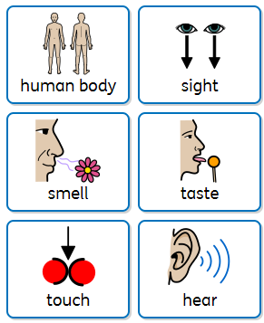
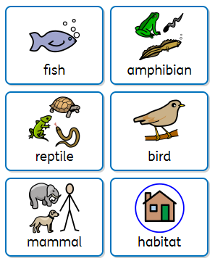
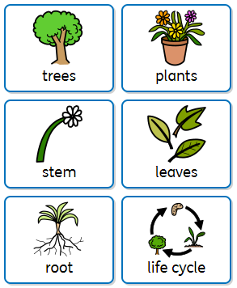
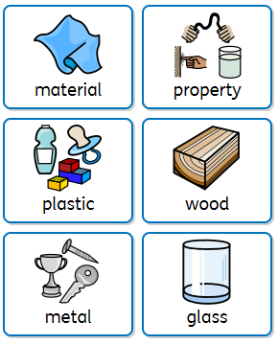
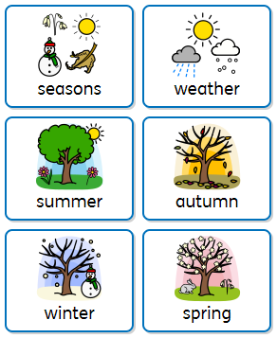
Year 1 vocabulary
Year 1 resources

Slide 4
SCIENCE Year 2
Biology Plants and animals including humans |  | Chemistry Every day materials | Biology All living things and their habitats
Prior | Know body parts; know the senses. Name animals; know observable characteristics of animal groups; name carnivores, omnivores and herbivores; engage in habitat walks. Name wild and garden plants; describe structure of flowering plant; know length of day; understand seasons; explore environment. Know what material makes an object; identify everyday materials; compare and group variety of materials; describe materials; compare and group materials.
Knowledge (substantive and disciplinary) | Lesson 1- Identifying and Describing Seeds and Bulbs (plant cress) Lesson 2- Understanding Plant Growth Requirements Lesson 3- Observing and Describing Growth Stages Lesson 4- Analysing and Presenting Experimental Results Lesson 5- TAPS - Plants observing seed growth - observe and describe how seeds and bulbs grow into mature plants Lesson 6- TAPS – plant growth comic strip - observe and describe how seeds and bulbs grow into mature plants Lesson 1- Understanding Offspring and Growth Lesson 2- Identifying Basic Survival Needs Lesson 3 - TAPS Animals match offspring - notice that animals have offspring which grow into adults Lesson 4- Exploring the Importance of Exercise Lesson 5- Learning About a Balanced Diet Lesson 6- Understanding Hygiene Practices Resources – data loggers to measure how sunlight impacts growth of plants. | Lesson 1- Identify materials different objects are from. Lesson 2- Investigate the properties of different materials. Lesson 3- Explain how materials are useful in different situations. Lesson 4- Suggest suitable materials for new situations. Lesson 5- Group objects by the material they are made from. Lesson 6- Investigate and compare the properties of different metal objects. Lesson 7- Investigate how I can change the shape of different objects. Lesson 8- TAPS Rocket mice – changing shapes of materials can create force Lesson 9- TAPS Plan materials hunt - Identify and compare the suitability of a variety of everyday materials Lesson 10- TAPS material hunters-Identify and compare the suitability of everyday materials Resources – tray C9 | Lesson 1- Know what living things need to survive. Recap learning from Y1 (animals need water, food, shelter and space to survive). Show the children two plants (one that has had water, light and one that has not). Children to discuss what they notice and children to conclude what living things need to survive. Lesson 2- Explore the difference between living things, dead things and things that have never been alive. Children to walk around the school site and outside space. Children to take clipboards and note down anything they see which is living, dead and things that have never been alive (take photos too). Children to discuss these as a class. Lesson 3- Compare the difference between living things, dead things and things that have never been alive. Use the photos taken last week to classify the different things seen. Add in ones which will test their understanding further e.g. flames, a bare tree in the winter. Sort these into hoops/circles. Lesson 4- Create charts to show findings of living, dead and things that have never been alive. Lesson 5- Recognise habitats within my local area. Use Digimap to look at aerial images of the Bradley Barton area. Relate the aerial image to photographs of habitats we have (forest, garden, field, hedgerow). Children to annotate the photographs with suggestions of animals that may live there. Discuss why do those animals live in that habitat? Lesson 6- Know what a micro-habitat is. As a class, find some micro-habitats within the school grounds. Children to take photographs of the different micro habitats to look at together after. Create a collage of the photographs for them to recall in their books. Discuss why do those animals live in that habitat? Lesson 7- TAPS woodlice tally – Identify that living things live in habitats that suit them. Lesson 8- Understand how habitats depend on each other (interdependence). Children to look at a photograph of a habitat at school. Discuss which animals depend on that habitat? Which living things depend on other living things? Draw out that the plants serve as a source of food and shelter. Lesson 9- Compare animals in familiar habitats with animals found in less familiar habitats. Compare animals at the seashore to those we find in the forest at school. How do the animals differ based on their habitat? Lesson 10- Name different habitats and know which animals are suited to that habitat. Children to build on last week by identifying other habitats. Use Google Earth to zoom in on unfamiliar habitats (The Great Barrier Reef, Amazon rainforest and Arctic). Children to compare these to habitats in our local environment. How have the animals adapted to their environment? (e.g. arctic fox with thick winter; iguana camouflages). Lesson 11- Construct a simple food chain. Discuss what people eat. Recap the terms learnt in Y1 (carnivore, omnivore and herbivore). Children to create a simple food chain for a human (grass, cot, human). Lesson 12- TAPS Living Habitat Survey - identify and name a variety of plants and animals in their habitats, including micro-habitats
Skills | Plan: To set up a fair experiment Do: observe closely | Do: gather and record data to help in answering questions Review: using their observations and ideas to suggest answers to questions | Do: gathering and recording data to help in answering questions Do: gathering and recording data to help in answering questions
END POINT | I can observe and describe how seeds and bulbs grow into mature plants. I can describe how plants need water, light and a suitable temperature to grow and stay healthy. I understand that animals, including humans, have offspring which grow into adults, describe the basic needs of animals for survival and understand the importance for humans of exercise, diet and hygiene. | I can identify and compare the suitability of a variety of everyday materials and can explain how the shapes of solid objects made from some materials can be changed. | I can compare the differences between things that are living, dead and things that have never been alive. I can identify that most living things live in habitats to which they are suited to. I can explain a simple food chain.
Next | Know the names and properties of the different types of rock; understand how fossils are formed. Know the names of the food types; identify muscles and bones. | Compare how things move on different surfaces; explore magnets; make predictions about magnets. | Know the parts of a plant; explore and investigate the biology of a plant.

Slide 5
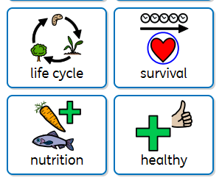
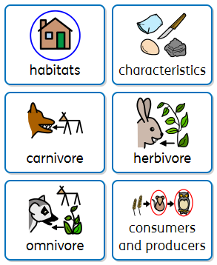
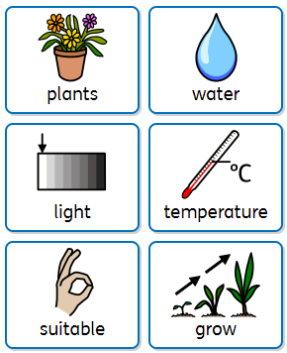
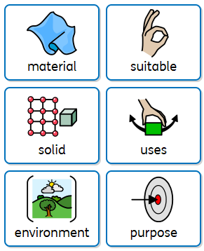
Year 2 vocabulary

Slide 6
SCIENCE Year 3
Biology and Physics Animals including humans and light |  | Chemistry Rocks | Biology and Physics Plants and forces
Prior | Body parts (Y1) Know that animals have offspring; group vertebrates; describe needs of animals; know how to keep healthy (Y2). Names of animals (Y1) Describe what plants need (Y2). Conduct growing plant experiments (Y2). Observe how bulbs mature (Y2). Use different materials in different environments (Y2). Know suitability of everyday materials (Y2). Compare and contrast suitability of materials (Y2).
Knowledge (substantive and disciplinary) | Lesson 1- Understanding Animal Nutrition Lesson 2- Comparing Animal Nutritional Needs Lesson 3- Planning balanced meals based on the eat well plate Lesson 4- Recognizing the Role of Skeletons and Muscles Lesson 5- Exploring the Functions of Skeletons and Muscles Lesson 6- TAPS animals draw inside fish - identify that animals have skeletons and muscles Lesson 1- Understanding Light and Vision Lesson 2- Exploring Light Reflection Lesson 3- Understanding Sun Safety Lesson 4- Recognising Shadows Lesson 5- Applying Knowledge of Light and Shadows Lesson 6- TAPS Light shadow invest - find patterns in the way that the size of shadows change Resources – skeletons on shelves. | Lesson 1- Name 3 different kinds of rock. Lesson 2- Group and compare different kinds of rock based on their appearance and properties. Lesson 3- Describe how each rock is formed. Lesson 4- Test and compare rocks based on their hardness. Lesson 5- Investigate the properties of rock. Lesson 6- Match rocks to their properties and suggest uses for them (final Outstanding science lesson). Lesson 7- TAPS Rock scratching - compare and group together different kinds of rocks on the basis of their simple physical properties Lesson 8- Explain how fossils are formed. Lesson 9- Describe fossils. Lesson 10– TAPS expl fossil formation - describe in simple terms how fossils are formed when things that have lived are trapped within rock Lesson 11- Investigate what soils are made of. Lesson 12- Examine what a soil sample is made of. Resources – trays c15-c20 | Lesson 1- Describe the functions of different parts of flowering plants. Children to explore a sample of flowering plants. Locate the roots, stem, leaves and flowers. Children to understand the role of these parts. Children to do a scientific drawing of their flower and label each part with their function. Lesson 2- Plan an experiment to test what plants need to grow. Children to recap Y2 learning on what living things to grow. Children to work in pairs to decide how this could be tested in a science experiment. (Children may choose to test light needed/fertiliser or plant food/water required. Ensure children focus on different plants so the difference can be incorporated into their conclusion). Lesson 3- Carry out an experiment. Children to carry out their experiment from last week. They will then conclude from this in week 5 (when the plants have adapted to their conditions). Lesson 4- Observe how water is transported in flowering plants. Children to put cut white carnations into coloured water and observe how water travels up the stem. Lesson 5- Explain the part flowers play in the life cycle of flowering plants. Look at photos of different stages on plant reproduction: pollination, seed formation and seed dispersal. Children to create a storyboard to show the life cycle of a flowering plant. Lesson 6- TAPS plants labelling and Q raising - identify and describe the functions of different parts of flowering plants: roots, stem/trunk, leaves and flowers Lesson 1- Know how magnets work. Share with children ‘The Japanese Maglev’. Show videos of it and how it works. Through this, explain how magnets work and let children explore moving different materials with magnets. Children to draw conclusions from this that magnet force does not require direct contact. Lesson 2- Predict whether magnets will attract or repel. Discuss how magnets have two poles. Children to explore using them to move different moveable vehicles (metal cars, plastic cars, their DT carts etc). How does putting a magnet onto their cart (with an elastic band) change how it moves? Children to flip the magnet (so the other pole is at the front). How does this change the movement? Use this to explain how magnets have poles. Lesson 3- Explain how magnets are used everyday. Recap how magnets are used in Japanese Maglev trains. Show them photos of lots of different magnets around used in every day life. Children to discuss and suggest some creative uses for magnets. Lesson 4- Know that some forces need contact. Recap how magnets do not need direct contact. Discuss what forces do and what forces do not need direct force. How is technology changing this (doorbell. Opening a door). Using hoops, create a Venn diagram with children and ask them to place their examples. Lesson 5- Compare how things move on different surfaces. Children to watch a video of someone ice skating. Why does the skater move in this way? Discuss what would happen if the skate was made of wood. What would happen is the floor was gravel? Children to relate this to their own lives and why our shoes are made of rubber soles. Introduce the word ‘friction’ throughout the discussion. Lesson 6- TAPS set up ramp invest - compare how things move on different surfaces. Magnets – c23-25, ramps
Skills | Do: making systematic and careful observations Review: reporting on findings from enquiries | Do: making systematic and careful observations, gathering and recording data. | Plan: raise their own questions about what they notice Plan: setting up simple practical enquiries, comparative and fair tests
END POINT | I can identify that animals, including humans, need the right types and amount of nutrition and they get it from what they eat. I can identify that humans and some other animals have skeleton and muscles for support, protection and movement. I can recognise that we need light to see things and darkness is the absence of light, know that light is reflected from surfaces, understand that light can be dangerous. I can understand how shadows are formed and find patters in the way that the size of a shadow changes. | I can compare and group together different kinds of rock based on their appearance and properties. I can describe how fossils are formed and recognise that soils are made from rocks and organic matter. | I can identify and describe the functions of different parts of flowering plants. Explain how magnets work and how they interact with materials.
Next | Know the names of the parts of the digestive system; know teeth names; create food chains. Know how sound is made and how it travels; find patterns in sounds; draw out conclusions from experiments on sound; create ear defenders. | Know the term solid, liquid and gases; know how they change state; apply knowledge to the water cycle. | Group living things; recognise changes to the environment; understand how to protect our environment. Know how electricity is used; build circuits; recognise when something is run by battery; make predications about conductors or insulators.

Slide 7
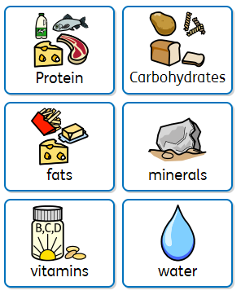
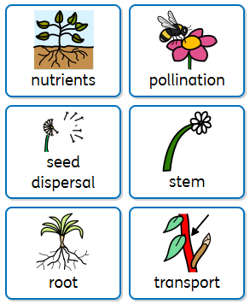
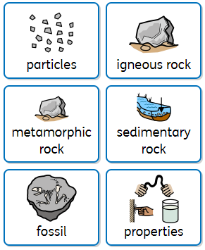
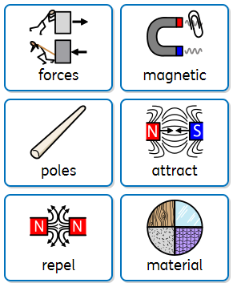
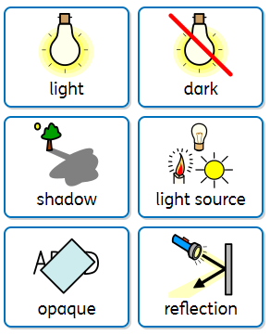
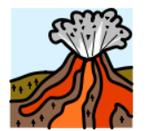
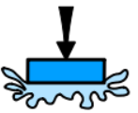
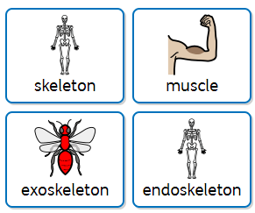
Year 3 vocabulary

Slide 8
SCIENCE Year 4
Biology All living things and their habitats and animals including humans |  | Biology and Chemistry Animals including humans and states of matter | Physics Sound and electricity
Prior | Know that animals have offspring (Y2). Know how to keep healthy (Y2). Know the names of the food types; identify muscles and bones (Y3) Classifications (Y1) Habitats (Y2) Know the parts of a plant; explore and investigate the biology of a plant (Y3). Every day materials (Y1) Know the names and properties of the different types of rock; understand how fossils are formed (Y3). Compare how things move on different surfaces; explore magnets; make predictions about magnets (Y3). Understand the need for light; understand how shadows are formed; sun safety (Y3).
Knowledge (substantive and disciplinary) | Lesson 1- Understand that living things can be grouped in various ways and learn basic classifications. Lesson 2- Learn how to use classification keys to identify and group living things. Lesson 3- Animal top trumps based on characteristics- Example in TAPS folder Lesson 4- Apply knowledge of classification keys to identify local flora and fauna. Lesson 5- Understand how environmental changes can affect living things. Lesson 6- Understand the effects of pollution, deforestation, and urbanisation on living things. Lesson 7- Understand ways to protect living things and their environments. Lesson 8- TAPS task- Local Environment Survey Lesson 9- Choose a local environmental issue and develop an action plan to address it Lesson 10- Identify producers, predators and prey in food chains. Lesson 11- Construct and interpret a variety of food chains Lesson 12- Understand the importance of maintaining balanced ecosystems. | Lesson 1- Describe the basic parts of the human digestive system Lesson 2- Understand the simple functions of each part of the digestive system. Lesson 3- Identify the different types of teeth in humans. Understand the simple functions of each type of tooth. Lesson 4- Understand how different types of teeth contribute to the digestive process. Lesson 5- TAPS task- Teeth in liquids news report Lesson 1- Group substances based on whether they are a solid, liquid or gas. Lesson 2- Explain how materials change state. Lesson 3- Investigate the boiling point of different materials. Lesson 4- Explain the water cycle. Lesson 5- Investigate how temperature affects evaporation rates. Lesson 6- TAPS task- Drying materials Resources – Changes of state (C6-C7); water cycle model – under tray G10. Resources – teeth (tray B4) | Lesson 1- Identify how sounds are made and associate sounds with something vibrating. Lesson 2- Recognise that vibrations from sounds travel through a medium to the ear. Know the parts of the ear. Lesson 3- Find patterns between the pitch of a sound and features of the object that produced it. Lesson 4- Find patterns between the volume of a sound and the strength of the vibrations that produced it. Lesson 5- Recognise that sounds get fainter as the distance from the sound source increases. Lesson 6- TAPS task- Does it conduct electricity? Lesson 1- Explore electrical circuits. Lesson 2- Construct a simple series circuit. Ensure children understand the terms cells, wires, bulbs. Lesson 3- Construct a series circuit with multiple components. Recap last week and build on it with the addition switches and buzzers. Introduce the term ‘current’. What happens to the build brightness if extra cells are put into the circuit? Lesson 4- Understand how important electricity is to us. Explain that Benjamin Franklin ‘discovered’ electricity. Children to name common appliances that run on electricity. Imagine life before electricity and the impact it has on us. Lesson 5- TAPS task- Electricity conductors Lesson 6- Explain how metal can be used as a conductor. Is there anything that can connect a gap in a circuit? Children to discover metal can be used to connect a gap. (They could do this with a piece of card and make it into a switch like the final picture on the SKO). Resources –Data loggers for sound – tray G1a and under Dictaphones Tuning forks and sound resources – P2a – 2b; tray P10-P14 for electricity. Resources –Data loggers for sound – tray G1a and under Dictaphones Tuning forks and sound resources – P2a – 2b; tray P10-P14 for electricity.
Skills | Do: Gather, record and classify data. | Review: reporting on findings from enquiries, using results to draw simple conclusions. Plan: Set up a fair test. | Review: Identify differences, similarities or changes related to simple scientific ideas and processes. Review: Report on findings from enquires, including oral and written explanations, displays or presentations of results and conclusions.
END POINT | I can recognise that living things can be grouped in a variety of ways, understand and use classification keys to group, identify and name a variety of living things and recognise that environments can change and that this can sometimes pose dangers to living things. construct and interpret a variety of food chains, identifying produces, predators and prey. | I can describe the simple functions of the basic parts of the digestive system in humans, identify the different types of teeth and their simple function and I can compare and group materials together according to their state of matter, observe some materials change state when they are heated or cooled and identify the part played by evaporation and condensation in the water cycle. | I can identify common appliances that run on electricity, construct a simple circuit, identify whether or not a lamp will light in a simple series circuit, recognise that a switch open and closes a circuit and recognise some common conductors and insulators. I can identify how sounds are made, recognise that vibrations from sounds travel through a medium to the ear, find patterns between the pitch of a sound and the features of the object that produced it and recognise that sounds get fainter as the distance from the sources increases.
Next | Know the life cycle of living things; know how living things reproduce. Aging in the human body. | Properties of materials; understand which materials will conduct, are magnetic, will dissolve; know about reversable and irreversible changes. | Name planets; know sun’s impact on the Earth; understand phases of the moon; understand how seasons are created Know forces push or pull; know about friction; understand gravity; understand mechanisms.

Slide 9
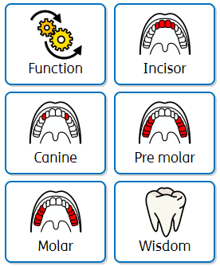
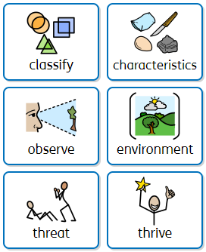
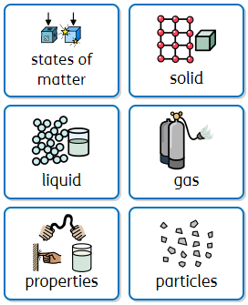
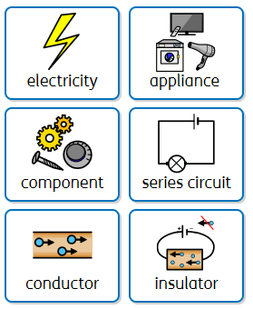
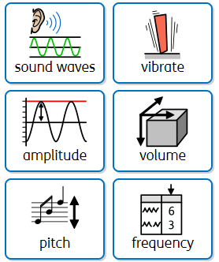
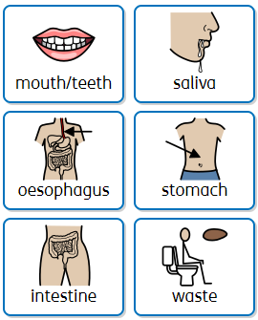
Year 4 vocabulary

Slide 10
SCIENCE Year 5Children to research and find
Physics Earth and Space |  |  | Biology and Physics All living things and their habitats and forces | Chemistry and Biology Properties and changes in materials and animals including humans
Prior | Food chains (Y2) Identify muscles and bones (Y3) Know the names of the parts of the digestive system; know teeth names; create food chains. Classifications (Y1) Habitats (Y2) Parts of plants (Y3) Group living things; recognise changes to the environment; understand how to protect our environment. (Y4). Every day materials (Y1) Rocks (Y3) Know the term solid, liquid and gases; know how they change state; apply knowledge to the water cycle (Y4). Forces (Y3) Know how electricity is used; build circuits; recognise when something is run by battery; make predications about conductors or insulators. (Y4). Seasons (Y1) Light (Y3) Know how sound is made and how it travels; find patterns in sounds; draw out conclusions from experiments on sound; create ear defenders (Y4).
Knowledge (substantive and disciplinary) | Lesson 1- Identify the role of the sun in the solar system. Revisit the names of the planets. Show the model of the planets. Lesson 2: Describe the movement of the planets. Children to physically move to show the movement of the planets. Lesson 3- Understand why the Earth’s rotation causes day and night. Work scientifically by exploring different locations using internet links and direct communication. Lesson 4- Describe the movement of the moon. Lesson 5- TAPS task- Solar System research. Lesson 6- Understand how the sun, Earth, and moon are spherical bodies. Create models of each the sun, moon and Earth. Lesson 7- Know the Earth’s rotation causes day and night. Lesson 8. Explain the apparent movement of the sun across the sky. Track the movement of the sun by using chalk to mark the shadows of a rounders pole. Lesson 9 – Understand how sundials were used. Lesson 10 - Construct a simple sundial. Calibrated to start the beginning and end of each day. Lesson 11- Predict what Stonehenge might have been used for. Children to research and identify different purpose of how Stonehenge was used as an astronomical clock. Lesson 12- Kahoot Resources – model of the solar system, inflatable planets in box next to unit and tray P21 | Lesson 1- Explain why objects fall to Earth. Explore falling objects and raise questions about air resistance. Use a range of different objects and include ones that will fall quickly and slowly (include sycamore seeds and parachutes) Lesson 2- Investigate the effects of air resistance. Explore falling cones or cupcakes cases and design and make a variety of parachutes and carry out fair tests. Lesson 3- Investigate the effects of water resistance. Explore resistance in water by making and testing boats of different shapes. Lesson 4- TAPS task- Aquadynamics Lesson 5- Explore the effects of friction on moving objects. Observe what happens to the wheel of a bike when the brakes are applied. Lesson 6- Explore how pulleys, levers and gears work. Resources – air resistance – P7; force meters in P4; ramps with different surfaces for friction testing (under units); levers/pulleys/gears models on wooden shelves Lesson 1- Describe the differences in the lifecycle of an animal, amphibian, insect and a bird. Observe life-cycle changes in a variety of living things. Include work of naturalists and animal behaviourists, e.g. David Attenborough. Compare with animals around the world. Lesson 2 - describe the life process of reproduction in plants. Observe life-cycle changes in plants in a vegetable garden or flower border. Try and grow new plants from different parts of a parent plant, e.g. seeds, stem, root cuttings. Lesson 3 - describe the life process of reproduction in animals. Observe changes in animals over a period of time. E.g. lifecycle of a chick. Comparing how different animals reproduce and grow. Lesson 4- describe the changes as humans develop to old age. Draw a timeline to indicate changes in the growth and development of humans. Changes experienced in puberty. Research gestation periods of animals and compare to humans. E.g. record length and mass as a baby grows. Lesson 5- TAPS task- Life Cycle Research |  | Lesson 1- Compare and group materials on the basis of their properties. Ensure children explore a broad range, include a focus on magnetism (Y3 learning revisit) and electricity (Y4 learning revisit). Within this, cover the following terms: hardness, solubility, transparency, conductivity, magnetism. Lesson 2- Give reasons for particular uses of everyday materials. Children to compare materials and decide which they would pick to reinforce the sea wall at Dawlish and why. Lesson 3- Understand that some materials dissolve in liquid to form a solution. Ensure children grasp that melting and dissolving are different processes. Use the terms solid, liquids and gases. Lesson 4- Explore the different ways mixtures can be separated. Children to split into groups to have a go at filtering, sieving, and evaporating (or seeing evidence of). Lesson 5- Conclude that dissolving, mixing, and changes of state are reversible. Lesson 6- Know some changes are difficult to reverse. Show children how vinegar and bicarbonate of soda react. Relate the difficulty of reversing this to other reactions like burning and rusting. Lesson 7- TAPS task- Testing Nappy Absorbency Lesson 8- Understand how chemists create new materials. Focus on Spencer Silver (who invented glue for sticky notes). Lesson 9- Know how chemical changes have an impact on our lives. Children to relate their learning about changes of states to cooking. Resources – sieves C26, funnels c4 and filer paper c3 C10 – solids for dissolving. Tray c8 for heating materials. Biology- Describe the changes as humans develop to old age (can cover this within SRE lessons). Lesson 1- Understand the changes which happen in puberty. Lesson 2- Draw a timeline to indicate the stages in growth in humans. Lesson 3- Compare gestation between humans and other animals. Resources – sieves C26, funnels c4 and filer paper c3 C10 – solids for dissolving. Tray c8 for heating materials.
Skills | Do: Gather and record data using tables and graphs. Review: Report and present findings from enquiries using appropriate scientific language | Review: Report and present findings from enquiries, in oral and written forms such as displays and other presentations, using appropriate scientific language. Review: Explain the degree of trust in the results |  | Plan: Plan different types of scientific enquiry, including recognising and controlling variables
END POINT | I can describe the movement of the Earth relative to the sun, the movement of the moon relative to the Earth, describe the sun, Earth and moon as approximately spherical bodies and understand why we have day and night. | I can describe the differences in life cycles of a mammal, an amphibian, an insect and a bird and describe the life processes of reproduction in some plants and animals. I understand the impact of gravity, the effects of different types of resistance and understand that different mechanism allow a smaller force to have a greater effect. |  | I can describe the changes as humans develop to old age. I can compare and group everyday materials based on their properties, separate mixtures, understand reversible and irreversible changes.
Next | Understand how light travels; explore parts of eyes. | Classify living things; make observations on a range of living things. Give explanations to the results of different circuits. |  | Know what evolution is; understand how genes come from biological parents and the impact of this. Know the human circulatory system and describe the function of the heart, blood vessels and blood; know how nutrients are transported; know impact diet, drugs, exercise and life style.

Slide 11
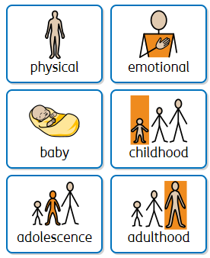
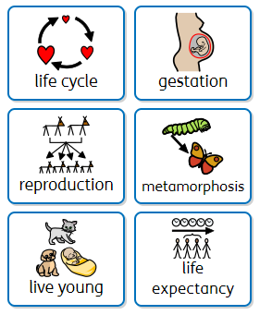
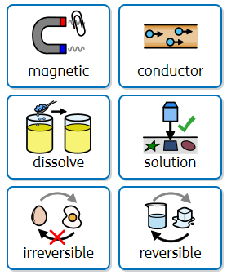
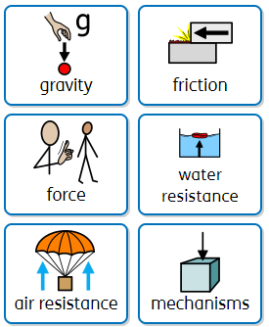
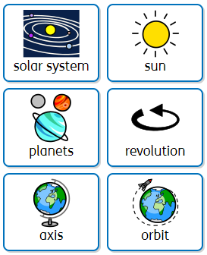
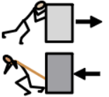
Year 5 vocabulary

Slide 12
SCIENCE Year 6
Physics and Biology Electricity and all living things and their habitats |  | Biology Animals including humans | Biology and Physics Evolution and inheritance and light
Prior | Food chains (Y2) Identify muscles and bones (Y3) Digestive system and teeth (Y4) Know the changes which happen to the human body when aging (Y5). Classifications (Y1) Habitats (Y2) Parts of plants (Y3) Group living things (Y4) Know the life cycles of different living things; know how living things reproduce (Y5). Every day materials (Y1) Rocks (Y3) States of matter (Y4) Properties of materials; understand which materials will conduct, are magnetic, will dissolve; know about reversable and irreversible changes (Y5). Know how electricity is used; build circuits; recognise when something is run by battery; make predications about conductors or insulators(Y4) Know forces push or pull; know about friction; understand gravity; understand mechanisms. (Y5). Light (Y3) Sound (Y4) Name planets; know sun’s impact on the Earth; understand phases of the moon; understand how seasons are created (Y5)
Knowledge (substantive and disciplinary) | Lesson 1- Identify the relationship between the brightness of a lamp and the number/voltage of cells in a circuit. Lesson 2- Compare and provide reasons for variations in how electrical components function. Lesson 3- Analyse and compare the behaviour of components in a circuit. Lesson 4- Use recognised symbols to represent simple circuits, incorporating technology. Lesson 5- Apply circuit symbols to represent complex circuits and explain their function. Lesson 6- TAPS- Bulb Brightness Lesson 1- Classify different living things based on observable characteristics (introduce what a living this is/why scientist classify and children to broadly classify a range of animals) Lesson 2- Understand the Linnaean system (introduce Carl Linnaean and understand and use his taxonomy system) Lesson 3 – Identify similarities and differences when classifying vertebrates Lesson 4 – classify and organise invertebrates Lesson 5 – Understand what a microorganism is Lesson 6 – classify the plant kingdom Resources – tray p10-p14 | Lesson 1- Identify and name the main parts of the human circulatory system. Lesson 2- Describe the functions of blood and blood vessels. Lesson 3- Identify the main parts of the human circulatory system and explain their functions. Lesson 4- Explain how the human heart works. Lesson 5- Describe ways nutrients and water are transported in humans and animals. Lesson6 - Investigate the effect of exercise on heart rate. Lesson 7- Use a graph to record findings. (Find out the preferred forms of exercise in our class.) Lesson 8- TAPS task- Reaction catches graph Lesson 9 - Describe the negative impact that alcohol and smoking has on the body. Lesson 10- explain how diet and exercise affect body weight. Lesson 11- TAPS task- Heart Rate Poses Resources- circulatory system model on top of shelving unit. | Lesson 1-Understand what fossils are and how they provide information about living things that inhabited the Earth millions of years ago. Lesson 2- Compare offspring with their parents to recognise patterns of inheritance and variation within species. Lesson 3- Identify how animals and plants are adapted to suit their environment in different ways. Lesson 4- Demonstrate how adaptation may lead to evolution over time. Lesson 5- Present information about animals and plants and their adaptations visually. Lesson 6- TAPS task- Fossil Habitats Lesson 1- Revisit my Year 3 learning on light. (As this was some time ago, spend the whole lesson revisiting all the previously taught elements. Ensure children are confident on light travelling in straight lines). Lesson 2- Design a periscope. Within this, ensure that children learn that light travels in straight lines. Lesson 3- Create my own periscope and explain how it works. Lesson 4- Explain how our eyes see objects. Link this to the Y6 show. How can people sitting at the back see the people on stage? Ensure children understand that we see things because light travels from a light source to objects which then reflects to our eyes. Lesson 5- TAPS task- Investigating Shadows Lesson 6- Know about different phenomena created by light. Children to explore rainbows, colours on soap bubbles, objects looking bent in water and coloured filters (children can explore the different phenomena but do not need to explain how they all happen). Resources – fossils tray c20
Skills | Plan: Plan a scientific enquiry to answer a question, recognising and controlling variables. Plan: Plan different types of scientific enquiries to answer their own questions (pattern seeking) | Do: recording data and results of increasing complexity. Do: Use test result to make predictions to set up further comparative and fair tests. | Review: Identifying scientific evidence that has been used to support or refute ideas or arguments. Do: Take accurate measurements and records data on a graph.
END POINT | I can associate the brightness of a lamp or volume of a buzzer with the number and voltage of cells used in a circuit, compare and give reasons for variations in how components function and use recognised symbols when representing a simple circuit in a diagram. I can describe how living things are classified and give reasons for this based on specific characteristics. | I can identify and name the main parts of the human circulatory system and describe the functions of the heart, bloody vessels and blood. I can recognise the importance of diet, exercise, drugs and lifestyle. I can describe the ways in which nutrients and water are transported within animals. | I can recognise that living things have changed over time, recognise that living things produce offspring that can vary and identify how animals and plants are adapted to suit their environment in different ways. I can recognise that light travels in straight lines, explain that objects are seen because they give or reflect light, explain how we see things and understand how shadows are created.
Next | Chemistry Particles and matter; periodic table; Earth and the atmosphere Photosynthesis; cellular respiration; eco system; | Understand cells; anatomy of human skeleton; importance of nutrients, gas exchange, reproduction and health. | Genetics; Physics Energy; energy changes; motion and forces; waves; electricity; matter; space physics

Slide 13
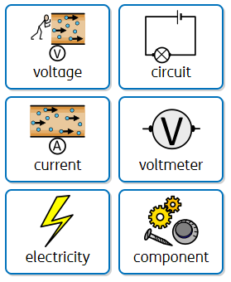
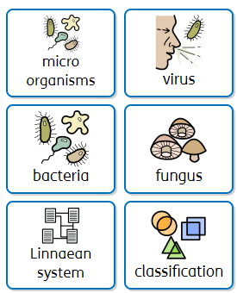
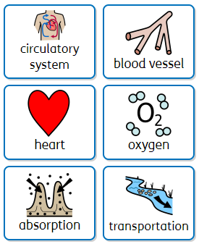
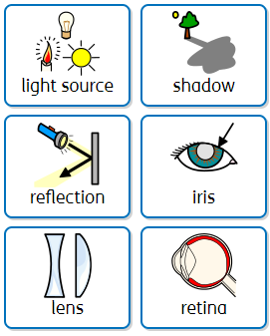
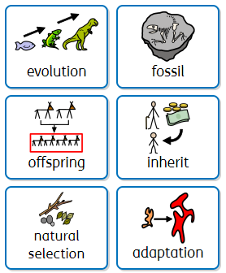
Year 6 vocabulary

