Slide 1
RE Year 1 (Judaism)
 | Christianity The Creation Story | Christianity The Christmas Story | Christianity Jesus as a friend | Christianity Easter | Judaism Shabbat | Judaism Chanukah
Prior | Know the term ‘religion’. | Know that Christmas was when Jesus was born. | Know what the bible is. Understand the bible is made up of different Christian stories. | Know a Christian event (Christmas). | Know the days of the week. | Know what Judaism is (learnt in Summer 1).
Knowledge (substantive and disciplinary) | Lesson 1- Know who Christians think created the world. Lesson 2- Understand the creation story. Lesson 3- Know how God wants Christians to treat the world. Lesson 4- Know how to look after the world. | Lesson 1- Know what makes a gift special. Lesson 2- Know who gave Jesus gifts in the Christmas story. Lesson 3- Re-tell the Christmas story. Lesson 4- Decide which gift I would give to Jesus. | Lesson 1- Know how it feels to be ‘left out’. Lesson 2- Understand how Jesus showed friendship to others. Lesson 3- Decide how difficult Jesus would have found it to show friendship. Lesson 4- Know how I can show friendship. | Lesson 1- Know how special people are welcomed. Lesson 2- Re-enact Jesus’ arrival on Palm Sunday. Lesson 3- Decide how Christians would welcome Jesus today. Lesson 4- Sequence the Easter story. | Lesson 1- Know how a Jewish person spends the Sabbath day. Lesson 2- Explain what a Shabbat meal is. Lesson 3- Know why Jewish people celebrate Shabbat. Lesson 4- Reflect on having a special time as a class. | Lesson 1- Know what a celebration is. Lesson 2- Know how Jewish people celebrate Chanukah. Lesson 3- Explain how celebrating Chanukah makes Jewish people feel closer to God. Lesson 4- Decide what I am thankful for.
Skills | Know what the bible is. Listen and respond to a Christian story. | Name something special to me. Re-tell a Christian story. | Understand different bible stories. Draw out key messages from bible stories. | Empathise with religious figures. Infer how a Christian would behave. | Understand there are different world religions. Relate religious practices to own life. | Know a religious festival. Reflect on my own life.
END POINT | Know that Christians believe that God made the world and that it took him 6 days. | Understand that because Christians believe God gave Jesus as a gift to the world , they give each other gifts at Christmas. | Understand how Jesus showed friendship to others and explain when Jesus found it difficult and why. | Know how Christians welcomed Jesus and why they behaved in this way. | Know why Jewish people have a special meal with their family. | Describe some of the ways in which Jewish children feel close to God during Chanukah.
Next | Re-tell other bible stories (Y2), | Give detailed recount of the Christmas story (Y2). | Jesus showing kindness (Y2). | Understand resurrection (Y2). | Y4 Judaism revisit | Y4 Judaism revisit

Slide 2
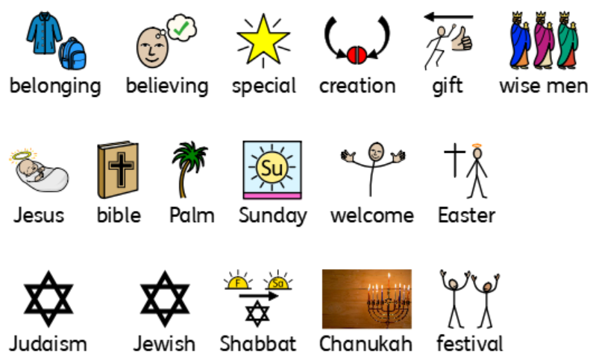
Year 1 vocabulary

Slide 3
RE Year 2 (Islam)
 | Christianity Kindness | Christianity Christmas | Islam Prayer | Christianity Loss | Islam Sense of belonging | Islam Hajj
Prior | Awareness of Christianity (Y1). | Re-tell basic Christmas story (Y1). | Awareness of world religions- Christianity and Judaism. | Know what Easter is to Christians (Y1). | Knowledge of Islam (Spring 1). | Knowledge of Islam (Spring 1 and Summer 1).
Knowledge (substantive and disciplinary) | Lesson 1- Know what kindness is. Lesson 2- Re-tell a bible story showing kindness. Lesson 3- Explain how Jesus showed kindness. Lesson 4- Make links to how I can be kind. | Lesson 1- Know Jesus’ purpose. Lesson 2- Re-tell the Christmas story giving details about all the events. Lesson 3- Know why Jesus was sent to the world. Lesson 4- Make links to help me show love to the world. | Lesson 1- Know what commitment is. Lesson 2- Understand how Muslims show commitment to God. Lesson 3- Understand the impact praying has on a Muslim’s life. Lesson 4- Make links to how I can show commitment . | Lesson 1- Know what loss is. Lesson 2- Understand a story in the bible about the resurrection. Lesson 3-Know what Christians believe about Easter. Lesson 4- Know how an Easter symbol relates to Easter. | Lesson 1- Know what a sense of belonging means. Lesson 2- Understand the features of a mosque. Lesson 3- Know how collective worship gives Muslims a sense of belonging. Lesson 4- Reflect on my sense of belonging. | Lesson 1- Know what a special journey is. Lesson 2- Understand the significance of the Hajj to Muslims. Lesson 3- Form an opinion on whether completing a Hajj makes a Muslim a better person. Lesson 4- Reflect on a special journey.
Skills | Learn how to reflect on a Religious story Learn how to re-tell Bible stories | Discuss Christian beliefs about Christmas Understand the reason for Jesus’ arrival on Earth | Explain what commitment means to us and Muslims Form opinions on how we can show commitment | Retell the Easter story Explain what Easter symbols mean to Christians | Discuss the features of a mosque Reflect on what a sense of belonging means to myself and Christians | Discuss the significance of Hajj Form opinions on the best way Jews can show their commitment to God
END POINT | I can tell you some ways Christians try to follow Jesus’ example of being good | I can explain how Jesus coming to the world shows Christians they should love/help people and the world | I can describe the Muslim prayer routine and explain how they believe this helps them in their everyday lives | I can tell you about the Christian belief in Jesus’ resurrection and start to explain why this is so important to them | I can start to explain what makes Jewish people believe they have a special relationship with God and understand the roles of Abraham and Moses in this. | I can describe some of the ways that Jews choose to show commitment to God and am starting to understand that they may do this in different ways
Next | Form an opinion on some bible stories about kind acts (Y3). | Discuss whether Christmas has lost its meaning (Y3). | Y6 Islam revisit | Relate forgiveness to the Easter story (Y3). | Y6 Islam revisit | Y6 Islam revisit

Slide 4
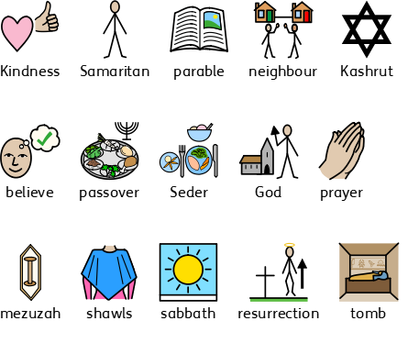
Year 2 vocabulary

Slide 5
RE Year 3
 | Hinduism Divali | Christianity Christmas | Christianity Jesus’ miracles | Christianity Easter forgiveness | Hinduism Hindi beliefs | Hinduism Pilgrimage to the River Ganges
Prior | Know the names of three religious- Judaism, Islam and Christianity. | Recall the Christmas story giving details about all events. | Name bible stories in which Jesus showed kindness. | Know what Christians believe happened at Easter. | Awareness of world religions- Christianity, Judaism and Islam. | Knowledge of Hindi beliefs (Summer 1).
Knowledge (substantive and disciplinary) | Lesson 1- Know how being united gives a sense of belonging. Lesson 2- Know what Diwali is. Lesson 3- Understand why Hindus celebrate Diwali. Lesson 4- Explain my own sense of belonging. | Lesson 1- Know what Christmas means to me. Lesson 2- Know what Christmas means to Christians. Lesson 3- Form an opinion on whether Christmas has lost its meaning. Lesson 4- Decide on a gift I would give for Christmas. | Lesson 1- Know how to retell bible stories where miracles have happened. Lesson 2- Form opinions about the Bible story about the Blind Man (John 9: 1-12). Lesson 3- Understand the idea of a miracle using the story of the Paralysed man (Mark 2:1-12). Lesson 4- Form opinions on the belief of miracles. | Lesson 1- Retell the Easter story. Lesson 2- Discuss the significance of the Easter story to Christians. Lesson 3- Understand why Jesus’ crucifixion symbolises hope for Christians. Lesson 4- Explain what Good Friday is good for. | Lesson 1- Know some Hindu gods and their significance to Hindus. Lesson 2- Discuss how Hindus use deities at home, in the temple and in Puja. Lesson 3- Understand the importance of Brahman to Hindus. Lesson 4- Make links between different religions and their beliefs on how the world was created. | Lesson 1- Know the importance of water and the River Ganges to Hindus. Lesson 2- Research the River Ganges and share facts about it. Lesson 3- Explain the why the Ganges is important and special to Hindus. Lesson 4- Discuss if a non-Hindu would find it special to visit the River Ganges.
Skills | Relate a sense of belonging between my life and that of a Hindu. Understand a Hindu festival. | Form opinions on the true meaning of religious festivals. Compare festivals between religious and non- religious followers. | Question if Jesus really did perform miracles Reason with others if the Bible story about the blind man did really happen | Recall key events in the Easter story Understand significant parts of the Easter story to Christians | Understand the significance of Brahman Make links between differing religions | Understand what the River Ganges is Know facts about the River Ganges
END POINT | Explain how celebrating Divali gives Hindus a sense of belonging. | Explain a Christian’s beliefs about the meaning of Christmas and compare them to my own. | I can explain two different ways Christians might interpret one of Jesus’ healing miracles | I can start to explain why some people see Jesus’ death as good | I can make links between Hindu beliefs regarding Brahman and gods with how they choose to live their lives | I can show an understanding of why the River Ganges is important to Hindus and also suggest why non-Hindus might also want to visit the water
Next

Slide 6
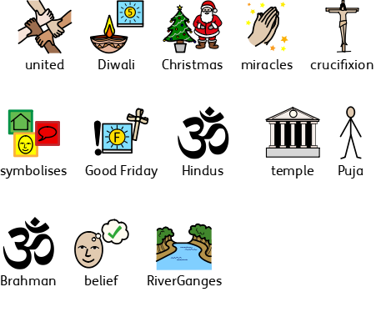
Year 3 vocabulary

Slide 7
RE Year 4 (Judaism)
 | Special relationship Judaism | Symbols Christianity | Passover Judaism | Easter Christianity | Beliefs and Practices Judaism | Prayer and worship Christianity
Prior
Knowledge (substantive and disciplinary) | Lesson 1- Understand what an agreement is. Lesson 2- Reflect on the special relationship that Jews have with their God. Lesson 3- Explain how Jewish people show their special relationship with God in their life. Lesson 4- Know what a Jewish affirmation is. | Lesson 1- Know that symbols mean something. Lesson 2- Explain the different symbols associated with Christmas. Lesson 3- Understand what a Christingle represents. Lesson 4- Form an opinion on which is the most significant part of the Nativity story. | Lesson 1- Know Jewish people are forbidden to eat certain foods. Lesson 2- Explain what the Festival of Passover is. Lesson 3- Re-enact a Seder meal. Lesson 4- Discuss the importance of different Jewish traditions. | Lesson 1- Know the importance of forgiveness to Christians. Lesson 2- Know how Jesus showed forgiveness. Lesson 3- Explain how Christians today showed forgiveness. Lesson 4- Express my understanding of forgiveness. | Lesson 1- Know how Jewish people show responsibility. Lesson 2- Justify the best way for Jews to show commitment to God. Lesson 3- Explain why Jews show their commitment to God. Lesson 4- Understand the importance of showing commitment to a religion/God. | Lesson 1- Discuss meaningful places between different religions. Lesson 2- Know the significance of the church to Christians. Lesson 3- Explain why Christians go to church. Lesson 4- Form an opinion on whether people need to go to church to show they are Christian.
Skills | Compare different world religions taught. Name Shema as a Jewish affirmation. | Distinguish between different symbols and name their significance. Justify my opinion. | Explain the following terms: Passover, Seder, Kashrut and kosher. Adapt my views based on the opinion of others. | Read an understand stories from the bible: Matthew 18:21-22 and Luke 23:34. Represent my views through art. | Notice and name the differences in opinions | Make comparisons between meaningful places from different religions. Draw out similarities and differences between religious special places.
END POINT | I can make links between the Abraham and Moses stories and the Jewish belief that they are in a special relationship with God. | I can describe one thing a Christian might learn about Jesus from a Christmas symbol. | I can identify and describe some of the ways Jews try to do as God asks and start to explain why they feel it is important to do so. | I can explain how Christians might try to put into practice Jesus’ teachings about forgiveness. | I can describe how different practices enable Jews to show their commitment to God and understand that some of these will be more significant to some Jews than others. | I can describe some ways that Christians can show their beliefs and recognise that some may choose to show their faith publicly and others may keep this more private.
Next

Slide 8
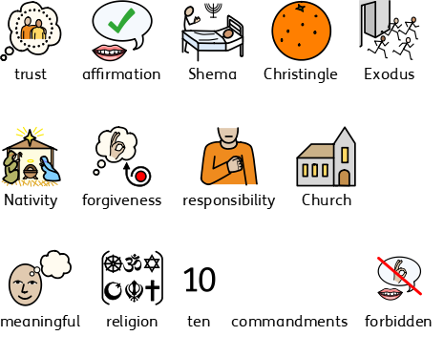
Year 4 vocabulary

Slide 9
RE Year 5 (Hinduism)
 | Prayer and worship Hinduism | Christmas Christianity |  | Hindu Beliefs Hinduism | Easter Christianity | Belief and moral values Hinduism | Beliefs and practices Christianity
Prior
Knowledge (substantive and disciplinary) | Lesson 1- Understand what commitment means Lesson 2- Explain how Hindus show their commitment to God through worship Lesson 3- Discuss how Prayer supports Hindus to show their commitment to God Lesson 4- Form an opinion on the best way for a Hindu to show commitment to God | Lesson 1- Understand how eyewitness accounts can vary Lesson 2- Explore and investigate different accounts of the Christmas Story in the Bible (Luke Ch 1: 26-28 and Ch 2:1-20 Matthew Ch 1: 18 – Ch 2: 12) Lesson 3- Evaluate different accounts of the Christmas story Lesson 4- Form an opinion on if the Christmas story is true |  | Lesson 1- Know who Brahman is Lesson 2- Explore the three main Hindu deities Lesson 3-Discuss if Brahman be everywhere and in everything Lesson 4- Explain how the Hindu belief influences their daily life | Lesson 1- Know what Jesus’ crucifixion is Lesson 2- Discuss the main events of Holy Week Lesson 3- Discuss if God intended on Jesus being crucified Lesson 4- Form an opinion on if event during Holy Week are part of God’s plan or consequence | Lesson 1- Understand certain Hindu beliefs Lesson 2- Explain that Hinduism consists of rites and ceremonies (Karma, Samara and Moksha) Lesson 3- Evaluate how Hindus can attain beliefs in their daily lives Lesson 4- Discuss if beliefs in Karma, Samara and Moksha help Hindus lead good lives | Lesson 1- Know how Christians show their commitment to God Lesson 2 Justify and order the Ten Commandments on which shows the most commitment Lesson 3- Form an opinion on the best way Christians show their commitment to God Lesson 4- Explain what commitment means to them
Skills | Name different ways in which Hindus show commitment to God Compare different ways Hindus show commitment | Re tell the Christmas story Justify my opinion |  | Explain why there are so many gods in Hinduism | Retell main events of Holy Week Justify opinion | Recall Hindu beliefs Name Karma, Samara and Moksha as Hindu beliefs | Justify opinion Name different Christian commitments
END POINT | I can describe how different practices enable Hindus to show their commitment to God and understand that some of these will be more significant to some Hindus than others | I can start to express an opinion on whether the Christmas story is true and what this might mean to Christians |  | I can make links between Hindu beliefs regarding Brahman and gods with how they choose to live their lives | I can start to explain whether God intended Jesus to be crucified or whether Jesus’ crucifixion was consequence of events during Holy Week | I can compare Hindu and Christian beliefs relating to life after death and tell you how these make a difference to believers’ lives | I can describe how different practices enable Christians to show their commitment to God and understand that some of these will be more significant to some Christians than others
Next

Slide 10
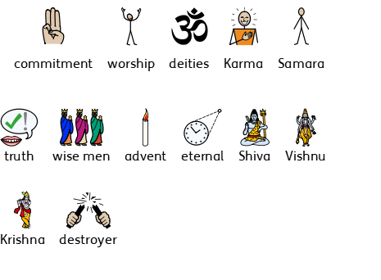
Year 5 vocabulary

Slide 11
RE Year 6 (Islam)
 | Beliefs and practices Islam | Christmas Christianity |  | Beliefs and meaning Christianity | Easter Christianity | Beliefs and moral values Islam | Beliefs and meaning
Prior
Knowledge (substantive and disciplinary) | Lesson 1-Know how Muslims show their commitment to God Lesson 2- Explain the five pillars of Islam Lesson 3- Form an opinion on the best way Muslims show their commitment to God (using the five pillars) Lesson 4- Write an affirmation to reinforce their commitment | Lesson 1- Know the significance of the Virgin birth to Christians Lesson 2- Discuss why Mary was chosen to be Jesus’ mother Lesson 3-Explain what incarnation means Lesson 4- Compare other Christian beliefs that rely on Jesus being God as well as human |  | Lesson 1- Know what eternity means Lesson 2- Explain what Christians believe about eternal life Lesson 3- Understand the Christian perspective on eternity Lesson 4- Evaluate different beliefs about eternity | Lesson 1- Know influential people through religion and history Lesson 2- Discuss if festival and symbols show that Christianity is still a strong religion Lesson 3- Explain where else in British society you see the influence of Christianity Lesson 4- Form an opinion on if Christianity is still a strong religion 2000 years on | Lesson 1- Know how Muslims try to lead good lives Lesson 2- Explain how Muslims belief I Akhirah influences them to lead a good life Lesson 3- Explain who Muhammad is and their significance to Muslims Lesson 4- Evaluate if believing in Akhirah helps Muslims lead good lives | Over the 4 lessons review knowledge on the different religions taught within KS2. Y1 & Y4- Judaism Y3 & Y5- Hinduism Y2 & Y6- Islam All years- Christianity Recap key learning on the religions. Discuss differences between them and form opinions. Focus on importance of tolerance between religions and the negative impact a lack of tolerance can cause.
Skills | Justify an opinion Name the five pillars of Islam | Explain key words Compare other Christian beliefs |  | Explain what eternity Is Evaluate different religions | Justify and form an opinion Name Christian festival and symbols | Name who Muhammad is Explain what Akhirah is | Form, justify and discuss opinions. Show respectfulness and tolerance.
END POINT | I can describe how different practices enable Muslims to show their commitment to God and understand that some of these will be more significant to Muslims than others | I can make links between the Virgin Birth and Christian beliefs about Jesus |  | I can make links between different Christian beliefs and their views on whether anything is ever eternal | I can explain how one of the reasons people use to suggest that Christianity is a strong religion today can be counteracted | I can explain how believing in Akhirah influences Muslims to do their best to lead good lives | I can explain 4 different religions and I can compare and contract between them. I understand how religions must be tolerant of each other and show respect.
Next

Slide 12
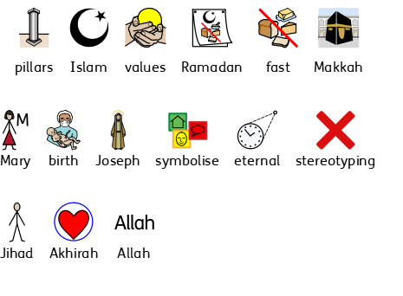
Year 6 vocabulary

