Slide 1
SUBJECT Year 1
Autumn Term Me and my Relationships |  | Valuing difference | Spring Term Keeping safe | Rights and respect | Summer Term Being my best | Growing and changing
Prior | Children are aware of own feelings and knows that some actions and words can hurt others feelings. | I can recognise that I can say ‘no’/ ‘please stop’ / ‘I’ll tell to someone who asks me to do something that makes me feel sad, embarrassed or upset | Know some strategies for dealing with sadness, including what to do or who to Understand that medicines can sometimes make people feel better when they’re ill and understand issues of safety and responsibility talk to | Recognise the impact of diet, exercise, medicines and lifestyle on the way their bodies function. | Understand that there is mental as well as physical health and what they can do to maintain or improve their mental health. • • | Understand that the body gets energy from food, water and air and that exercise and sleep are important to our health. • Name major internal body parts – heart, blood, lungs, stomach, brain. • Understand the importance of basic personal hygiene, e.g. washing, cleaning teeth and brushing hair.
Knowledge (substantive and disciplinary) | * know why we have rules. * identify and name a range of feelings. recognise and name different relationships I have and communities that I belong to. read body language and facial expressions and respond accordingly. demonstrate attentive listening skills. | * Positively describe differences between people. * define bullying. * recognise and explain what is fair, unfair, kind and unkind. follow school rules. empathise with those that are different from me. | know that the body gets energy from food, water and air. know the importance of sleep in order to remain healthy. name and know which parts should be private. eat a healthy diet. get adequate sleep. can ask for help when I feel unsafe. | Explain what I do to maintain good personal hygiene. know why it’s important to look after our environment. know where money comes from. maintain my own personal hygiene. can take responsibility and look after things that belong to both myself and others. | know why a healthy diet is important. know the stages of the learning pit. know how a person’s behaviour (including my own) can affect others. try new foods and eat a balanced diet. act positively on my ‘green for growths’. can sometimes put others needs before my own. | name major internal body parts and external private parts. know the different stages of growth and can explain the needs of a baby. know the difference between bullying and teasing. can tell someone if something makes me feel uncomfortable. can get help for others who might need it.
Skills | read body language and facial expressions and respond accordingly. demonstrate attentive listening skills. | can follow school rules. can empathise with those who are different from me. | eat a healthy diet. get adequate sleep. can ask for help when I feel unsafe. | maintain my own personal hygiene. can take responsibility and look after things that belong to both myself and others. | try new foods and eat a balanced diet. act positively on my ‘green for growths’. can sometimes put others needs before my own. | can tell someone if something makes me feel uncomfortable. can get help for others who might need it.
END POINT | Identify a range of feelings and demonstrate my understanding of these in a variety of situations. | I can talk about people and their differences and empathise with those that are different to me. | I can talk about the importance of a healthy diet and lifestyle. | I can explain and demonstrate the importance of good hygiene. | I can explain the importance of putting others needs before myself and understanding how my behaviour can impact others. | I understand the difference between bullying and teasing. I can name my internal and external body parts.
Next | I can trust. I can learn to recognise signs of worry in my own body. | If something happens that makes me feel sad, worried, uncomfortable or frightened I can give examples of when and how to speak Recognise, name and understand how to deal with feelings (e.g. anger, loneliness). k to an adult | Recognise the impact of diet, exercise, medical drugs and lifestyle on the way their bodies function. I can recognise that there may be people online who could make me feel sad, embarrassed or upset. | Understand that there is mental as well as physical health and what they can do to maintain or improve their mental health. | Understand that that there are different types of bullying, including online bullying and unkind behaviour. Understand that bullying is unacceptable, but know that for most of the time, most children do not take part in bullying behaviour, or experience bullying. Know where someone could get help if they were being upset by someone else’s behaviour. | Understand that the body gets energy from food, water and oxygen and that exercise and sleep are important to our health

Slide 2
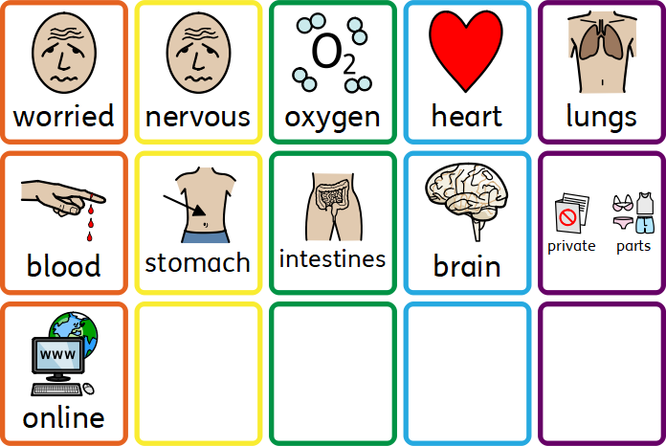
Year 1 vocabulary

Slide 3
SUBJECT Year 2
Autumn Term Me and my Relationships |  | Valuing difference | Spring Term Keeping safe | Rights and respect | Summer Term Being my best | Growing and changing
Prior | * know why we have rules. * identify and name a range of feelings. recognise and name different relationships I have and communities that I belong to. | * Positively describe differences between people. * define bullying. * recognise and explain what is fair, unfair, kind and unkind. | know that the body gets energy from food, water and air. know the importance of sleep in order to remain healthy. name and know which parts should be private. | Explain what I do to maintain good personal hygiene. know why it’s important to look after our environment. know where money comes from. | know why a healthy diet is important. know the stages of the learning pit. know how a person’s behaviour (including my own) can affect others. | name major internal body parts and external private parts. know the different stages of growth and can explain the needs of a baby. know the difference between bullying and teasing.
Knowledge (substantive and disciplinary) | Use a range of words to describe feelings; Define what is meant by the terms 'bullying' and 'teasing' showing an understanding of the difference between the two; Identify some of the ways that good friends care for each other Recognise that people have different ways of expressing their feelings; Recognise that friendship is a special kind of relationship; | Identify some of the physical and non-physical differences and similarities between people; Identify groups they are part of; Suggest kind words and actions they can show to others Recognise and explain how a person's behaviour can affect other people. Demonstrate active listening techniques (making eye contact, nodding head, making positive noises, not being distracted); | Explain simple issues of safety and responsibility about medicines and their use. Identify who they can talk to if someone touches them in a way that makes them feel uncomfortable. Identify how inappropriate touch can make someone feel; Recognise that body language and facial expression can give clues as to how comfortable and safe someone feels in a situation; Recognise the importance of telling someone they trust about a secret which makes them feel unsafe or uncomfortable. | Describe and record strategies for getting on with others in the classroom Make suggestions for improving the school environment; Identify special people in the school and community who can help to keep them safe; Recognise that they all have a responsibility for helping to look after the school environment. Recognise that money can be spent on items which are essential or non-essential; | Explain the stages of the learning line showing an understanding of the learning process; Describe simple hygiene routines such as hand washing; Name major internal body parts (heart, blood, lungs, stomach, small and large intestines, brain) Understand and give examples of things they can choose themselves and things that others choose for them; Help themselves and others develop a positive attitude that support their wellbeing; | Identify different stages of growth (e.g. baby, toddler, child, teenager, adult) Identify which parts of the human body are private Explain what privacy means Demonstrate simple ways of giving positive feedback to others Understand that humans mostly have the same body parts but that they can look different from person to person
Skills | Can define what bullying and teasing is and give examples of each one. | Can explain and give examples of kindness and how a person’s behaviour can affect others. | Can recognise how body language and facial expressions can give subtle clues about how a person is feeling. | Identify and talk about different people in the community. and their role in keeping people safe. | Name the major internal body parts. | Identify and discuss the different stages of growth. Talk about the importance of privacy.
END POINT | Understand the importance of friendship and how people have different ways in expressing their feelings. | Demonstrate active listening techniques. Identify different groups that they are part of. | Can talk about the importance of keeping medicine safe and why some people may use medicine. | Understand and recognise the responsibility of helping to look after people. | Help support those around them, including self to have a positive attitude and support their well-being. | Understand that people mostly have the same body parts but that they can look different from person to person. Show
Next | I know and understand why we have rules. I can identify different ways of dealing with feelings and situations. I can identify qualities of friendship and use skills for making up again. | I can define ‘community’. I can identify similarities and differences between a diverse range of people from varying national, regional, ethnic and religious backgrounds. I can explain what a prejudice view it. | I can define the words ‘danger’ and ‘risk’. I can recognise internet safety risks. I know to trust my body when something doesn’t feel right. | I know the difference between ‘fact’ and ‘opinion’. I can define what is meant by ‘environment’. I can recognise that there are times we can buy items we want and times when we need to save for items. | I know why a balanced diet is important. I can explain and empathise with different wellbeing issues. I can identify and name the major internal body parts and describe what they do. | I know who I have positive relationships with. I can identify what ‘personal space’ is and when it is okay to let someone into my personal space. I can define the terms ‘secret’ and ‘surprise’ and know the difference between a safe and an unsafe secret. I understand that for girls, periods are a normal part of puberty.

Slide 4
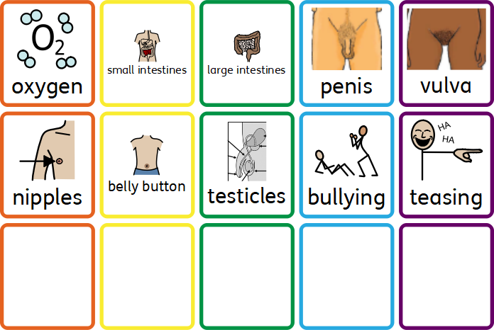
Year 2 vocabulary

Slide 5
SUBJECT Year 3
Autumn Term Me and my Relationships |  | Valuing difference | Spring Term Keeping safe | Rights and respect | Summer Term Being my best | Growing and changing
Prior | Use a range of words to describe feelings; Define what is meant by the terms 'bullying' and 'teasing' showing an understanding of the difference between the two; Identify some of the ways that good friends care for each other | Identify some of the physical and non-physical differences and similarities between people; Identify groups they are part of; Suggest kind words and actions they can show to others | Explain simple issues of safety and responsibility about medicines and their use. Identify who they can talk to if someone touches them in a way that makes them feel uncomfortable. Identify how inappropriate touch can make someone feel; | Describe and record strategies for getting on with others in the classroom Make suggestions for improving the school environment; | Explain the stages of the learning line showing an understanding of the learning process; Describe simple hygiene routines such as hand washing; Name major internal body parts (heart, blood, lungs, stomach, small and large intestines, brain) | Identify different stages of growth (e.g. baby, toddler, child, teenager, adult) Identify which parts of the human body are private Explain what privacy means
Knowledge (substantive and disciplinary) | *know and understand why we have rules. * identify different ways of dealing with feelings and situations. identify qualities of friendship and use skills for making up again. can suggest appropriate rules for a range of settings. | * define ‘community’. * identify similarities and differences between a diverse range of people from varying national, regional, ethnic and religious backgrounds. explain what a prejudice view it. can suggest strategies for bullying. | * define the words ‘danger’ and ‘risk’. * recognise internet safety risks. know to trust my body when something doesn’t feel right. know how to get help in an online situation. | * know the difference between ‘fact’ and ‘opinion’. * define what is meant by ‘environment’. recognise that there are times we can buy items we want and times when we need to save for items. know different methods of looking after the school environment. | * know why a balanced diet is important. * explain and empathise with different wellbeing issues. identify and name the major internal body parts and describe what they do. make suggestions to support my own and others health and wellbeing. | * know who I have positive relationships with. * identify what ‘personal space’ is and when it is okay to let someone into my personal space. * define the terms ‘secret’ and ‘surprise’ and know the difference between a safe and an unsafe secret. understand that for girls, periods are a normal part of puberty. know who to ask for help if a secret made me feel uncomfortable or unsafe.
Skills | I can listen to others and explain the thinking behind their ideas and opinions. | Give examples of respectful language. | I can describe appropriate behaviour online and offline. | I know ways to helps each other stay safe. | I promote and eat a balanced diet. I can empathise with different viewpoints. | I know strategies for when someone is inappropriately in my body space. I know who to ask for help if a secret made me feel uncomfortable or unsafe.
END POINT | I can talk about the importance of having rules and different ways of dealing with a variety of feelings and situations which may occur. | I can explain what a prejudice view is. | I can explain what ‘danger’ and ‘risk’ are. | I can explain the difference between a fact and an opinion and give examples. | I can identify and name the major internal body parts and describe and explain what their role is. | I can explain the definition ‘secret’ and ‘surprise’.
Next | I know what makes a good relationship. | I understand discrimination and its injustice and can give examples. | I can explain strategies for dealing with face-to-face and online bullying. | I know the differences between responsibilities, rights and duties. | I understand a variety of ways to stay healthy. | I know the correct words for various sexual organs.

Slide 6
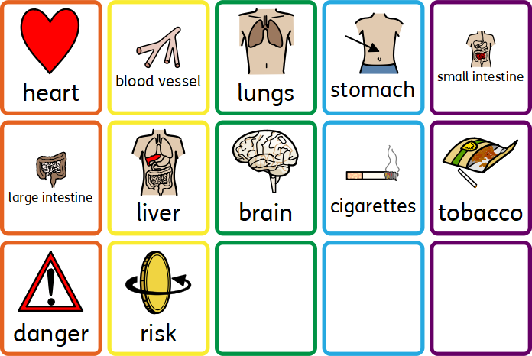
Year 3 vocabulary

Slide 7
SUBJECT Year 4
Autumn Term Me and my Relationships |  | Valuing difference | Spring Term Keeping safe | Rights and respect | Summer Term Being my best | Growing and changing
Prior | *know and understand why we have rules. * identify different ways of dealing with feelings and situations. identify qualities of friendship and use skills for making up again. | * define ‘community’. * identify similarities and differences between a diverse range of people from varying national, regional, ethnic and religious backgrounds. explain what a prejudice view it. | * define the words ‘danger’ and ‘risk’. * recognise internet safety risks. know to trust my body when something doesn’t feel right. | * know the difference between ‘fact’ and ‘opinion’. * define what is meant by ‘environment’. recognise that there are times we can buy items we want and times when we need to save for items. | * know why a balanced diet is important. * explain and empathise with different wellbeing issues. identify and name the major internal body parts and describe what they do. | * know who I have positive relationships with. * identify what ‘personal space’ is and when it is okay to let someone into my personal space. * define the terms ‘secret’ and ‘surprise’ and know the difference between a safe and an unsafe secret. understand that for girls, periods are a normal part of puberty.
Knowledge (substantive and disciplinary) | Know what is meant by a positive, healthy relationship. Recognise that different people may have different feelings in the same situation. Know appropriate strategies to deal bullying situations. Use appropriate, assertive strategies for saying no to a friend. | Give examples of how people are different to each other. Know the different types of relationships that I have with different people. Give an affective definition of the word respect. Develop strategies for dealing with someone who is behaving aggressively. | Identify situations which can become dangerous, risky or hazardous. Explain how to use medicine safely and understand the risks of smoking, drinking and alcohol. I know how to be safe online Understand that consuming chemicals/smoke/drink has an effect on our bodies, Which may cause damaged if misused. . | Name some rights and responsibilities I have as a child. Explain why rules are in place. Understand the role of different public services. Explore The United Nations Convention on the Rights of the Child (UNCRC ) and discuss why some parts of life are protected and why some are not. – the right to school vs the right to stay up late. | Give an affective definition of the word unique. Know which parts of life are important for our health – Physical and mental. I can list the seven Rs. Recycle. Refuse. Reduce. Reuse. Repair. Re-gift. Recover. Feel confident in making choices based on myself, not what my friends have chosen. Know the importance of eating a balanced diet. | Know the correct terminology for genitalia. Know the difference between a safe and unsafe secret. Know how the onset of puberty can have emotional as well as physical impact on my body Correctly identify parts of the body that males and females have in common and those that are different.
Skills | I can recognise and demonstrate a range of feelings through facial expressions and body language. | I can explain the importance of celebrating difference. | I know online safety tips and follow the ‘Smart’ online safety rules. | I understand how different public services protect us and acknowledge how to respect support them. | I can identify 5 activities to do to help improve my mental health. | I can discuss people who may be able to help me deal with change.
END POINT | I know a variety of strategies I can use to help deal with bullying situations. | I can talk about the different relationships I have with different people. | I can talk about which situations can become dangerous, risky or hazardous and explain which people could help me. | I can talk about the different rights and responsibilities I have as an individual. | I can talk about why I am unique. I can talk about the 7 Rs linked to recycling and the importance of recycling. | I can correctly identify parts of the body that males and females have in common and those that are different.
Next | Know how to be assertive. Identify risks in different situations. | Understand discrimination. Listen actively and follow dialogue rules. Know consequences of behaviour. | Explain strategies for dealing with bullying. Know how to protect personal information online. | Know the differences between responsibilities, rights and duties. Understand work done by voluntary groups. Identify fact and opinion in media. | Know ways to stay healthy. Identify strengths and areas for development. | Know body changes in puberty. Use appropriate vocabulary to describe my feelings.

Slide 8
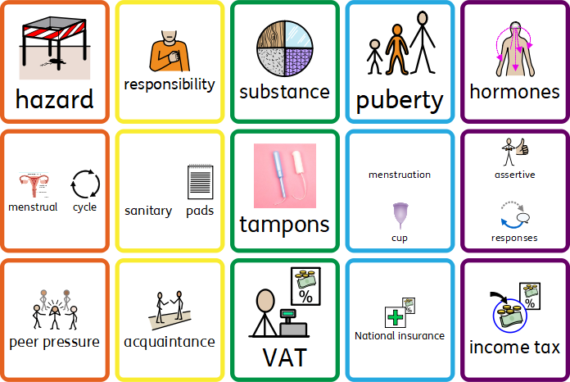
Year 4 vocabulary

Slide 9
SUBJECT Year 5
Autumn Term Me and my Relationships |  | Valuing difference | Spring Term Keeping safe | Rights and respect | Summer Term Being my best | Growing and changing
Prior | Know what is meant by a positive, healthy relationship. Recognise that different people may have different feelings in the same situation. Know appropriate strategies to deal bullying situations. | Give examples of how people are different to each other. Know the different types of relationships that I have with different people. Give an affective definition of the word respect. | Identify situations which can become dangerous, risky or hazardous. Explain how to use medicine safely and understand the risks of smoking, drinking and alcohol. I know how to be safe online . | Name some rights and responsibilities I have as a child. Explain why rules are in place. Understand the role of different public services. | Give an affective definition of the word unique. Know which parts of life are important for our health – Physical and mental. I can list the seven Rs. Recycle. Refuse. Reduce. Reuse. Repair. Re-gift. Recover. | Know the correct terminology for genitalia. Know the difference between a safe and unsafe secret. Know how the onset of puberty can have emotional as well as physical impact on my body
Knowledge (substantive and disciplinary) | Know what makes a good relationship. Know how and when to be assertive. Know how to collaborate with a range of people. Identify risk factors in different situations. | Understand discrimination and its injustice and can give examples. Understand that information I see online is not always true. Explain the importance of mutual respect for different groups. Identify the consequences of positive and negative behaviour on others, following the school’s restorative processes. | Explain strategies for dealing with face-to-face and online bullying. Understand that some drugs are helpful and some are harmful. Keep safe online, including protecting personal information, looking at websites such as TikTok, Facebook, Instagram and Snapchat, including location settings. (Link to computing) | Know the differences between responsibilities, rights and duties. Understand issues around personal finance. Understand work done by voluntary groups. Ask appropriate questions before buying a product. | Understand a variety of ways to stay healthy. (Link to P.E.) Know what is means to be a part of a community. Identify people who are responsible for keeping me healthy and safe. Recognise star qualities in people. | Know the correct words for various sexual organs (penis, vagina, vulva, labia, clitoris, testicles, scrotum). Understand the changes that will happen to both boys’ and girls’ bodies during puberty, including periods, Understand the difference between safe and unsafe secrets. Identify people who can trusted and what action to take when I feel uncomfortable.
Skills | I can respond appropriately to a wide range of feelings in others. | I can listen actively and respectfully following the dialogue rules. | I can support others who are experiencing bullying. | I can identify fact and opinion in the media. | I can identify my strengths and areas for development. | I can use appropriate vocabulary to describe my feelings.
END POINT | Discuss what makes a good relationship and how to collaborate with a variety of people. | I can talk about how information I view online is not always true and how to keep myself safe when I am online. | I can discuss how some drugs are helpful and some drugs are harmful and who to discuss any worries I have. | I can talk about how some people may have financial issues and understand what work is done by a variety of voluntary organisations. | I can talk about the importance of keeping my body healthy through exercise. | Know the correct words for various sexual organs (penis, vagina, vulva, labia, clitoris, testicles, scrotum). Understand the changes that will happen to both boys’ and girls’ bodies during puberty, including periods,
Next | Recognise the challenges which arise from friendships. Understand negotiation and compromise. | Recognise bullying can result from disrespect. Explain the term prejudice and stereotype. | Understand different categories of drugs. Suggest positive ways people can get their needs met. | Explain the term bias. Understand that different levels of jobs that have different pay. | Know positive ways to promote well being. Set goals and steps to achieve them. | Explain the difference between a safe and unsafe secret. Describe strategies to keep myself safe.

Slide 10
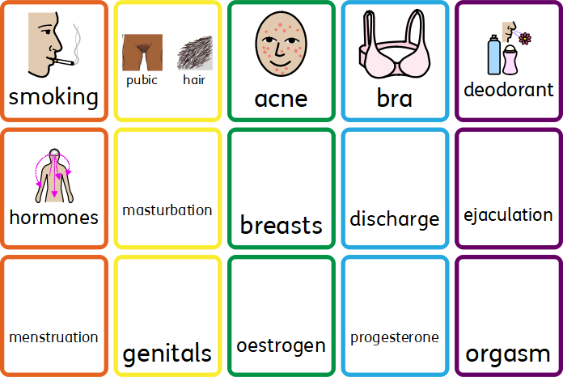
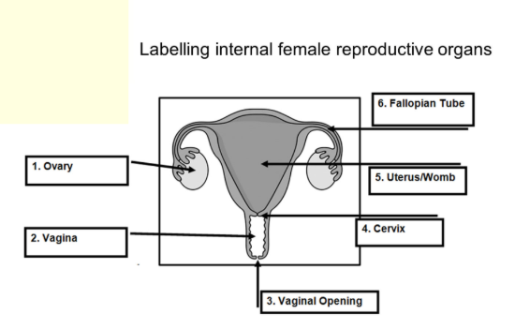
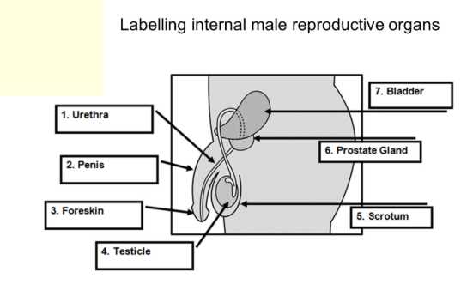
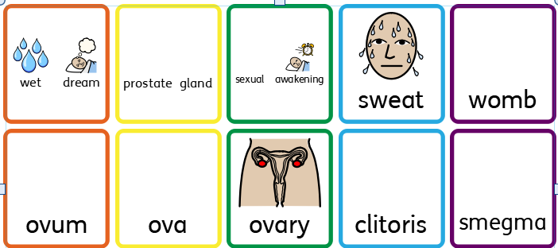
Year 5 vocabulary

Slide 11
SUBJECT Year 6
Autumn Term Me and my Relationships |  | Valuing difference | Spring Term Keeping safe | Rights and respect | Summer Term Being my best | Growing and changing
Prior | Know what makes a good relationship. Know how and when to be assertive. | Understand discrimination and its injustice and can give examples. Understand that information I see online is not always true. Explain the importance of mutual respect for different groups. | Explain strategies for dealing with face-to-face and online bullying. Understand that some drugs are helpful and some are harmful. | Know the differences between responsibilities, rights and duties. Understand issues around personal finance. Understand work done by voluntary groups. | Understand a variety of ways to stay healthy. (Link to P.E.) Know what is means to be a part of a community. Identify people who are responsible for keeping me healthy and safe. | Know the correct words for various sexual organs (penis, vagina, vulva, labia, clitoris, testicles, scrotum). Understand the changes that will happen to both boys’ and girls’ bodies during puberty, including periods, Understand the difference between safe and unsafe secrets.
Knowledge (substantive and disciplinary) | Recognise the challenges that arise from friendships. List some assertive behaviours . Recognise peer influence and pressure. Suggest ways that people can respond more positively to others. Explain what is meant by negotiation and compromise and provide examples to support ideas. Demonstrate a collaborative approach to a task. | Recognise that bullying and discriminatory behaviour can result from disrespect from people’s differences. Understand that all people are unique. Explain the terms prejudice and stereotype. Describe what it is like to live in a diverse society. Explain the importance of mutual respect for different faiths and beliefs | Understand about the different categories of drugs. Understand what is meant by addiction. Know the risks of sharing photos or films of myself or others online Understand and can describe the ease in which a post online can spread. Describe some of the risks of drinking alcohol Suggest positive ways in which people can get their needs met. | Explain the term bias. Know the legal age of having a social media account. Explain the term voluntary, community and pressure group. List actions that can be taken to live in a more sustainable way. Describe the aim, mission statement, activity and beneficiary of a chosen group. Explain why some public services are more important than others. | Describe and explain the five ways to promote positive well-being. Recognise what a risk is. . Set an aspirational goal and steps to achieve it. Identify the risk factors in a given situation. Explain how a risk can be reduced. | Explain the word puberty and give examples of changes associated with it. Know the legal age of consent and what it means. Explain the difference between a safe and an unsafe secret Describe strategies to keep myself safe.
Skills | Recognise basic emotional needs and understand they change according to circumstance. | Suggest strategies of dealing with bullying as a bystander. Offer support to someone being bullied | Demonstrate an understanding of how to keep safe online and apply knowledge to different scenarios. | Understand and give examples of different levels of jobs that have different pay. | Show that I understand a health and wellbeing issue | Know where I can get support if I am worried about my own or another’s safety.
END POINT | I can recognise and discuss challenges that may arise from friendships. | I can talk about bullying and discriminatory behaviour and the impact it can have. | I can explain the different categories of drugs and understand what is meant by addiction. | I can talk about the term bias. I know the legal age of having a social media account. | I can identify the risk factors in a given situation. I can explain how a risk can be reduced. | I can explain the word puberty and give examples of changes associated with it. KI can talk about what the legal age of consent and what it means. I can discuss the difference between a safe and an unsafe secret
Next | Sex and relationship education is compulsory in KS3.

Slide 12
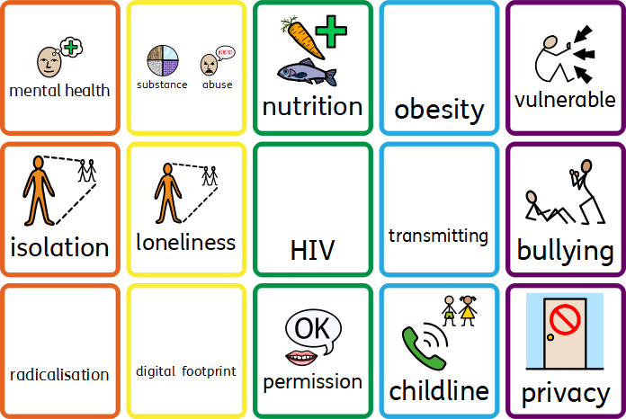
Year 6 vocabulary

