Slide 1
PE Reception
A | We are Bradley Barton Our First Nativity | Reach for the Stars | A Journey to Space Healthy bodies, healthy minds | Oh, the Places You Will Go Moving on up
B | We are family Christmas Spectacular! | Reach for the Stars | Reach for the Stars Let’s Get Physical | Our Planet Moving on up
Prior
Knowledge and Skills | I can roll a ball to a target. I can stop a rolling ball. I am developing accuracy, when throwing to a target. I can bounce a ball. I can catch a ball. I can dribble a ball with my feet. I can kick a ball. I can use the correct pencil grip to write and draw. I am beginning to form letters correctly. I can use scissors to cut straight lines. I can roll a ball to a target. I can stop a rolling ball. I am developing accuracy, when throwing to a target. I can bounce a ball. I can catch a ball. I can dribble a ball with my feet. I can kick a ball. I can use the correct pencil grip to write and draw. I am beginning to form letters correctly. I can use scissors to cut straight lines. I can perform a simple dance to music. |  | I can explore how different parts of my body move. I can remember and repeat movements. I can explore directions and levels in my movement. I can adapt and perform simple dance patterns. I can move with control and co-ordination, linking, copying and repeating actions. I can use scissors to cut around objects. I am beginning to control the size of my letters and shapes, as I write and draw. I can sit up straight, while on the carpet. I can balance whilst stationary and on the move. I can run and stop with control. I can change direction, when moving at different speeds. I can jump and land safely. I can hop and land safely. I can travel safely in different ways. I use scissors with a good level of control. I can form letters of a consistent size. I can hold my knife and fork correctly. I know the correct posture for writing at the table. I can talk about how to keep my body healthy and safe. I can take turns. I understand that I can express myself through different mediums. I am beginning to create my own movements to music. I am beginning to evaluate my creations. | I can throw with accuracy. I can play games, showing an understanding of the different roles within games. I can move safely while playing tagging games. I can work co-operatively and take turns during games. I can use a range of small tools safely and with accuracy. I can use my knife and fork independently. I can copy and create shapes with my body. I can create shapes whilst on apparatus. I can balance on different levels. I can rock and roll in different ways. I can copy and create short sequences of movements. I demonstrate good control over small tools, as I write, draw, cut and paint. I form letters of a consistent and appropriate size. I maintain a good posture, while sitting on the carpet and at tables. I can consider how to make healthy choices. I can use strategies to help complete challenges. I understand that I can make healthy choices. I can name and recognise how healthy choices can keep us well. I can use regulation techniques I have learned. I can set myself goals. I can give focused attention to my teacher and follow instructions involving several ideas or actions. I can explain the reasons for rules and behave accordingly. I understand the importance of plan, do, review, while creating. I can move my body to music, when appropriate. I can independently follow the plan, do, review system.
END POINT | Early Learning Goals:
Next

Slide 2
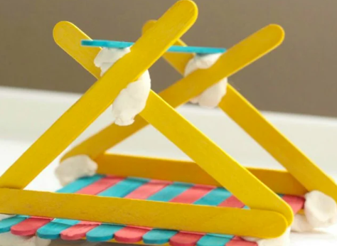
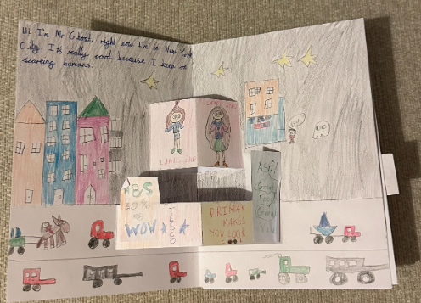
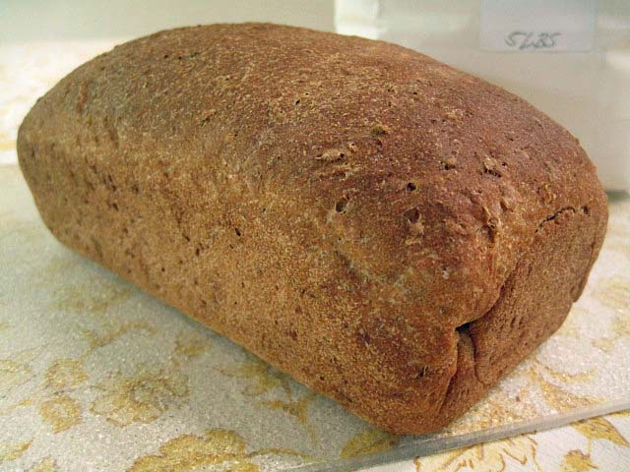
DT Year 1
Once upon a time around the world Make a pop-out book with slider. |  | Great Fire of London- SPRING 1 Make bread. | Bradley Barton Area- Summer 1 Make a bridge.
Prior | Experiences with junk modelling and building with blocks. | Make a fruit salad. | Joining materials to make things.
Knowledge (substantive and disciplinary) | Lesson 1- Explore what a pop-up book is. What makes it appealing? Lesson 2- Create a design criteria for a pop-up page with a slider. Lesson 3- Design a pop-up page with a slider. Lesson 4- Make a pop-up page with a slider. Lesson 5- Make a pop-up page with a slider. Lesson 6- Evaluate my pop-up page against the criteria. | Lesson 1- Taste test different kinds of bread (baguette, ciabatta, brown, multi grain) and identify what makes it appealing. Lesson 2- Order a bread recipe. Understand the term ‘recipe’ and use this to put a bread recipe in order. Lesson 3- Know how to be hygienic when making food. https://www.cieh.org/what-is-environmental-health/resources/school-materials/ Lesson 4- Design their bread. They can decide a flavour (sun-dried tomatoes/olives/sea-salt rosemary/garlic and herb) and how they want to present it (twisted/plaited/bun/loaf). Lesson 5- Make bread. (once made, take a feedback sheet home for their parents to fill out giving them constructive feedback). Lesson 6- Adapt their designs (based on feedback). | Lesson 1- Know what a bridge is and what makes it strong. (Re-tell story about using a bridge to get to school. Explain purposeful unit). Lesson 2- Select from a range of materials and design a bridge for a toy car to go over. Resources Pritt sticks, glue guns, thin card, paper, thick cardboard, lolly pop sticks, pipe cleaners Lesson 3- Justify design choices to a peer. Lesson 4- Create bridge. Lesson 5- Test and evaluate whether it meets the purpose. Lesson 6- Make model stronger, stiffer or more stable (to hold more load).
Skills | Cut cardboard. Stick cardboard together to make a slider. Folding cardboard. Design through drawing. | Combine ingredients. Sieve flour. Measure ingredients. Knead bread. Follow a recipe. How know to be hygienic (wash hands). | Selecting materials. Talk through design idea. Know how to cut. Know how to join with glue.
END POINT | Make a pop-out page with a slider for own story. | Design and make some bread. | Design and make a bridge.
Next | Make moon buggies with axel and wheels. | Make a soup. | Make a wooden bridge (Y4).
Yellow- mechanisms
Grey- junk modelling
Green- food tech
Orange- woodwork
Blue- textiles

Slide 3
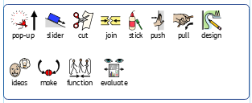
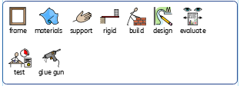
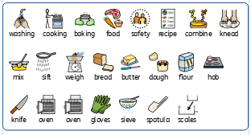
Year 1 DT vocabulary
Slider story book page
Make a bridge
Making bread

Slide 4
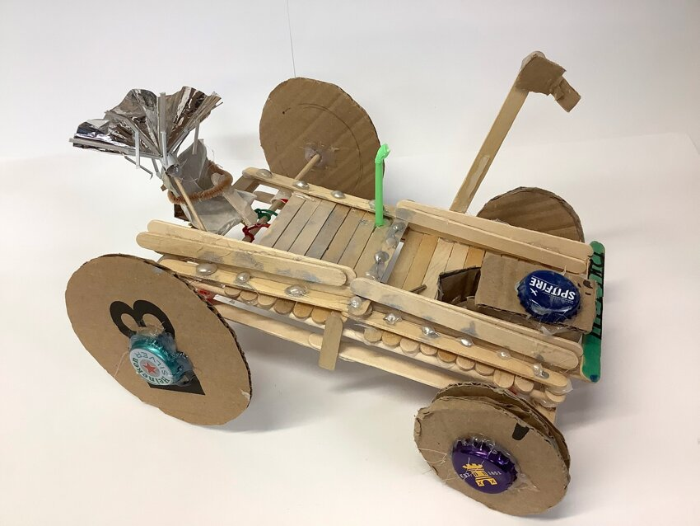

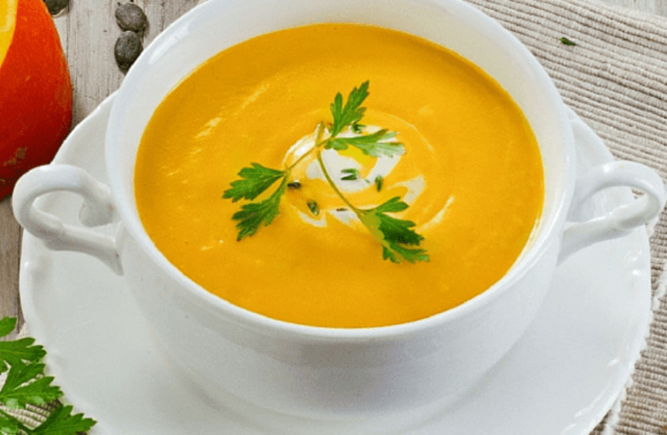

DT Year 2
Whatever the weather Make pumpkin soup. Autumn 1 |  | NASA- SPRING 1 Make moon buggies. | Newton Abbot- Make a Devon flag. Summer 1
Prior | Know how to make bread. | Creating bridges
Knowledge (substantive and disciplinary) | Lesson 1- Explore seasonal local crops and know where they come from. Lesson 2- Understand the importance of a healthy and varied diet. (Recognise bread is a carbohydrate). Lesson 3- Evaluate a range of different seasonal crops (taste testing). Lesson 4- Create a recipe based on evaluation. Lesson 5- Make an appealing soup. Lesson 6- Evaluate their product and suggest amendments. Food hygiene https://www.cieh.org/what-is-environmental-health/resources/school-materials/ | Lesson 1- Know what a moon buggy is and explain how an axel and a wheel work. Lesson 2- Select from a variety of materials and tools to make a prototype moon buggy. Give children access to different resources (cardboard circles, dowels, straws, lolly sticks, masking tape, celotape, PVA glue, glue guns) to experiment with to make a prototype moon buggy (focus on the moveable element). Lesson 3- Evaluate prototype moon buggy and design final product. Lesson 4- Create moon buggy based on design. Teachchildren on safe use of glue guns and let them use them to create models. Lesson 5- Evaluate a moon buggy and suggest ways it could be improved. Lesson 6- Improve model following feedback. | Lesson 1-Know about county and country flags and what they look like (relate Devon flag to Newton Abbott.) Lesson 2- Select patterns and materials and design their own flag. Lesson 3- Learn how to do a running stitch Lesson 4- make a flag Lesson 5- make a flag Lesson 6-Evaluate their flag/stitching
Skills | Know how to use a blender. Know how to weigh. Chop vegetables. Serve soup. Know how to make a product more appealing. | Know how to make a working axel and wheel Cutting, sticking, joining materials Selecting appropriate materials Evaluate a model | Cutting textiles Running stitch Thread a needle
END POINT | Make a seasonal soup. | Make a moveable vehicle axles and wheels. | Use a running stitch to make a Devon flag.
Next | Create a seasonal dish | Make a trailer with a pulley. | Make a tool bag.
Yellow- mechanisms
Grey- junk modelling
Green- food tech
Orange- woodwork
Blue- textiles

Slide 5
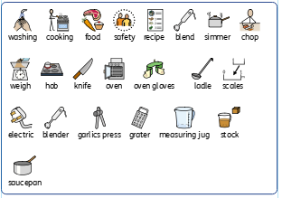
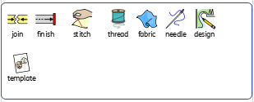
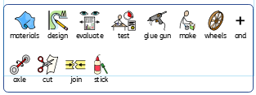
Year 2 DT vocabulary
Making soup
Make a flag
Make moon buggies

Slide 6
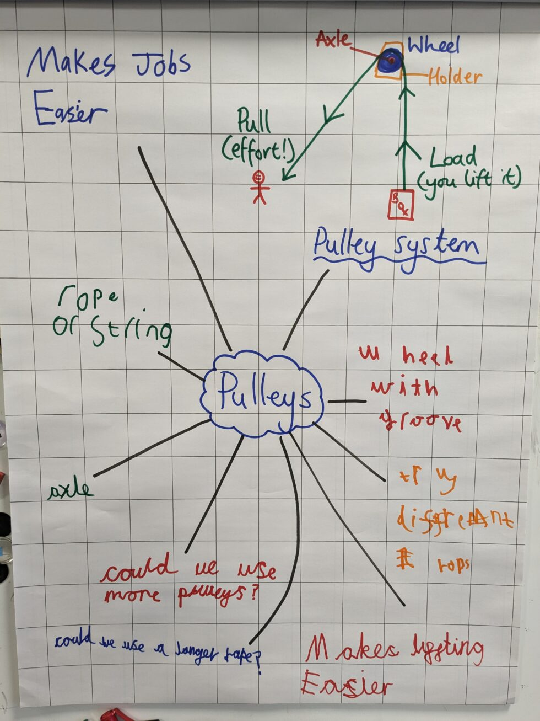
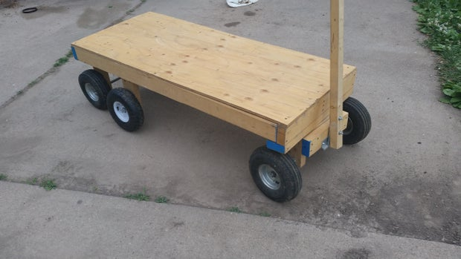
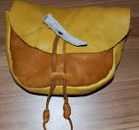
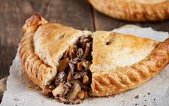
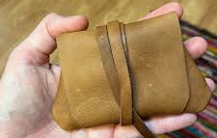
DT Year 3
Welcome to Devon! Create a seasonal savoury dish. AUTUMN 2 |  | Stone age to Iron age Make a satchel | Land use Summer 1 Make a model trailer for moving crops.
Prior | How to make bread How to make a seasonal soup | How to make a flag running stich | Make a moon buggy
Knowledge (substantive and disciplinary) | Lesson 1:Research seasonal crops grown and local dishes in Devon Lesson 2:Recap nutrition and healthy eating and apply these in the end products and food hygiene (Trip Occombe farm-how things a re grown, reared, caught and processed) Lesson 3: Design your Devon pasty using cross sectional diagrams and what filling it will have and why Lesson 4: Make your pasty and receive feedback Lesson 5: Make amendments to your ingredients list to improve your pasty. Lesson 6:Batch cook pasties for Christmas events at school. | Lesson 1: create a criteria of what a satchel should look like. To do this, children need to know what they would have used a satchel for, their main purpose and then create a success criteria. Lesson 2: practise different stitches. Children to recap running stitch and learn to backstitch. Children can then pull the material to test which stitch is stronger. Lesson 3:Design a satchel based on the criteria (set in lesson 1). (using exploding diagram for this). Provide children with samples of different materials for this for them to incorporate into their design. Lesson 4:Make a satchel. Lesson 5: Complete their satchels. Lesson 6: Evaluate their satchel against the criteria and suggest improvements. | Lesson 1:Explain how farming equipment has changed over time. Show farming equipment used in the Bronze Age and compare with robotic technologies used now. Lesson 2: Know how a pulley works and what they are used for. Lesson 3: Design a trailer with a pulley system. Children to look at images of trailers and draw out a design criteria. Children to use this to plan their trailer and write an equipment list. Lesson 4: Learn about woodwork and safe use of tools. Lesson 5:Make trailer and pulley (Use Techcard). Lesson 6: Evaluate their product in comparison to existing products. Children to compare their trailer to the photos presented on lesson 3. What is similar? What is different? What would you change about yours?
Skills | Learn how to cook vegetables Learn how to prepare and cook meat safely Learn how to use pastry and make it visually appealing Learn how to create appealing products | Learn how to backstitch Learn how to create a handle Learn how to make a purposeful/working product. Select materials and components needed Evaluate product against design criteria | Learn how to use wood work tools safely Learn how to make a pulley system Select materials, tools and components Evaluate product in comparison to other existing products Understand and use mechanical systems in their products
END POINT | Create a seasonal, locally- traditional dish- a pasty. | Create an iron age satchel using my sewing skills. | Create a model trailer for moving crops.
Next | Make a burger. | Make own clothes (Y6). | Make a wooden bridge.
Yellow- mechanisms
Grey- junk modelling
Green- food tech
Orange- woodwork
Blue- textiles

Slide 7
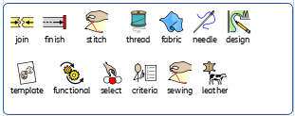
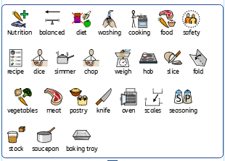
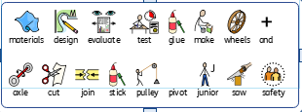
Year 3 DT vocabulary
Make leather bag
Make pasties
Make a model trailer

Slide 8
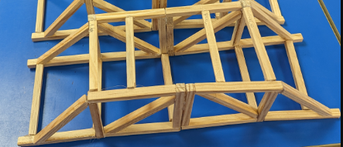
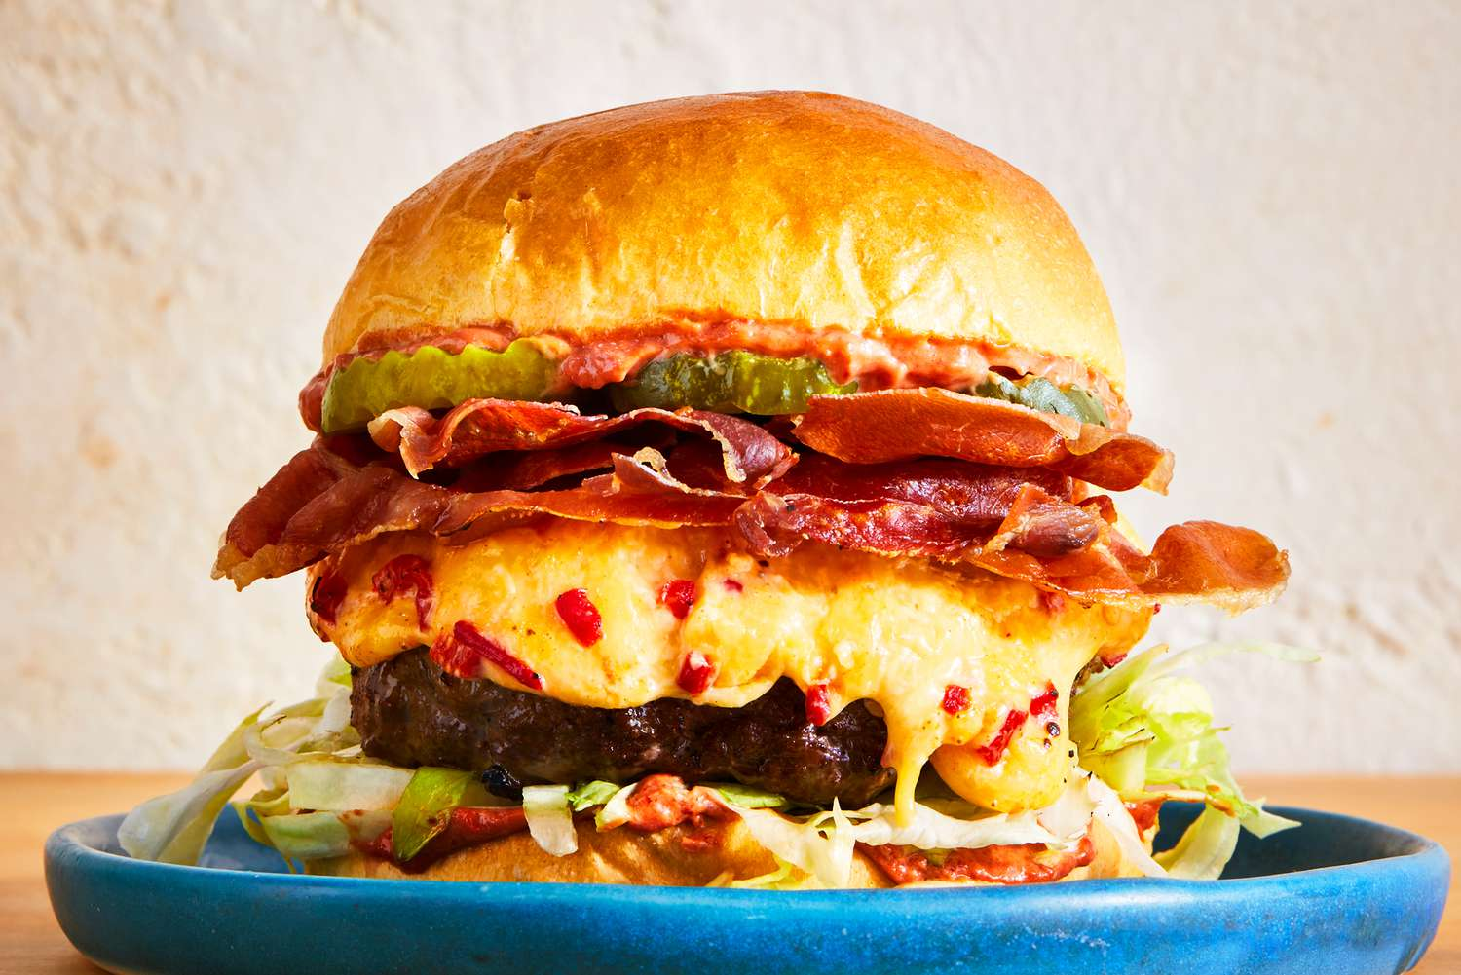
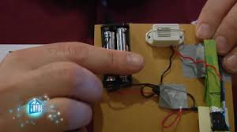
DT Year 4
Natural disasters Make a bridge which can withstand the elements. |  | Romans Make fast food (burger). | Ancient Greece Summer 2 Make an alarm.
Prior | Make a bridge to hold a toy car | Made bread Made soup Made pasties
Knowledge (substantive and disciplinary) | Lesson 1:Play ‘build a bridge’ game on ipad app Research how natural disasters and key events have affected bridges around the world Lesson 2:Design a bridge on paper using an exploded diagram Lesson 3: introduction to Design a bridge on CAD Lesson 4:Make a woodwork bridge Lesson 5:Make a woodwork bridge Lesson 6: Test and evaluate it against withstanding elements.- Strengthen, stiffen and reinforce bridge | Lesson 1: Know the food which the Romans bought to Britain. (Ensure children do not develop a misconception that the Romans created burgers. Explore the foods they bought to the UK and those they ate outside-fast food). Lesson 2: Recap nutrition and healthy diet. Link this to fast-food. Lesson 3: Design a burger. Lesson 4: Make burgers and receive feedback. Ensure children know that a burger must reach 71 degrees to be safe and model this when cooking using a probe. Lesson 5: Alter designs based on feedback. Lesson 6: Make burgers following feedback. | Lesson 1:Research what an Ancient Greek alarm looked like and why they were used Lesson 2: Investigate what alarm systems are used for and what different switches are activated. Lesson 3: Investigate how to create a circuit with a variety of switches. Lesson 4:Design an alarm system for a purpose. Lesson 5:Make an alarm system based on design Lesson 6: Peer evaluation of the finished product.
SKILLS | Use technology Use software for computer aided design Design purposeful and functional products Learn how architects design structures Learn how to use woodwork tools Select materials, tools and components | Design appealing products that are fit for purpose Select ingredients according to their functional properties of the product. Food hygiene Food preparation Combine ingredients Evaluate product against design | Use research to develop ideas Generate and create prototype Investigate and analyse a range of existing designs Understand and use electrical systems in their products.
End point | Make a bridge which can withstand the elements. | Create a savoury snack (a burger). | Create a working alarm with an electrical circuit.
Next | Incorporate woodwork to make a toy with gears. | Create a variety of savoury dishes. | Create robotic Mars Rover.
Yellow- mechanisms
Grey- junk modelling
Green- food tech
Orange- woodwork
Blue- textiles
Red- Electrical

Slide 9
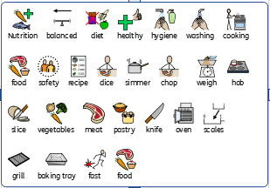
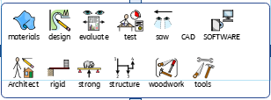
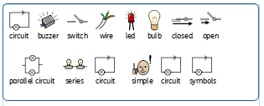
Year 4 DT vocabulary
Fast food burger
Make a bridge to withstand elements
Greek alarm

Slide 10
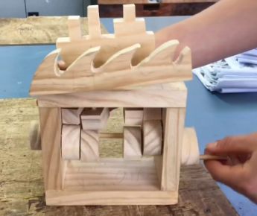
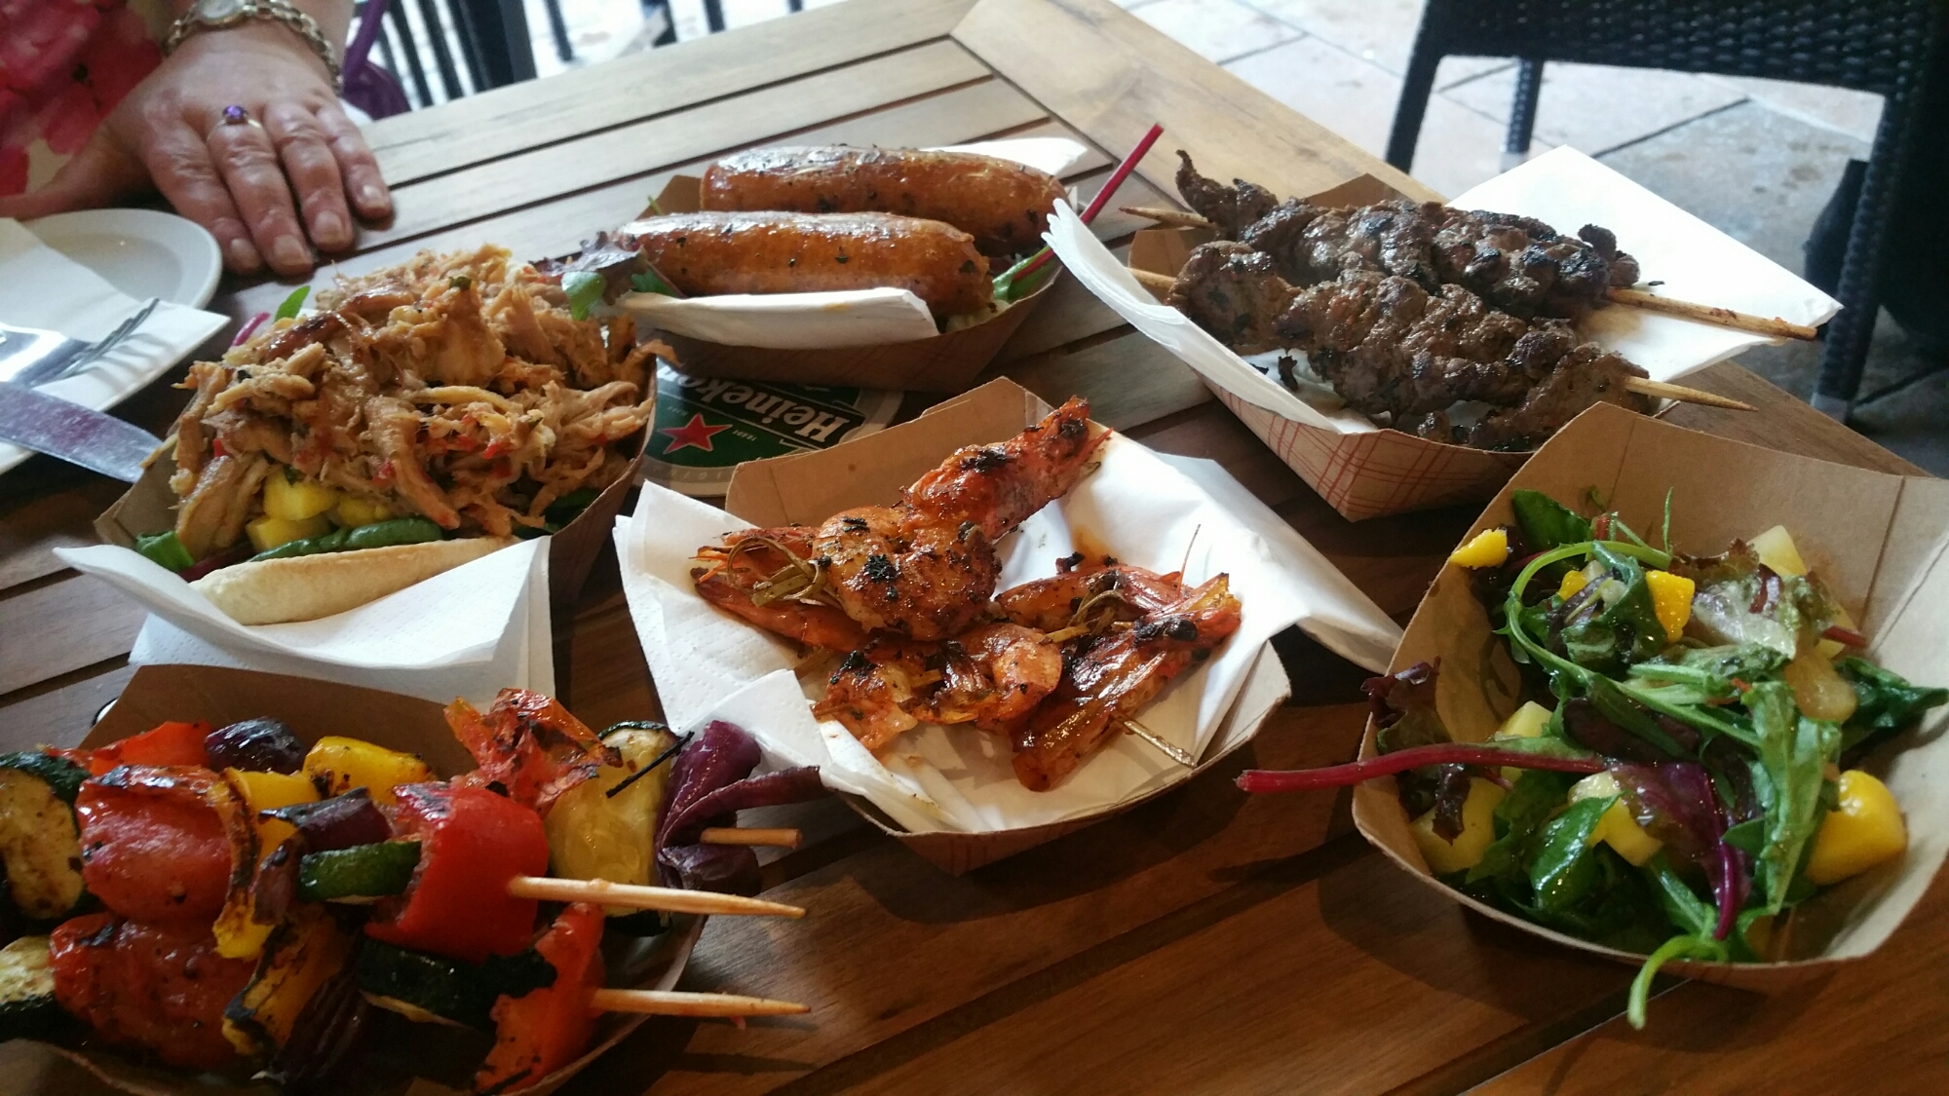
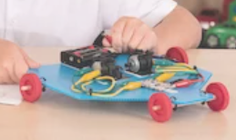
DT Year 5
Our Galaxy Mars Rover creation. |  | Invaders Make a Viking long boat and wave toy. | Mayans Summer 2 Create a food festival.
Prior | Know how to create an electrical circuit (Y4 science retrieval). | Know how to use sliders, axels, wheels, pulleys to make products with a mechanical element. | Understand seasonality and know how to make different savoury dishes.
Knowledge (substantive and disciplinary) | Lesson 1: Understand how computing can program, monitor and control products relate this to Mars Rover. Lesson 2: Make a detailed annotated design sketch of a Mars Rover. Lesson 3: Practise making electrical circuits. Lesson 4: Create body of Mars Rover following design. Lesson 5: Create circuit and programme Mars Rover. Lesson 6: Evaluate Mars Rover. Resource- Crumble Robotics Set. | Lesson 1:Know what a cam is. Within the lesson, learn about how cam works and why they are used. Lesson 2: Research different cam toys and use this to decide on design criteria. Show the model Viking long boat toy during this lesson (ask Stacey for this). Lesson 3: Apply understanding of a cam to design a cam toy. Use an exploded diagram to design. Lesson 4: Make Viking longship and wave toy. Lesson 5: Continue to make Viking long boat and wave toy. Lesson 6: Evaluate own cam toy against design criteria (created in lesson 2). | Lesson 1:Research successful stalls at Devon County show (any use of cocoa in products?) Explore how ingredients are grown, reared, caught and processed. Lesson 2: Research tortilla wrap meals and cocoa foods as these were used a lot by Mayans and how Mayan cooking has influenced current trends. Lesson 3:Create a Mayan inspired menu for the food festival consider healthy diet and seasonality. (for example how to use veg and cocoa in healthy desserts such as avocado mousse and beetroot brownies) Lesson 4:Make prototypes and taste and evaluate against healthy diet, taste, appearance. Lesson 5:Make cocoa foods and tortilla wrap foods Lesson 6:Make cocoa foods and tortilla wrap foods
Skills | Use Ict skills to research key events Design Programming Joining Making axles Folding Reinforcing Making levers and pulleys | Use research to design Annotate plans Select materials and tools | Use ICT skills to research Design appealing products that are fit for purpose Select ingredients according to their functional properties of the product. Food hygiene Food preparation Chopping, peeling Presentation of food
End point | Create a product with an electrical component. | Create a moving toy with a cam. | Create a variety of savoury dishes.
Next | Create a stop motion set. | Create a stop motion set with gears. | KS3 food tech.
Yellow- mechanisms
Grey- junk modelling
Green- food tech
Orange- woodwork
Blue- textiles
Red- electrical systems
Purple-Computer controlled product

Slide 11
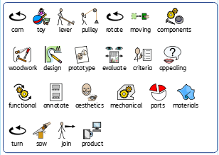
Year 5 DT vocabulary
Viking long boat and wave cam toy

Slide 12
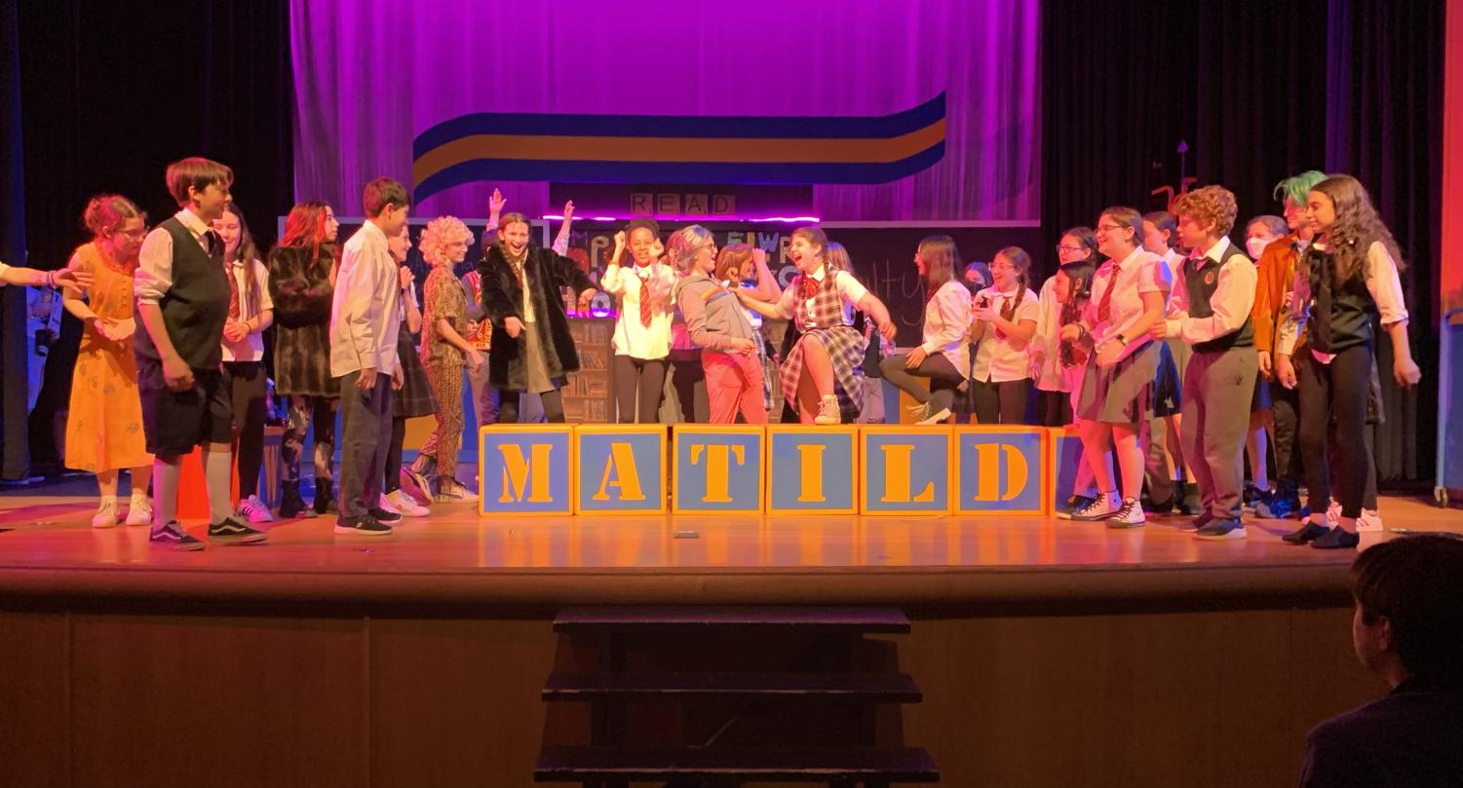
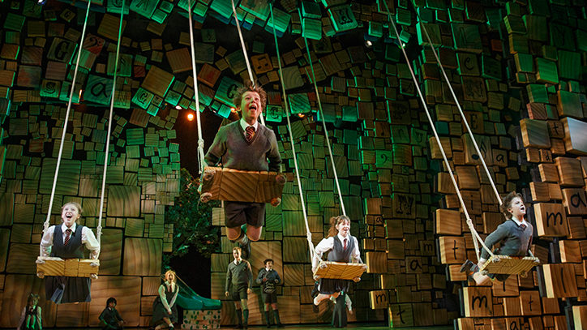

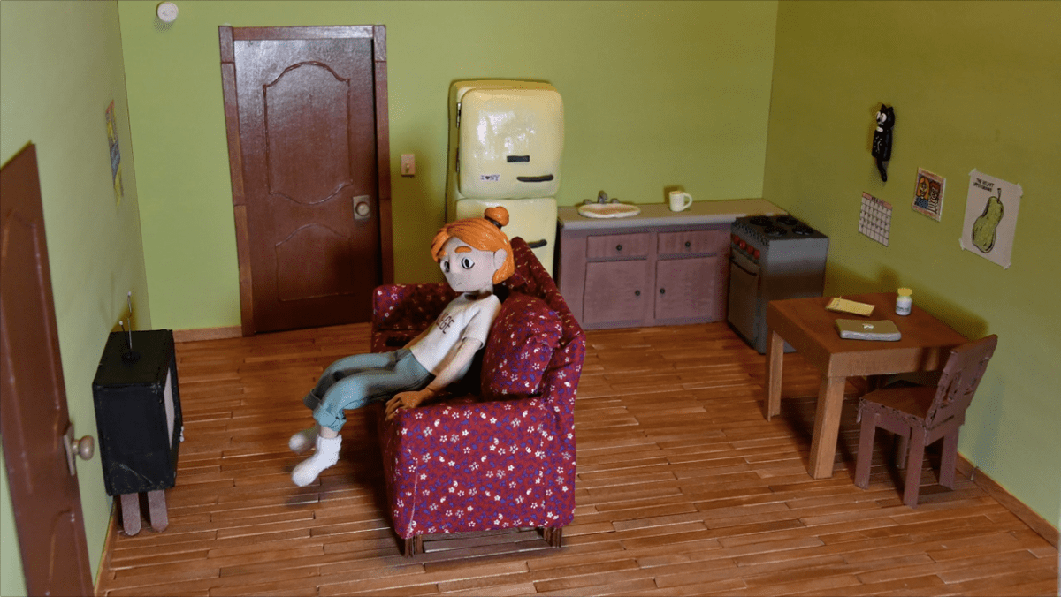
DT Year 6
Cultural Create clothing |  | Blitz Create a set (for a stop-motion) | Show Summer 2 Create a set.
Prior | Know how to do a running stitch and back stitch. | Know how to use sliders, axels, wheels, pulleys, cams to make products with a mechanical element.
Knowledge (substantive and disciplinary) | Lesson 1: Learn how to use a sewing machine. Lesson 2: Learn how to thread a sewing machine. Lesson 3: Design an outfit for a fashion show. Lesson 4: Create applique. Lesson 5: Learn to tack and applique. Lesson 6: Model their individual pieces. | Lesson 1: Understand how gears work. Within this, children to understand why gears are used to control and move components (consider how gears could be used to control movements on set and curtain movement.) Lesson 2: Plan a stop motion animation. (ensure at least one set has a moveable part which can be controlled by a gear). As a year group, decide the story of the Blitz which will be shown within the animation. Lesson 3: Design set. As a year group, decide how many ‘scenes’ there will be in the stop motion and work in groups to design the sets (ensure they include a moveable element). Lesson 4 and 5: Make set. Different joins could be useful to help them make stronger: https://www.bbc.co.uk/bitesize/articles/z9pms82#zk6jp9q Ensure children have a range of materials (wood planks, dowels, fabric, newspaper) and a range of things to join with (glue guns, glue, tacks and hammers). Lesson 6: Evaluate against design. | Design and create set for show.
SKILLS | Select materials based on properties Cut material accurately and precisely Select best stitch for the purpose Use a sewing machine | Know how to use gears Know how to join gears
END POINT | Create a piece of clothing to show my views and opinions. | Create a set for a motion picture. | Create set for whole school show.
NEXT | KS3 textiles. | KS3 woodwork. | KS3 drama.
Yellow- mechanisms
Grey- junk modelling
Green- food tech
Orange- woodwork
Blue- textiles
Red- Electrical systems

Slide 13
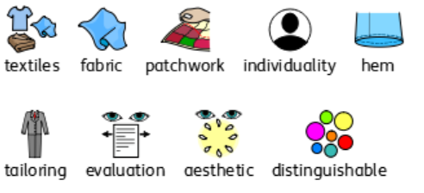
Year 6 DT vocabulary
Making clothes

