Slide 1
MUSIC Reception
A | We are Bradley Barton Our First Nativity | Reach for the Stars | A Journey to Space Healthy bodies, healthy minds | Oh, the Places You Will Go Moving on up
B | We are family Christmas Spectacular! | Reach for the Stars | Reach for the Stars Let’s Get Physical | Our Planet Moving on up
Prior
Knowledge and Skills | I am building on my listening skills. - Listening with headphones to music I know some familiar stories and poems. I can talk about what I can see, hear and feel whilst outside at my school. I can sing our class routine songs. I can sing familiar nursery rhymes. I know how to listen carefully and why it is important to listen. I can sing a range of songs for our Christmas performance. I understand the difference between singing and talking. I can perform a simple dance to music. |  | I understand that I can express myself through different mediums. - Musical instruments, singing, music mark making I know that listening is important. I have some favourite songs. I am beginning to create my own movements to music. I am beginning to evaluate my creations. | I listen attentively I use a wide range of vocabulary I have learned through stories and poems. I can perform songs in a group, matching pitch and rhythm. - Musical instruments - Stimulus for improvising singing and music making, music mark marking
END POINT | Early Learning Goals:
Next

Slide 2
MUSIC Year 1
Autumn Term Senses |  | Autumn Term Superheroes | Spring Term Dinosaurs | Spring Term At the Seaside | Summer Term Carnival of the Animals | Summer Term Fantasy and Adventure
Prior | I can play percussion and body sounds and I am developing a good awareness of a steady beat. I can sing in a group or on my own, increasingly matching the pitch and following the melody. | I can create new verses or words to a song. I can play instruments changing tempo and dynamics. | I can explore sounds using instruments, body percussion and my voice, showing an awareness of a steady beat, tempo and dynamics. I can respond appropriately to written symbols or hand signs. | I can copy and create simple rhythm patterns on an instrument or with body sounds. | I can match rhythm to words. I listen attentively and talk about the music showing imagination and thought. • | I can add sound effects appropriately to enhance a story or song.
Knowledge (substantive and disciplinary) | Lesson 1 – Finding the pulse and following simple instructions when performing. Lesson 2 – Singing, playing and exploring pulse and tempo. Lesson 3 – Exploring dynamics, duration and graphic notation. Lesson 4 – Exploring timbre and pitch. Lesson 5 – Exploring pulse and rhythm. Lesson 6 – Performing as a class ensemble. | Lesson 1 – Composing, performing and notating a sequence of sounds to create descriptive music. Lesson 2 – Composing a piece of music inspired by words. Lesson 3 – Creating a soundscape. Lesson 4 – Performing music as a class. Lesson 5 – Composing music based on a theme. Lesson 6 – Composing and performing music based on a theme. | Lesson 1 – Moving to the pulse and thinking about dynamics. Lesson 2 – Composing a piece of music with different timbres. Lesson 3 – Exploring and understanding how pitch can change. Lesson 4 – Understanding what tempo is. Lesson 5 – Following a graphic score. Lesson 6 – Composing and performing music using a graphic score. | Lesson 1 – Composing a sequence of sounds to create music. Lesson 2 – Following a visual score. Lesson 3 – Understanding and choosing symbols to compose and perform a score. Lesson 4 – Playing keeping a steady pulse. Lesson 5 – Using symbols to compose, record and perform sounds on a score. Lesson 6 – Using symbols to structure and perform a score keeping a steady pulse. | Lesson 1 – Identify how music can represent different moods or characters. Lesson 2 – Identify changes in the music representing the mood or character of a piece. Lesson 3 – Create a soundscape showing an awareness of tempo. Lesson 4 – Recognise changes in pitch and play a rhythmic ostinato. Lesson 5 – Understand pitch and play different notes on an instrument. Lesson 6 – Use and identify musical elements to convey different animals. | Lesson 1 – Listening to music and making comparisons. Lesson 2 – Creating and performing from written symbols with an awareness of pitch. Lesson 3 – Adding accompanying sounds to a melody. Lesson 4 – Responding to music showing an awareness of pitch, dynamics and tempo. Lesson 5 – Exploring and understanding stick notation with a good awareness of a steady pulse. Lesson 6 – Composing and performing a piece of music that tells a story.
Skills | Listening: Identify dynamics, duration, tempo, timbre, instruments, mood and pitch. Composing: Understand how to create rhythms. Performing: Perform in time with a pulse, follow a conductor, change tempo, dynamics and duration, perform rhythms, understand graphic notation, chant rhythms, sing in two parts. | Listening: Identify pulse and instruments and understand changes in dynamics. Composing: Understand how to use dynamics, tempo and structure when singing or playing music. Performing: Perform in a group ensemble, add actions to music, follow a score, follow a conductor, change dynamics when singing. | Listening: Identify sounds, changes in pitch and match instruments to their sound. Composing: Understand how timbre, dynamics, tempo, pitch and the order of sounds effect music. Performing: Use dynamics, pulse, tempo and percussion when performing. Use a graphic score to play music, follow a conductor, chant in music and understand changes in pitch. | Listening: Identify sounds and interpret music. Composing: Create sound effects, layer sounds, understand percussion, play loudly/quietly/quickly/ slowly, create a graphic score. Performing: Follow a score, perform in a group ensemble, perform to a pulse, change tempo, and add actions to singing or playing. | Listening: Identify instruments, match instruments to a theme, respond with movement, and recognise changes in music. Composing: Improvise in singing and playing, use dynamics and tempo when playing, and explore character. Performing: Understand ostinato, play and sing together, understand dynamics, tempo, timbre and pitch, understand call and response. | Listening: Compare music, identify feelings, pitch, tempo and dynamics, and respond to music with movement. Composing: Use ‘so’ and ‘mi’, write a score, understand call and response, change tempo and dynamics, and compose a duet and a group. Performing: Follow symbols (so, mi, ta, and titi), sing in a duet and a group, understand call and response, understand dynamics and tempo.
END POINT | I can use simple musical terms when talking about music and change dynamics when playing and accompanying singing with actions and body sounds. | I can compose a sequence of sounds to create music with a structure and use graphic symbols to convey sounds in a visual score. | I can use a graphic score to read music, include differences in timbre, pitch, dynamics and tempo when singing or playing music, and sing with an awareness of pitch and clarity in diction. | I can play to a steady pulse, accompany singing with actions and body sounds to a study pulse and express opinions when selecting and describing sounds to create music. | I can sing simple songs in different styles with an awareness of pitch and tempo, and name some instrumental sounds and instruments. | I can make a composition, with an understanding of stick notation, and perform with others, with an awareness of pulse.
Next | I can perform rhythms to the pulse with increasing success, sing with developing control of pitch and use musical notation. | I can follow simple dot notation, respond to changes in high and low pitch, and use percussion instruments and body percussion to rapeat simple rhythms. | I can perform in time with the pulse, singing with developing control of pitch and pulse, and share ideas to create a dramatic piece. | I can perform with increasing confidence and accuracy controlling dynamics, pulse and rhythm. | I can identify timbre by describing the sound and link it with the intended effect and I can create my own rhythmic patterns and perform them with a steady pulse. | I can demonstrate and utilise images to structure a piece using a simple dot notation score and perform following dot notation.

Slide 3
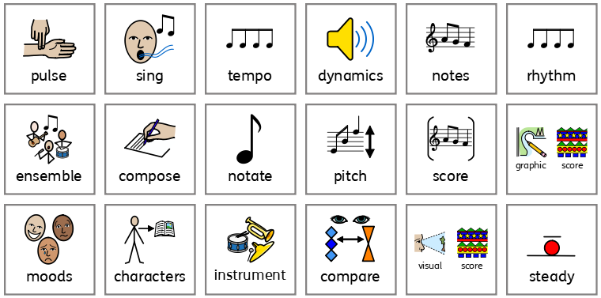
Year 1 vocabulary

Slide 4
MUSIC Year 2
Autumn Term Oceans |  | Autumn Term Four Seasons | Spring Term Jupiter | Spring Term Great Fire of London | Summer Term Folksongs | Summer Term Toys
Prior | I can use simple musical terms when talking about music and change dynamics when playing and accompanying singing with actions and body sounds. | I can compose a sequence of sounds to create music with a structure and use graphic symbols to convey sounds in a visual score. | I can use a graphic score to read music, include differences in timbre, pitch, dynamics and tempo when singing or playing music, and sing with an awareness of pitch and clarity in diction. | I can play to a steady pulse, accompany singing with actions and body sounds to a study pulse and express opinions when selecting and describing sounds to create music. | I can sing simple songs in different styles with an awareness of pitch and tempo, and name some instrumental sounds and instruments. | I can make a composition, with an understanding of stick notation, and perform with others, with an awareness of pulse.
Knowledge (substantive and disciplinary) | Lesson 1 – Understanding the difference between a verse and a chorus and singing as a part of an ensemble. Lesson 2 – Singing and performing rhythmic patterns on instruments to show a mood or a character. Lesson 3 – Recognising and performing rhythmic patterns using notation. Lesson 4 – Singing and performing rhythmic patterns on instruments using notation. Lesson 5 – Reading, performing and notating rhythmic patterns. Lesson 6 – Composing and performing rhythmic patterns on instruments using notation. | Lesson 1 – Identifying contrasts in dynamics, tempo and beat groupings. Lesson 2 – Listening, singing and performing with an awareness of dynamics. Lesson 3 – Creating music with contrasts for effect. Lesson 4 – Performing as a class ensemble with an awareness of pulse and pitch. Lesson 5 – Creating and performing rhythmic patterns and melodies. Lesson 6 – Creating, performing and notating a melody independently within a group performance. | Lesson 1 – Performing a fanfare inspired by the music of Richard Strauss. Lesson 2 – Creating a class performance inspired by the music of Gustav Holst. Lesson 3 – Creating a group performance inspired by the music of Gustav Holst. Lesson 4 – Refining, rehearsing and performing our Jupiter piece as a group. Lesson 5 – Recognising changes in tempo and performing in time with the pulse. Lesson 6 – Creating a school anthem inspired by the music of Gustav Holst. | Lesson 1 – Understanding dynamics through listening and performing. Lesson 2 – Understanding dynamics through composition and performance. Lesson 3 – Performing with a steady pulse with a partner. Lesson 4 – Identifying beat groupings. Lesson 5 – Creating and performing rhythms using notation. Lesson 6 – Performing a rhythm using notation as part of a whole class ensemble. | Lesson 1 – Identifying the pulse, playing on beat 1 to accompany singing. Lesson 2 – Embedding pulse and exploring and understanding key features of folk songs. Lesson 3 – Understanding how texture can be created when singing in a round. Lesson 4 – Using texture and dynamics in class performance. Lesson 5 – Understanding the difference between pulse and rhythm. Lesson 6 – Reading and responding to notated rhythm patterns. | Lesson 1 – Understanding pulse through listening and performing. Lesson 2 – Recognising the relationship between dot notation and movement in pitch. Lesson 3 – Using dot notation to compose a simple melody. Lesson 4 – Performing from dot notation as a pair. Lesson 5 – Performing as a class following dot notation. Lesson 6 – Improvising a rhythm within a performance.
Skills | Listening: Identify instruments, rhythm, pitch, dynamics and tempo. Composing: Improvise rhythm. Performing: Follow staff notation, and use pitch, dynamics and tempo. | Listening: Identify insturments, rhythm, pitch, dynamics and tempo. Composing: Improvise. Performing: Follow dot and staff notation, and use pitch, dynamics and tempo. | Listening: Identify instruments, dynamics, tempo, pitch and themes within music. Composing: Select and combine resources to create music in response to a non-musical stimulus. Performing: Performing a class ensemble, small group ensemble, show changes in dynamics and tempo, add lyrics to music, and demonstrate an awareness of occasion. | Listening: Identify features of Baroque, instruments, use of voice and word painting. Composing: Understand vocal sounds, found sounds and instruments. Record rhythms using notation. Performing: Follow a score and notation, perform with body percussion, copy rhythms, chant to a pulse, add actions when singing, and sing in a round. | Listening: Identify pulse, tempo, structure, repetition of melody and different instruments. Composing: Improvise rhythmic patterns. Performing: Perform as a class ensemble, drone, play and sing together, create texture, maintain parts, call and response, sing in a round, sing/chant in three parts, and use dynamics for expression. | Listening: Identify pulse and tempo. Composing: Create improvised phrases and use dot notation to record a melody. Performing: Move to music, follow a score, play tunes percussion, play and sing together.
END POINT | I can perform rhythms to the pulse with increasing success, sing with developing control of pitch and use musical notation. | I can follow simple dot notation, respond to changes in high and low pitch, and use percussion instruments and body percussion to repeat simple rhythms. | I can perform in time with the pulse, singing with developing control of pitch and pulse, and share ideas to create a dramatic piece. | I can perform with increasing confidence and accuracy controlling dynamics, pulse and rhythm. | I can identify timbre by describing the sound and link it with the intended effect and I can create my own rhythmic patterns and perform them with a steady pulse. | I can demonstrate and utilise images to structure a piece using a simple dot notation score and perform following dot notation.
Next | I can record ideas using rhythmic notation and perform from simple western notation symbols | I can record ideas using graphic notation and apply the inter-related dimensions of music when performing a piece. | I can create simple rhythmic patterns using 1 beat, ½ beat, 2 beat and 4 beat notes and a 1 beat rest and perform as an ensemble. | I can perform independently and in small groups demonstrating an understanding of my role within the ensemble. | I can play a drone, sing with project and clear diction over a greater range of pitches, and contribute ideas in group work with consideration of the structure and theme of the music. | I can use the inter-related dimensions of music to compose and perform within an ensemble.

Slide 5
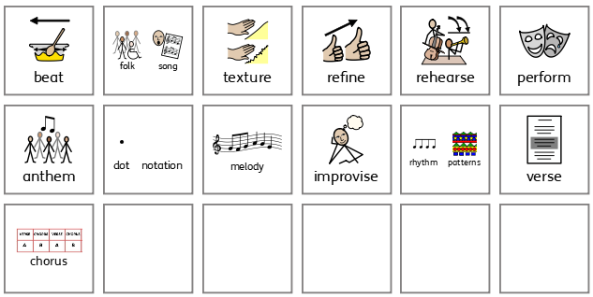
Year 2 vocabulary

Slide 6
MUSIC Year 3
Autumn Term In the Garden |  | Autumn Term Volcanoes | Spring Term Stone Age | Spring Term Castles | Summer Term Greek Myths | Summer Term Mayans
Prior | I can perform rhythms to the pulse with increasing success, sing with developing control of pitch and use musical notation. | I can follow simple dot notation, respond to changes in high and low pitch, and use percussion instruments and body percussion to repeat simple rhythms. | I can perform in time with the pulse, singing with developing control of pitch and pulse, and share ideas to create a dramatic piece. | I can perform with increasing confidence and accuracy controlling dynamics, pulse and rhythm. | I can identify timbre by describing the sound and link it with the intended effect and I can create my own rhythmic patterns and perform them with a steady pulse. | I can demonstrate and utilise images to structure a piece using a simple dot notation score and perform following dot notation.
Knowledge (substantive and disciplinary) | Lesson 1 – Reading and performing notation and understanding the difference between pulse and rhythm. Lesson 2 – Reading, writing and performing rhythmic notation. Lesson 3 – Composing and notating a rhythm using one, two and half beat notes. Lesson 4 – Understanding pitch using graphic and western notation. Lesson 5 – Composing, notating and performing a melody. Lesson 6 – Performing a solo as part of a class ensemble. | Lesson 1 – Learn how changes in tempo, dynamics and texture can create effects in music. Lesson 2 – Creating a graphic score considering dynamics, tempo and texture. Lesson 3 – Using the inter-related dimensions of music to create effect. Lesson 4 – Reading, recording and performing ideas using graphic notation. Lesson 5 – Selecting and combining skills learned to create a piece of music. Lesson 6 – Performing as a group and reflecting on our own and other’s performances. | Lesson 1 – Reading, performing and writing 1 beat and ½ beat notes. Lesson 2 – Reading and performing rhythms in time with the pulse. Lesson 3 – Reading, performing and writing rhythm notation using ½ beat, 1 beat, 2 beat and 4 beat notes. Lesson 4 – Notating and performing rhythms including a rest. Lesson 5 – Composing and performing rhythm notation as an ensemble. Lesson 6 – Performing as an ensemble and providing feedback to others. | Lesson 1 – Performing as an ensemble and maintaining a rhythmic pattern. Lesson 2 – Composing a rhythmic performance as a group ensemble. Lesson 3 – Composing and performing a rhythm for a musical theatre performance. Lesson 4 – Learning the feudal song and perform as a class ensemble. Lesson 5 – Building performance skills through vocal and instrumental improvisation. Lesson 6 – Playing and singing an improvisation within a class performance. | Lesson 1 – Singing, dancing and playing with an awareness of the pulse. Lesson 2 – Improvising and performing simple melodies, maintaining a strong sense of pulse. Lesson 3 – Exploring, selecting and combining sounds as a class. Lesson 4 – Exploring, selecting and combining sounds as a group. Lesson 5 – Rehearsing and refining compositions for a final performance. Lesson 6 – Evaluating my own music and music from another era. | Lesson 1 – Understanding how the inter-related dimensions of music can be combined to create an effect. Lesson 2 – Creating a performance inspired by Mayan wind instruments. Lesson 3 – Composing and performing using the inter-related dimensions of music to reflect the rainforest. Lesson 4 – Composing a piece of music to reflect a Mayan god. Lesson 5 – Adding rhythm to the Mayan god music. Lesson 6 – Performing and evaluating using the inter-related dimensions of music.
Skills | Listening: Identify instruments and changes in pitch. Composing: Use rhythmic notation, pitch notation, and add accompaniment. Performing: Perform by reading staff notation and graphic notation, play by ear and sing in unison. | Listening: Identify the inter-related dimensions of music. Composing: Add accompaniment, improvise, write graphic notation, and use the inter-related dimensions of music. Performing: Follow graphic notation and perform as an ensemble. | Listening: Identify accuracy of rhythms played. Composing: Read and write rhythm notation and turn words in rhythms. Performing: Follow graphic score and western notation, perform rhythms as a soloist, duet or ensemble, add emotion to voices, chant to the pulse, call and response, and add actions to a performance. | Listening: Identify instruments and inter-related dimensions. Composing: Create rhythms, add actions and improvise melodies. Performing: Perform ostinato rhythms, chant and play 2 part, 3 part and 4 part rhythms, conduct a performance, perform as a group ensemble, move to the pulse, call and respond, and sing in character. | Listening: Identify inter-related dimensions of music, identify how the music makes you feels, appraise compositions, and place music in history. Composing: Improvise melodies and soundscapes. Performing: Drone, perform in a group ensemble and solo, move to the pulse, and combine singing, dancing and playing. | Listening: Identify instruments and the inter-related dimensions of music. Composing: Use rhythmic and pitch notation, add accompaniments and improvise. Performing: Follow staff and graphic notation.
END POINT | I can record ideas using rhythmic notation and perform from simple western notation symbols. | I can record ideas using graphic notation and apply the inter-related dimensions of music when performing a piece. | I can create simple rhythmic patterns using 1 beat, ½ beat, 2 beat and 4 beat notes and a 1 beat rest and perform as an ensemble. | I can perform independently and in small groups demonstrating an understanding of my role within the ensemble. | I can play a drone, sing with project and clear diction over a greater range of pitches, and contribute ideas in group work with consideration of the structure and theme of the music. | I can use the inter-related dimensions of music to compose and perform within an ensemble.
Next | I can identify musical conventions being employed in a variety of piece and link rhythmic and melodic patterns into structured responses using voice, percussive and melodic instruments. | I can identify and describe how the inter-related dimensions are used to create samba music. | I can record music accurately using graphic scores, creating a key and beginning to use dynamic and tempo markings. | I am aware of and can apply how the inter-related dimensions of music can be used to create effects in response to a stimulus. | I can use the pentatonic scale to compose simple melodies and show increasing confidence in recording ideas using graphic score. | I can link rhythmic and melodic patterns into structured responses and record ideas using sign and symbols including graphic score and pitch and rhythmic notation.

Slide 7
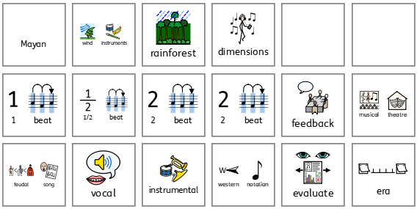
Year 3 vocabulary

Slide 8
MUSIC Year 4
Autumn Term Jazz |  | Autumn Term Samba | Spring Term Words, Words, Words | Spring Term Minimalism | Summer Term Rivers | Summer Term Ancient China
Prior | I can record ideas using rhythmic notation and perform from simple western notation symbols | I can record ideas using graphic notation and apply the inter-related dimensions of music when performing a piece. | I can create simple rhythmic patterns using 1 beat, ½ beat, 2 beat and 4 beat notes and a 1 beat rest and perform as an ensemble. | I can perform independently and in small groups demonstrating an understanding of my role within the ensemble. | I can play a drone, sing with project and clear diction over a greater range of pitches, and contribute ideas in group work with consideration of the structure and theme of the music. | I can use the inter-related dimensions of music to compose and perform within an ensemble.
Knowledge (substantive and disciplinary) | Lesson 1 – Understanding and exploring vocal improvisation within the context of scatting and jazz music. Lesson 2 – Performing a rhythmic pattern with a secure sense of pulse using body percussion. Lesson 3 – Creating a simple improvisation to a known rhythm using the pentatonic scale. Lesson 4 – Creating swinging rhythms in 4, 3 and 2 beat phrases to use to compose a melody. Lesson 5 – Composing a piece of music using key features of jazz. Lesson 6 – Composing and performing using key features of jazz music and express evaluation opinions. | Lesson 1 – Understanding samba music through listening, appraising and singing. Lesson 2 – Creating and performing rhythms using call and response. Lesson 3 – Refining, performing and appraising samba introductions. Lesson 4 – Learning and performing the rhythms of a Brazilian samba groove as a while class ensemble. Lesson 5 – Performing a sole in an ensemble. Lesson 6 – Creating a suitable ending for a samba piece and performing in carnival style. | Lesson 1 – Exploring and understanding the language of music through the inter-related dimensions of music. Lesson 2 – Using the inter-related dimensions to translate the language of words into the language of music. Lesson 3 – Interpreting music notation with consideration of dynamics. Lesson 4 – Creating a symphonic poem and broadening knowledge of the inter-related dimension of tempo. Lesson 5 – Creating a symphonic poem using knowledge of the inter-related dimensions of music. Lesson 6 – Performing and evaluating a final piece using knowledge of the inter-related dimensions of music. | Lesson 1 – Performing a rhythmic piece using minimalist techniques. Lesson 2 – Understanding and using features of minimalist music to compose a short melodic piece. Lesson 3 – Composing and performing pieces using minimalist techniques. Lesson 4 – Developing knowledge of minimalist music through singing, listening and performing. Lesson 5 – Exploring and understanding structure and texture to create a group piece. Lesson 6 – Exploring and understanding how minimalist techniques have influenced other styles of music. | Lesson 1 – Exploring and understanding pitch using graphic notation. Lesson 2 – Composing and performing melodies using graphic notation. Lesson 3 – Performing pentatonic melodies using grid notation. Lesson 4 – Composing and notating pentatonic melodies. Lesson 5 – Composing a song in the style of a barcarolle. Lesson 6 – Developing, refining, rehearsing and performing a barcarolle. | Lesson 1 – Exploring and understanding harmonious sounds and pitch notation. Lesson 2 – Exploring and understanding pitch, harmonious notes and scales. Lesson 3 – Singing and playing a melody using the pentatonic scale. Lesson 4 – Improvising, reading and writing melodies using the pentatonic scale. Lesson 5 – Choosing and combining notes from the pentatonic scale to create a piece of music. Lesson 6 – Refining and performing compositions
Skills | Listening: Identify characteristics, appraise and identify instruments. Composing: Use pitch, rhythm, improvisation and notation. Performing: Follow staff notation, perform in a group ensemble and as a solo, call and respond, perform through scatting. | Listening: Identify characteristics, appraise and identify instruments. Composing: Use polyrhythm, rhythm and staff notation. Performing: Follow staff notation, perform in a group ensemble and as a solo, call and response, and sing in a round. | Listening: Identify characteristics, appraise, identify instruments and identify inter-related dimensions. Composing: Use graphic notation and inter-related dimensions. Performing: Follow graphic and western notation, perform in a group ensemble, chant and sing to explore inter-related dimensions. | Listening: Identify key features and inter-related dimensions of music. Composing: Use staff notation and graphic score. Performing: Follow graphic notation and staff notation, and perform in a group ensemble. | Listening: Identify instruments, key features and inter-related dimensions of music. Composing: Select and combine to creature texture, use graphic score, use the pentatonic scale, write melody and lyrics, compose to represent a theme and use inter-related dimensions. Performing: Follow graphic notation, sing in unison and perform in a group ensemble. | Listening: Identify instruments, features and appraise performances. Composing: Use the pentatonic scale, add accompaniment, improvise and tell a story. Performing: Perform to the pule, rhythm and pitch notation. Use harmonious notes, sing using the pentatonic scale. Perform as a solo, in a group and in a class ensemble.
END POINT | I can identify musical conventions being employed in a variety of piece and link rhythmic and melodic patterns into structured responses using voice, percussive and melodic instruments. | I can identify and describe how the inter-related dimensions are used to create samba music. | I can record music accurately using graphic scores, creating a key and beginning to use dynamic and tempo markings. | I am aware of and can apply how the inter-related dimensions of music can be used to create effects in response to a stimulus. | I can use the pentatonic scale to compose simple melodies and show increasing confidence in recording ideas using graphic score. | I can link rhythmic and melodic patterns into structured responses and record ideas using sign and symbols including graphic score and pitch and rhythmic notation.
Next | I can combine the inter-related dimensions of music imaginatively, create my own melodic and rhythmic motifs, and demonstrate increased confidence and accuracy using various forms of notation to record musical ideas. | I can demonstrate a secure sense of pulse when playing and singing, and match pitches across a wider range of notes, leaps, lengths and rhythmic complexity. | I can use simple Western notation to record and perform my rhythms. | I can improvise and use rhythmic and melodic ideas of greater length and musical shape, I can recognise and perform from an increasing range of Western notation. | I can confidently demonstrate an increasing confidence recording and performing Western notation, and show an understanding of how to place music relating features heard to justify placement. | I can use intervals and chords demonstrating increased confidence and understanding of the harmonic features studied.

Slide 9
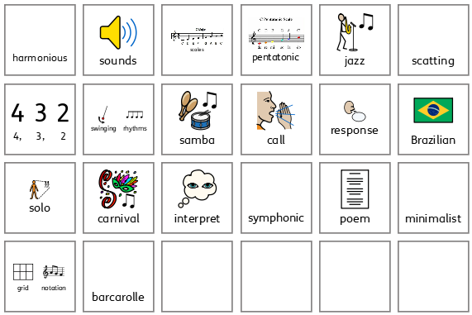
Year 4 vocabulary

Slide 10
MUSIC Year 5
Autumn Term Planets |  | Autumn Term Africa | Spring Term Vikings | Spring Term Rock and Roll | Summer Term Melodies of Divinity | Summer Term Animal Kingdom
Prior | I can identify musical conventions being employed in a variety of piece and link rhythmic and melodic patterns into structured responses using voice, percussive and melodic instruments. | I can identify and describe how the inter-related dimensions are used to create samba music. | I can record music accurately using graphic scores, creating a key and beginning to use dynamic and tempo markings. | I am aware of and can apply how the inter-related dimensions of music can be used to create effects in response to a stimulus. | I can use the pentatonic scale to compose simple melodies and show increasing confidence in recording ideas using graphic score. | I can link rhythmic and melodic patterns into structured responses and record ideas using sign and symbols including graphic score and pitch and rhythmic notation.
Knowledge (substantive and disciplinary) | Lesson 1 – Listening and appraising music exploring the sounds used to capture characteristics of different planets. Lesson 2 – Composing a programmatic piece of music considering the inter-related dimensions of music. Lesson 3 – Creating a motif considering the inter-related dimensions of music. Lesson 4 – Considering how motifs can be accompanied and record this using Western notation. Lesson 5 – Using ABA structure to organise music and create a satisfying listening experience. Lesson 6 – Performing as a group and appraise the work of others. | Lesson 1 – Copying and improvising rhythms through musical games and song. Lesson 2 – Performing an independent part within a whole class ensemble. Lesson 3 – Applying and using key features of African music to create rhythmic compositions. Lesson 4 – Developing a piece of music considering the structure. Lesson 5 – Refining and performing our composition and critically appraise it. Lesson 6 – Performing a group composition with confidence, using the key features of African music. | Lesson 1 – Exploring and organising rhythms using voice and instruments. Lesson 2 – Organising rhythms into beats and notate them using 1, ½ and 2 beat notes. Lesson 3 – Performing simple rhythms from music notation. Lesson 4 – Composing and combining rhythms creatively to convey an intended effect. Lesson 5 – Selecting and combining musical ideal to create an interesting and satisfying structure. Lesson 6 – Performing Viking compositions and offer feedback on recorded music and the music of my peers. | Lesson 1 – Singing as part of an ensemble. Lesson 2 – Singing as part of an ensemble in a two part harmony. Lesson 3 – Knowing what a cord is and being able to play a chord pattern on tuned percussion. Lesson 4 – Improvising a melody line within a call and response structure. Lesson 5 – Reading and performing pitch notation to a steady beat. Lesson 6 – Performing an independent part within an ensemble. | Lesson 1 – Improvising over a drone with a sense of shape and character. Lesson 2 – Improvising freely over a drone using a wider range of notes developing a sense of melody and rhythm. Lesson 3 – Performing the opening of a raga with consideration of the style and features of Indian classical music. Lesson 4 – Composing and performing a rhythm with consideration of the features of a tal. Lesson 5 – Understanding the structure of a raga and composing and notating a short melody. Lesson 6 – Structuring and performing a final piece. | Lesson 1 – Exploring the relationships between pitches to create harmonies. Lesson 2 – Understanding how chords are formed and to play as an ensemble. Lesson 3 – Exploring using chords to create effect. Lesson 4 – Exploring how chords can be adapted to achieve intended effects. Lesson 5 – Composing music using harmony, intervals and chords to create an intended effect. Lesson 6 – Rehearsing, refining and performing our composition.
Skills | Listening: Identifying structure, inter-related dimensions, identifying instruments, and identifying pitch. Composing: Use Western notation, compose a melody, use ternary form, and compose an accompaniment. Performing: Use Western notation, a graphic score, and perform in an ensemble. | Listening: Identifying features and instruments. Composing: Creating polyrhythms, creating ostinato, use mnemonics, improvising rhythms, structuring a piece, using inter-related dimensions. Performing: Performing a class ensemble, group ensemble and as a solo. Call and response, chant rhythms, and sing in two parts. | Listening: Identifying structure, inter-related dimensions, and instruments. Composing: Using rhythmic grids and Western notation, creating melodies, and improvising. Performing: Follow Western notation and rhythm grids, perform as part of a group ensemble, sing in 2, 3 & 4 part rounds, and pitch over octave. | Listening: Identify structure, identify instruments, and identify features. Composing: Using Western notation, creating melody and bass line. Performing: Follow Western notation, improvise, play chords and bass line, and sing melody and harmony. | Listening: Identify instruments, and the features of the style. Composing: Using staff notation, and creating melodies and rhythms. Performing: Follow staff notation and perform as a soloist. | Listening: Identifying inter-related dimensions, effect and character, identifying intervals and harmonies. Composing: Using intervals, improvising melodies, using harmonies and chords, and inter-related dimensions. Performing: Follow notation, group ensemble, and harmonise in 2, 3 & 4 parts.
END POINT | I can combine the inter-related dimensions of music imaginatively, create my own melodic and rhythmic motifs, and demonstrate increased confidence and accuracy using various forms of notation to record musical ideas. | I can demonstrate a secure sense of pulse when playing and singing, and match pitches across a wider range of notes, leaps, lengths and rhythmic complexity. | I can use simple Western notation to record and perform my rhythms. | I can improvise and use rhythmic and melodic ideas of greater length and musical shape, I can recognise and perform from an increasing range of Western notation. | I can confidently demonstrate an increasing confidence recording and performing Western notation, and show an understanding of how to place music relating features heard to justify placement. | I can use intervals and chords demonstrating increased confidence and understanding of the harmonic features studied.
Next | I can confidently demonstrate a secure sense of pulse when playing in different time signatures. | I sing confidently with control and accurately match pitch across a range of notes; leaps, lengths and rhythmic complexity. | I can use GarageBand to compose and record a more complex melody using notes from the chord and passing notes. | I sing confidently with control and expression and can accurately match pitch across a range of notes in unison and in parts. | I am able to record ideas using both graphic score and western notation, selecting appropriate notes to accompany a melodic line or for effect. | I sing confidently with control and accurately match pitch across a range of notes; leaps, lengths and rhythmic complexity in unison, in parts and as a soloist.

Slide 11
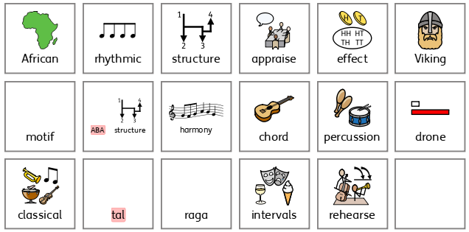
Year 5 vocabulary

Slide 12
MUSIC Year 6
Autumn Term Electricity |  | Autumn Term Reggae | Spring Term WW2 | Spring Term Revision | Summer Term Summer Musical | Summer Term Summer Musical
Prior | I can use intervals and chords demonstrating increased confidence and understanding of the harmonic features studied. | I can improvise and use rhythmic and melodic ideas of greater length and musical shape, I can recognise and perform from an increasing range of Western notation. | I can demonstrate a secure sense of pulse when playing and singing, and match pitches across a wider range of notes, leaps, lengths and rhythmic complexity.
Knowledge (substantive and disciplinary) | Lesson 1 – Exploring rhythmic notation and find the beats of the pulse in different time signatures. Lesson 2 – Reading and performing rhythmic notation. Lesson 3 – Extending knowledge of time signatures and rhythmic notation. Lesson 4 – Creating rhythms and notating using a variety of different lengths notes and rests. Lesson 5 – Refining and rehearsing rhythmic grid compositions. Lesson 6 – Performing and appraising notated rhythmic pieces. | Lesson 1 – Learning about the origins and features of reggae and sing in style. Lesson 2 – Identifying the common features of reggae and introducing the drum groove. Lesson 3 – Developing an understanding of the common features of reggae with a focus on chords. Lesson 4 – Developing an understanding of the common features of Reggae with a focus on the chords and bass line. Lesson 5 – Developing performing chords and bass line in small groups. Lesson 6 – Composing a melody made of pairs of phrases to fit over a chord structure and bass line. | Lesson 1 – Identify what makes a successful melody. Lesson 2 – To explore melodic structure and sing melody and counter melody in an ensemble. Lesson 3 – To arrange, notate and perform a well structure melody. Lesson 4 – To compose and perform a catchy melody and lyrics for a D-day song. Lesson 5 – To accompany a melody selecting the most appropriate chords. Lesson 6 – To refine and perform as an ensemble with appropriate expression, chordal and rhythmic accompaniment.
Skills | Listening: Identifying instruments, time signatures, and features. Composing: Using inter-related dimensions. Performing: Ostinato, polyrhythm, group ensemble, sing in different time signature, and play and sing in different time signatures. | Listening: Identifying features. Composing: Composing bass line from triads. Performing: Combining, rehearsing and refining an ensemble. | Listening: Identifying features. Composing: Composing bass line from triads. Performing: Combining, rehearsing and refining an ensemble.
END POINT | I sing confidently with control and accurately match pitch across a range of notes; leaps, lengths and rhythmic complexity in unison, in parts and as a soloist. | Performing a melody made of pairs of phrases to fit over a chord structure and bass line. | I sing confidently with control and accurately match pitch across a range of notes; leaps, lengths and rhythmic complexity in unison. | Y6 Revision | I am able to perform ideas with greater accuracy by reading graphic scores and western notation. I can improve my work through self-evaluation, comparison and positively engaging with feedback from my peers. | I can use my music knowledge and skills to perform a musical.
Next | KS3 Music | KS3 Music | KS3 Music | KS3 Music | KS3 Music | KS3 Music

Slide 13
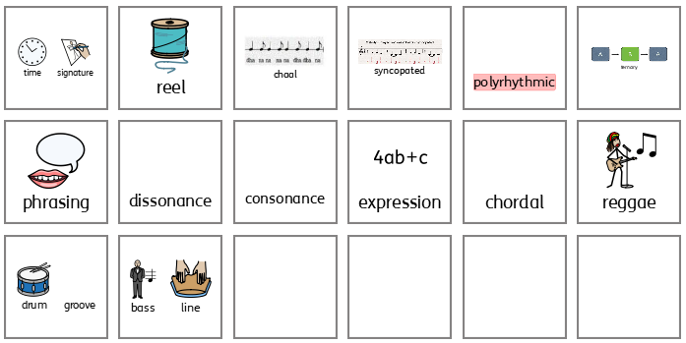
Year 6 vocabulary

