Slide 1
History Year 1
 | Significant National event Great Fire of London | Significant individual in Dorset Mary Anning | Changes in Living Memory Schools
Prior | Have an understanding of ‘past’ and ‘present’. Know what a timeline is and how they work.
Knowledge (substantive and disciplinary) | Lesson 1- Show knowledge and understanding of aspects of the past beyond living memory- identifying characteristic features of a period. Lesson 2- Show understanding that the past has been interpreted in different ways. Lesson 3- Begin to realise that there are reasons why people acted as they did. Lesson 4- Describe the Great Fire of London using structured writing to help. Lesson 5- Select and combine information from different sources. Lesson 6- Give reasons and results for the changes after the Great Fire of London (introduce term monarchy). | Lesson 1- Possible trip to Visit Mary Anning’s place of birth to become fossil hunters. Lesson 2- Know who Mary Anning and what made her a significant person. Lesson 3- Ask questions to Mary Anning (Claire Lambshead to visit in-role). Lesson 4- Create a timeline of Mary Anning’s life. Lesson 5- Know what life was like in Victorian times. Lesson 6- Compare the Victorian times to today. Destination idea- Showcase of Mary Anning’s life. | Lesson 1- Understand how things have changed in our living memory. Use a timeline to show their lives (this is their living memory). Ensure children understand that the living memory is the time someone has been alive. How do they think toys have changed since their grandparents had toys to now? Show pictures of different old toys and new toys. Draw out the material has changed to make them and they are now more technological (use of batteries). Lesson 2- Create a timeline to show how toys have changed over time. Lesson 3- Predict the changes that have happened in schools in living memory. First focus on changes at Bradley Barton within their living memory (if they went to nursery, they may remember Ms Barton being headteacher). What do they thing schools were like when their parents went? How about grandparents? Record predictions. Lesson 4- Plan questions to ask the elderly about how schools have changed in their living memory. Lesson 5- Visit the residential home to ask questions about schools (and complete portraits). Lesson 6- Recall changes within living memory (within their own and that of the elderly).
Skills | Recognise that things can be viewed from different view points. Understand people have different reasons for their actions. Use historical sources to support views. | Ask and answer questions about the past. Make comparisons between periods. | Use appropriate vocabulary and terminology associated with schooling. Pose questions to find out about the past. Draw conclusions about what the past was like from different sources.
END POINT | I can describe what happened in the Great Fire of London using what I have learnt from different historical sources. | Name a locally significant people (Mary Anning) and recall what is significant about her. | Recall changes within living memory.
Next | Know about global significant events: Rosa Perks bus segregation; NASA space race. |  | Understand the changes in Newton Abbot town centre over the same time period.

Slide 2
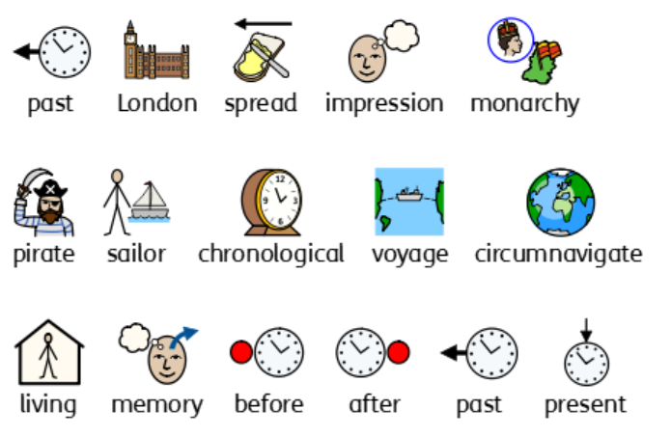
Year 1 history vocabulary

Slide 3
History Year 2
Significant Individuals Rosa Parks Katherine Jonhson |  | Significant individual Sir Francis Drake | Local Study Our High Street
Prior | Explain a significant national event (the Great Fire of London). |  | Understand how schools have changed in recent history.
Knowledge (substantive and disciplinary) | Lesson 1- Understand what we mean by significant. Explain why we see some people as significant. Discuss who is significant in their lives. Lesson 2 and 3-- What do we know about Nasa- create a timeline of space travel. Lesson 4- Discuss and decide what were the most important parts of Katherine Johnson’s life and why. Lesson 5- Learn about hidden figures of Nasa, focus on Mae Jemison. | Possible trip to the Golden Hind in Brixham. Lesson 1- Ask and answer questions about what makes a pirate. Reflect and discuss whether Sir Francis Drake looks like a pirate. Lesson 2- Know what it was like when Sir Francis Drake was born (revise term monarchy). Lesson 3- Sequence events from Sir Francis Drake’s life (recap oceans he sailed over). Lesson 4- Know and explain why Sir Francis Drake’s voyage was significant. Lesson 5- Explain another point of view on Sir Francis Drake’s voyage. Lesson 6- Form an opinion on whether Sir Francis Drake was a sailor or a pirate. Destination idea- Perform the Sir Francis Drake song and dance to parents | Lesson 1- Know what Newton Abbot high street was like in the 1950s. Lesson 2- Draw what the high street was like in 1950s in Newton ABBOT (Within this lesson, introduce term trade). Lesson 3- .Explain how that the shops on our high street have changed- name different types of shops. (Based on this introduce the term ‘primary/secondary source’). Discuss Austins. Lesson 4- Comparing shops now to shops in the 1950s. Focus on payment changes too. (Introduce the term ‘grocery’) Lesson 5- recreate a high street (History Association planning in folder to support with this unit- some elements are quite outdated).
Skills | Look at photographs and infer from observations. Understand chronology and sequence things in chronological order. Explain similarities and differences between individuals. Research historical figures, pulling out key knowledge. Justify opinions based on historical understanding. | Identify different ways the past is represented. Use common words and phrases relating to the passing of time. Ask and answer questions, choosing and using parts of a story to show knowledge and understanding of key features of events and where they fit within a chronological framework. Develop an understanding of different ways in which the past is represented. | Find answers from sources. Make distinctions between aspects of their own lives and those of past times. Use sources to ask and answer questions about the past. Select and combine information from sources. Find answers from sources that go beyond simple observations. Make deductions. Begin to realise there are reasons why people in the past acted as they did. Identify similarities and differences across periods. Demonstrate factual knowledge and understanding of aspects of the past.
END POINT | I can name globally significant people and recall what is significant about them, justifying which I feel is most significant and why. | Give different viewpoints of whether Francis Drake was a pirate or not and use these to explain my own opinion. | Recall how Newton Abbot town high street has changed over the last 70 years.
Next | Know the changes in Britain from the Stone Age to the Iron Age. Understand an ancient civilization: Ancient Egypt. | Know the changes in Britain from the Stone Age to the Iron Age. Understand an ancient civilization: Ancient Egypt.

Slide 4
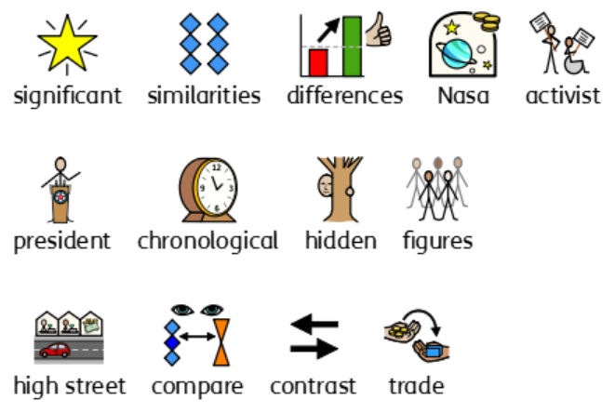
Year 2 history vocabulary

Slide 5
History Year 3
British history Changes in Britain between the Stone age to Iron age |  | ANCIENT EGYPTIANS Main achievements of the Ancient Egyptians
Prior | Understand the lives of different significant individuals. Explain how Newton Abbot town centre has changed over time.
Knowledge (substantive and disciplinary) | Trip to Kents Cavern with workshops on the Stone Age. Lesson 1- Understand that our understanding of history is based on what we can find. Complete ‘Rubbish Bin Activity’ on HA planning. Lesson 2- Understand the Stone Age came after the Ice Age. Show a short clip of the film Ice Age. Discuss what life would have been like then (explain to the children that it is not factual but represents the setting). Find the Ice Age on a timeline and label this. Show photographs from the Stone Age. What would life have been like then? What are the similarities between the two periods? What is the same. Plot this on the timeline. Compare the two. Lesson 3- Explain how the Stone Age differs from cartoon images. Watch a clip of the Flintstones. Compare the houses, vehicles, animals, clothes in the clip to more realistic images from the Stone Age. Children to conclude that the Flintstones is not like what life was like in the Stone Age. Children to write a thought bubble to show their conclusions. Lesson 4- Know that our understanding of the Stone Age changes with new discoveries. Split the class into three with each group focusing on a different new finding: Howick House (recently discovered Mesolitic House) https://www.bbc.co.uk/history/ancient/archaeology/oldest_house_01.shtml Cheddar Man (recently discovered remain) https://www.nhm.ac.uk/discover/cheddar-man-mesolithic-britain-blue-eyed-boy.html Remains of clothes found. http://www.theguardian.com/science/sifting-the-evidence/2013/may/20/who-invented-clothes-palaeolithic-archaeologist Lesson 5- Draw conclusions about the significance of the Beaker people. Watch this video ‘Bronze Age Britain’ https://www.youtube.com/watch?v=cH_uowNBJno up to 4 minutes in. Make it very clear to children that this is an animation and is not real- this would be impossible as historians rely on artifacts. Debate what the significance of the Beaker People were. What did they bring? What did it change in Britain? Annotate pictures of the things they bought to draw their own conclusions. Lesson 6- Know how stone circles were used in the Bronze Age. Watch this video ‘Bronze Age Britain’ from 4 minutes. https://www.youtube.com/watch?v=cH_uowNBJno Discuss how Stone Age circles. Look at images of Stonehenge. Children to draw a representation and write some notes to explain. Lesson 7- Explain why the Iron Age began in Britain. Show the video clip… https://www.bbc.co.uk/teach/class-clips-video/articles/z42d7nb Discuss what they noticed in the clip. What was different compared to the Bronze Age? Children to write a short explanation. Children to draw what the Iron Age bought with it. Lesson 8- Understand how the introduction of the coin in the Iron Age changed trade. Look at some images of the first coins used in Britain from the Iron Age (there are some on Oak Academy lesson- How did trade change in the Iron Age). Explore the designs of the coins. Discuss how coins would have changed farming. Children to design an Iron Age coin and use it to role play trading within the Iron Age. Lesson 9- Explain the changes of the houses between the Stone Age, Bronze Age and Iron Age. Using the knowledge gained in the previous lessons, children to discuss the changes of the houses between the three periods. Complete the sheet on the PDF in which compares each. Lesson 10 and 11- Recreate the Stone Age through music. Lesson 12- Perform Stone Age, the musical. | Lesson 1- Know when the Ancient Egyptian period was. (At the start of the lesson, recap where Egypt is on Google Earth). Lesson 2- Understand why the civilisation grew near the River Nile. Investigate how the River Nile was used for trade. (revisit term trade). Locate significant places in relation to the River Nile (Valley of Kings, pyramids, sphinx) Lesson 3- Explain an achievement of the Ancient Egyptians: pyramids. Lesson 4- Know the Ancient Egyptian writing system: hieroglyphics. Within this learn about the Rosetta Stone and the importance of this for learning about hieroglyphics. Lesson 5- Investigate the beliefs of the Ancient Egyptians (focus on their Gods and the burial process). Lesson 6- Present knowledge of the Ancient Egyptians.
Skills | Draw conclusions. Make comparisons. Deduce from historical sources. Justify opinions. Pull on a range of sources to form interpretations. Use a range of sources to justify conclusions. | Retrieve information from historical sources. Provide reasons for historical events. Explain similarities and differences. Deduce why events are interpreted differently.
END POINT | Use different sources to explain opinion of which was better to live in- Stone age, Bronze Age or Iron Age. | Recall the main achievements of the Ancient Egyptians.
Next | Understand why the Romans invaded Britain and the legacies they left. | Know how Ancient Greece influenced the world.

Slide 6
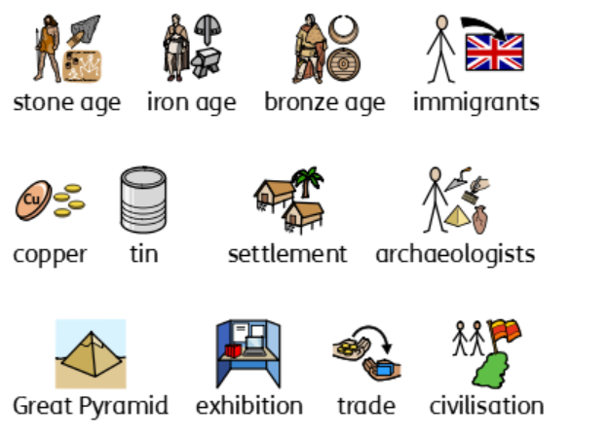
Year 3 history vocabulary

Slide 7
History Year 4
British History The Romans |  | ANCIENT Greeks Influence on the Western World
Prior | Know the changes in Britain from the Stone Age to the Iron Age. | Know the achievements on the Ancient Egyptians.
Knowledge (substantive and disciplinary) | Enquiry one: when did the Romans invade and why? Lesson 1- Understand why the Romans invaded Britain (introduce term ‘invasion’). Lesson 2- Understand why we know so little about period in history- what sources can be use? Lesson 3- Explain why the Roman army were so successful at building up the Roman Empire. Lesson 4- Understand how we know about life on Hadrian’s Wall. Lesson 5- Possible Trip to RAMM with workshop on Romans in Devon (to understand the impact of the Romans in our locality). Enquiry two: did the native Britons welcome or resist the Romans- why? Lesson 6- Explain why some tribes welcomed the Romans and why some didn’t. Lesson 7- Use chronological understanding to order the story of Boudicca. Lesson 8- Assess sources for accuracy and bias- link to description of Boudicca. Enquiry three: how did the Romans influence the culture of the people already in Britain? Lesson 9- Use sources to know how the Celtic people lived. Lesson 10- Explain why the Romans built Hadrian’s Wall in the north. Lesson 11- Explain the ways the Romans have impacted Britain: Roman roads; changes to towns; and left Roman ruins. (include impact on trade links- geography focus). Lesson 12- Explain the letter sent by Emperor Honorius marking the end of the Roman rule. Destination idea- Put on own Roman museum with workshops for parents (like at RAMM). | Lesson 1- Relate the location of Greece to the Ancient Greek civilisation. Relate the Ancient Greek civilisation to other known periods on a timeline. Recap the location and physical features of Greece and relate to life in Ancient Greek times. Lesson 2- Identify some similarities and differences between life in Athens and Sparta. Lesson 3- Infer information from artefacts and archaeological sites about what it was like in Ancient Greece. Lesson 4- Use different sources to identify the most important achievements of Alexander the Great. (Recap terms primary and secondary sources) Lesson 5- Know how the Olympic games have changed since they were first held in Ancient Greece. Lesson 6- Explain some the legacies of the Ancient Greeks. (Relate these to the impact they had on the Western World as we know it now.)
END POINT | Recall why the Romans successfully invaded Britain. Use sources to give an opinion about the most important impact the Romans had in Britain. | Explain the main achievements of the Ancient Greeks and explain how these have influenced the Western World.
Next | The effects of Anglo-Saxon, Viking and Scots settlement in Britain | Understand the Mayan civilization.
Skills | Explain why historical sources are not always accessible. Use a range of historical sources to form opinions. Explain different viewpoints on historical events. Determine accuracy. Justify opinions based on sources. | Notice and discuss similarities and differences. Infer and deduce information from artefacts. Use a range of sources to identify historical achievements.

Slide 8
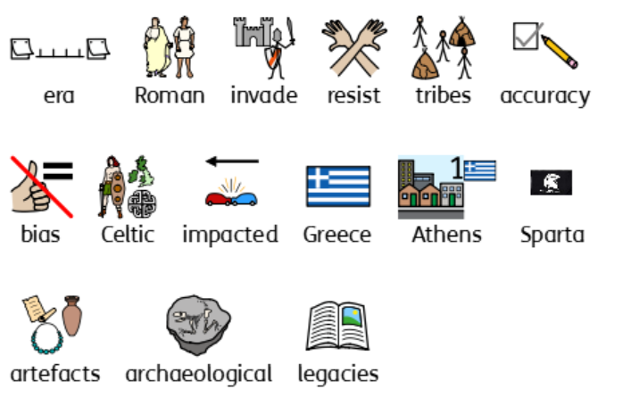
Year 4 history vocabulary

Slide 9
History Year 5
British History The effects of Anglo-Saxon, Viking and Scots settlement in Britain (INVADERS) |  | Ancient civilizations Mayans
Prior | Understand why the Romans invaded Britain and the legacies they left. | Know how Ancient Greece influenced the world.
Knowledge (substantive and disciplinary) | Enquiry one: Who were the Anglo-Saxons and Vikings and why did they invade and settle in Britain? Possible living History trip at Wildwood focusing on time of the Anglo-Saxons- they offer an Anglo-Saxon day experience. Lesson 1- Know where the Anglo-Saxons came from. Lesson 2- Know what kind of people the Saxons, Vikings and Scots were- use different sources. Lesson 3- Explain the reasons for invading and settling and the main features of both societies. Enquiry two: How well did the Anglo-Saxons and Vikings get on with each other? Lesson 4- Understand how much fear the Viking raids caused. Lesson 5- Discuss and explain who was more successful- the Saxons or the Vikings? Enquiry three: What was life really like in Anglo-Saxon and Viking Britain? Lesson 6- Know the similarities and differences of the lives led by the Saxons and by the Vikings. Lesson 7- Understand the importance of religion to the Saxons and the Vikings. Enquiry four: What did the Anglo-Saxons and Vikings leave behind? Lesson 8- Assess the reliability of some sources about the Saxons and Vikings. Lesson 9- Know how much from Saxon and Vikings contributed to life at sea. Lesson 10- Explain how much from Viking and Saxon life still remain today. Lesson 11- Reflect on how Britain may have looked different if the Vikings/Saxons had never arrived. Lesson 12- Debate the question, “is there anything we should be thankful to the Saxons and Vikings for?” Destination idea- Viking battle re-enactment (possibly through dance/drama) to perform to parents. | Lesson 1- Know where and when the Mayans lived- link to work of archaeologists. Lesson 2- Compare and contrast the Mayan writing system and ours. Lesson 3- Understand how the Mayans told the time- understand the Mayan calendar. Lesson 4- Research how the Mayans traded goods. Lesson 5- Explain the Mayan culture and make comparisons to ours. Lesson 6- Explain why it took so long to find the Mayan civilization.
END POINT | Recall the settlement of the Anglo-Saxons, Scots and Vikings. Explain the struggles between them for the Kingdom of England. | Explain what makes the Mayans an important civilisation.
Next | Significant events post 1066- the Blitz. Local study- the impact of WW2 on Newton Abbot and south Devon.
Skills | Use a variety of sources to come up with reasoned views. Justify opinion with evidence. Explain reliability and use this to discuss how reliable sources are. Explain different viewpoints and use this to justify opinions. | Make comparisons and explain these in detail. Make deductions from artefacts rather than written evidence. Conduct own historical research. Understand the difficulty of making conclusions about the past using only the materials that remain.

Slide 10
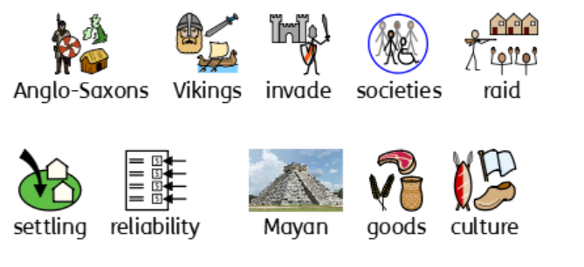
Year 5 history vocabulary

Slide 11
History Year 6
Significant even post 1066 Focus on the Blitz |  | A Local Study Our railway!
Prior | British history- Stone Age to Iron Age; Roman Britain; The effects of Anglo-Saxon, Viking and Scots settlement in Britain.
Knowledge (substantive and disciplinary) | Enquiry 1: How significant was the Blitz? Recap learnt British History to this point (up to 1066). Lesson 1- Understand the causes of WW2 and when it started. Lesson 2- Explain how the Blitz related to the rest of the war. Enquiry 2: World War 2: Whose War? Lesson 3- Understand how people world-wide were involved in the war (revisit term empire). Enquiry 3: What was the impact of WW2 on people in our locality? Lesson 4- Know and explain how the war impacted Newton Abbot (introduce term evacuee). Compare map of Newton Abbot railway station and Plymouth pre/post war to see what buildings have gone (e.g. Station Cottages- row of houses behind Newton Abbot railway station). Lesson 5- Understand the significance of the Blitz in Devon (possible trip to science trip to Plymouth in which sites could be pointed out). Enquiry 4: How well does a fictional story tell us what it was like to be an evacuee. Lesson 6- Explain what it was like to be an evacuee. Enquiry 5: Evacuee experiences in Britain. Lesson 7- Know what it was like to be a child in the war. Enquiry 6: New opportunities? How significant was the impact of WW2 on women? Lesson 8- Explain the role of women in the war. Enquiry 7: What did men do in the war? Lesson 9- Identify similarities and differences in the experiences of men during the war. Enquiry 8: When was the most dangerous time to live? How different was the Blitz? Lesson 10- Use historical knowledge to justify my opinion. Lesson 11- Use knowledge to create a re-enactment of the Blitz through an animation. Lesson 12- Teach others about the Blitz (through sharing an animation). | Depth study linked to site dating back from beyond 1066 that is significant in the locality. Investigation on Newton Abbot railway (use History Association PDF to support). Children to use primary and secondary sources to focus on these questions: - How were people and goods moved before the railways came? When did the railway arrive in the locality and why did it come then? What did those building the local railway hope to achieve? Who actually used the railway? How did the railway keep going? What were the main changes that the railway brought? Why did so many people stop using their local railway? What can we learn about the railway from what survives today? Children to present their investigation findings on this. Children to create their own knowledge organiser based on their investigation findings.
END POINT | Explain what made the Blitz significant. Understand the impact of WW2 on Devon particularly how having the evacuees effected life in the town. | Present findings, using primary and secondary sources, about the railway station in Newton Abbot.
Next
Skills | Address a historically valid question related to the cause and significant of the Blitz. Inform their response through thoughtfully selected relevant information. Address questions related to similarity and difference. Ability to select information from a range of historical sources. Understand that there were similarities and differences between people and their experiences. Understand how far historical fiction can be constructed from a range of historical sources. Address historically valid questions about significance. Construct informed responses that involve thoughtful selection and organisation of relevant historical information Make connections, contrasts and trends over time

Slide 12


