Slide 1
Geography Year 1
Once upon a time around the world |  | Our school journey How do I get to school?
Prior
Knowledge (substantive and disciplinary) | Lesson 1: Explore what is meant by the ‘world’? Lesson 2: Know how to find a place on a globe. Lesson 3: Find and locate the seven continents of the world using ipads and Google Earth. Lesson 4: Learn the seven continents song. Lesson 5: Colour code a map with the continents. Lesson 6: Locate Europe on a world map. Lesson 7: Locate the UK on a European map. Lesson 8: Find Devon on a UK map. Lesson 9: Explore and label some physical features of Devon (beach, coast, sea, river, valley). Lesson 10: Find and locate the five oceans in the atlases and colour code them on the map. | Lesson 1: Know locational and directional language in the classroom and use that language when walking around the school. Lesson 2: Explore the local area from a short walk around Bradley Barton. What can you see? Use directional and locational language. Lesson 3: Look at aerial photos and maps of Bradley Barton – what features can you see? Lesson 4: Know the school and our home address. Lesson 5: Gather information from KS1 children on how they came to school in a tally chart. Lesson 6: Present findings of how children come to school in a pictogram. What have you found out?
END POINT | To name and locate the seven continents and five oceans. To identify some physical features of a local area. | To explore the local area and identify features. Gather and present findings from observations.
Next | Know that the UK is in Europe. Know where Europe is in the world. | Know locational and directional language. Know school and home address.
Skills | To locate different areas on a map. | Identify features of a map. Locational and directional language.

Slide 2
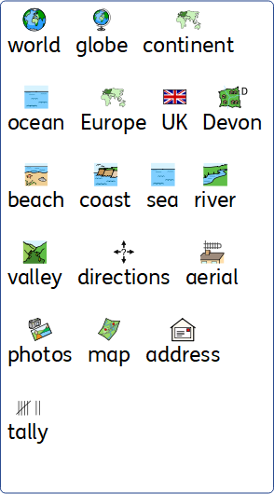
Year 1 geography vocabulary

Slide 3
Geography Year 2
Whatever the weather |  | Our town How does Bradley Barton compare to Newton Abbot town centre?
Prior | To name and locate the seven continents and five oceans. To identify some physical features of a local area. | To explore the local area and identify features. Gather and present findings from observations.
Knowledge (substantive and disciplinary) | Explorer dome visit- weather Met office visitor in Lesson 1: Identify the characteristics of the four countries in the UK. Within this lesson, children to name the 4 countries and identify certain characteristics (physical features, weather patterns, areas of settlement) by using a physical map. Lesson 2: Locate the capital cities and the surrounding seas of the UK. Lesson 3: Identify clothing needed in each season. Children to do a sorting activity in which they can discuss and decide whether is best suited to winter, summer, autumn and spring. Lesson 4: Recognise the features of the different seasons throughout the UK. Lesson 5: Explore daily weather patterns in the UK. Use this to revisit the names of the capital cities in the UK and spot patterns within their weather. Lesson 6: Understand what the equator is and use it in relation to where hot countries are. Lesson 7: Locate and name cold countries in relation to the equator. Ensure Iceland is included. Lesson 8: Investigate the characteristics of Iceland. Identify certain characteristics (physical features, weather patterns, areas of settlement) by using a physical map. Lesson 9: Compare the physical similarities and differences between Newton Abbot and Reykjavik. Lesson 10: Compare features in Newton Abbot and Reykjavik. Compare transport (e.g. people commuting by aeroplane in Iceland) , housing, offices and shops. Lesson 11: Create a weather map for the UK/Iceland. Lesson 12: Present a weather report for the UK/Iceland. | Lesson 1: Explore Newton Abbot town centre by bus and take photos along the route. Lesson 2: Use the photos to identify the characteristics of Newton Abbot and use them to annotate a route map. Lesson 3: Compare photos of Newton Abbot town centre to Bradley Barton. Lesson 4: Identify known features on a large scale map of the local area. Lesson 5: Use simple and cardinal compass points. Lesson 6: Create annotated drawings of Bradley Barton and Newton Abbot town centre
END POINT | To identify seasonal and daily weather patterns in the UK. To name and locate hot and cold countries in relation to the equator. | To identify and annotate known features of the local area using maps and aerial photographs.
Next | To name and locate counties and cities of the UK and identify their human and physical characteristics. | To understand how land use has changed over time in Newton Abbot.
Skills | Navigate google earth. Locate the equator. | Use compass and cardinal points (North, South, East and West) Identify features on a map.

Slide 4
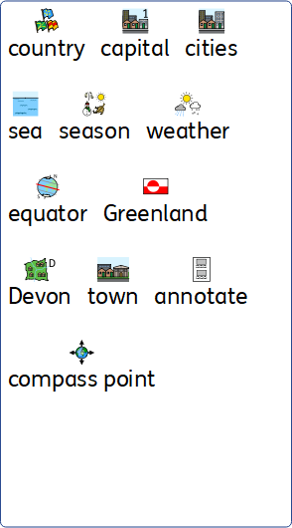
Year 2 geography vocabulary

Slide 5
Geography Year 3
Welcome to the West Country |  | Land use How has the land use of Newton Abbot varied over time?
Prior | To identify seasonal and daily weather patterns in the UK. To name and locate hot and cold countries in relation to the equator. | To identify and annotate known features of the local area using maps and aerial photographs.
Knowledge (substantive and disciplinary) | Lesson 1: Recap the four capital cities (Y2) and locate other cities in the UK. Focus on them finding the nearby cities then other major cities in the UK. Lesson 2: Name and locate some counties of the UK (include counties in all 4 nations). Lesson 3: Explore characteristics of Devon and Cornwall. Discuss what Devon and Cornwall are famous for. Lesson 4: Identify the physical features of Devon and Cornwall, (including rivers and coasts). Lesson 5: Identify the physical features of Devon and Cornwall, (including mountains and moors). Lesson 6: Identify the human features of Devon including economic activity and trade links. Focus on Templar way (stone mined in Dartmoor and bought to Teignmouth). Lesson 7: Identify contour lines on a map. Know that there are steep hills (where lines are close together) and shallow hills where lines are further apart. Lesson 8: Apply understanding to a relief map of Devon. Lesson 9: Create a replica contour map of Dartmoor. Lesson 10 and 11: Create a replica contour map of a section of Devon. Lesson 12: Put contour map together as a year group (to share and destination). Devon Farm visit- possible Farm Wise visit | Lesson 1: Explore the viewpoint in Highweek and make observations of how land is used. Lesson 2: Create a sketch map of the route from school to the vantage point. Lesson 3: Locate the position of a photo on a map. Lesson 4: Identify and compare differences in land use from archived maps to present day. Lesson 5: Present findings of the changes identified. Lesson 6: Analyse and evaluate the findings.
END POINT | To name and locate counties and cities of the UK and identify the human and physical characteristics of Devon. | To understand how land use has changed over time in Newton Abbot.
Next | To locate Europe on a world map and identify a region within Europe. Describe and understand the impact of natural disasters. | To explore whether precipitation impacts water speed.
Skills | Locate places on a map/ipad. | Annotate photographs Sketch maps.

Slide 6
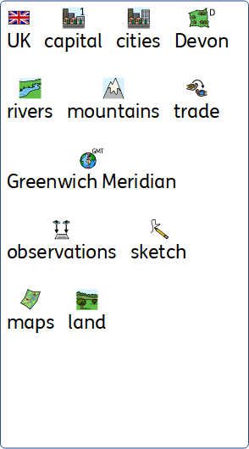
Year 3 geography vocabulary

Slide 7
Geography Year 4
Natural disasters in Europe |  | Rivers The River Lemon
Prior | To name and locate counties and cities of the UK and identify the human and physical characteristics of Devon. | To understand how land use has changed over time in Newton Abbot.
Knowledge (substantive and disciplinary) | Explorer dome visit- Natural Disasters Lesson 1 and lesson 2: Name some of the major countries and capital cities in Europe. Locate Europe on a globe (include the European part of Russia). Children to select a country in Europe to research and present a mood board to their peers (include neighbours of the country, which country speak the same language, capital city). Lesson 3: Understand how the distribution of food and water affects human activity. Children to look at maps of Europe and identify where the landscape is dry. Think about how this affects food and water and the impact this has on where humans chose to live and work. Lesson 4: Name and describe different natural disasters. (volcanoes, earthquakes, flooding, wild fires, hurricanes). Lesson 5 and 6: Identify features of a volcano. Within this, include locate Pompeii on the map and then children to make a volcano (with a chamber, crust, vents, lava, throat). Lesson 7: Describe and understand the impact of volcanoes. Lesson 8: Explain where earthquakes take place around the globe. Lesson 9: Describe and understand key aspects and impact of earthquakes. (set up aroundthekampfire.com landslides investigation for use in week 10). Lesson 10: Describe how removing trees/plants leads to landslides. Lesson 11: Apply understanding of landslides the causes of an avalanche. Children to create an Alpes avalanche survival kit. Lesson 12: Decide how to replicate natural disasters (for destination). | Lesson 1: Compare the speed of the River Lemon and a stream which feeds into it. Lesson 2: Annotate (giving date and location) photographs of the visited river. (Digimaps) Lesson 3: Use a database to compare with another river in the UK. The Spey in Scotland is a fast flowing river to compare to. Lesson 4: Create graphs to compare and display data collected. (the River Lemon, a stream and the River Spey). Lesson 5: Explore how land use around the River Lemon is affected by its course. Focus on looking on Kingsteignton and how the buildings weave around the river (Digimaps). Lesson 6: Explore how land use has changed between 1950 and now around the river.
END POINT | To locate Europe within the world and describe and understand key aspects of volcanoes and earthquakes. | Make comparisons between the flow of different rivers.
Next | To locate South America within the world, concentrating on their environmental regions and their key physical and human characteristics. | To understand how land use has changed over time in Newton Abbot.
Skills | Locate places on maps. Understand geographical features. | Annotate photographs. Create and analyse graphs.

Slide 8
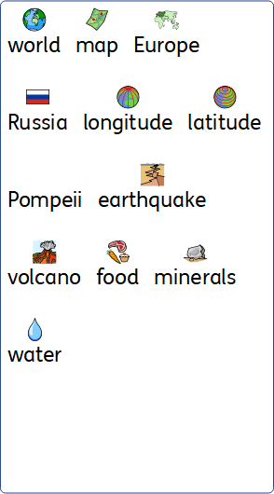
Year 4 geography vocabulary

Slide 9
Geography Year 5
Our Galaxy |  | Coastal erosion What has been put in place to prevent coastal erosion in Dawlish?
Prior | To locate Europe within the world and describe and understand key aspects of volcanoes and earthquakes. | To explore whether precipitation impacts water speed.
Knowledge (substantive and disciplinary) | Lesson 1 and 2: Name some of the major countries and capital cities in South America. Locate South America on a globe. Children to select a country in South America to research and present a mood board to their peers (include neighbours of the country, which country speak the same language, capital city). Lesson 3: Identify key environmental regions of South America. Lesson 4: Identify the position and significance of the Tropic of Cancer and Tropic of Capricorn. (Make link to the equinoxes in science). Lesson 5 and 6: Describe and understand types of settlement and land use in the Amazon Basin. Within the lesson, locate the Amazon within South America. Debate ‘Is it right for land use to be changed to meet human needs?’ (How Amazon is being destroyed to make room for rearing cattle for food). Lesson 7 and 8: Understand the physical geography of South America. Within this, study biomes, climate zones and vegetation belts. Children to split into Rainforest of Brazil, Savanah of Argentina, Atacama Desert in Chile and convey their learning to the class. Possible trip to The Eden Project. Lesson 9: Investigate the importance of the distribution of natural resources and how this has changed over time. Children to learn how the mining of certain minerals (such a nickel) to make batteries impacts on the local population. Lesson 10: Explain the wonders of South America. Create a fact-file/book/report about the wonders: Amazon rainforest, Iguazu falls, Salt flats of Bolivia, Angel falls, Galapagos islands, Atacama Deserts, River of 5 colours. Lesson 11: Link to destination. Lesson 12: Link to destination. | Lesson 1: Explore and create a freehand map of the visited site and use the eight points on a compass to navigate the site. Lesson 2: Annotate drawings and field sketches to record observations of prevention schemes in place. Lesson 3: Annotate digital photos of the visited area. Lesson 4: Identifying relevant features of the site on a large-scale plan. Lesson 5: Record observations of findings in a chart. Lesson 6: Analyse and evaluate findings.
END POINT | To locate South America within the world, concentrating on their environmental regions and their key physical and human characteristics. | To understand why and what has been done to prevent coastal erosion in Dawlish.
Next | To locate North America within the world, concentrating on their environmental regions and their key physical and human characteristics. | To understand and present findings on why Exmouth is a popular tourist destination.
Skills | Locate places on a map. | Compass points

Slide 10
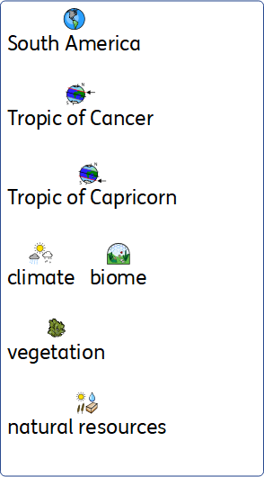
Year 5 geography vocabulary

Slide 11
Geography Year 6
Celebration of culture |  | Exmouth Why is Exmouth a popular tourist destination?
Prior | To locate South America within the world, concentrating on their environmental regions and their key physical and human characteristics. | To understand why and what has been done to prevent coastal erosion in Dawlish.
Knowledge (substantive and disciplinary) | Locate North America (Canada, USA, Mexico, Central America, Caribbean) Locate states and major cities. Identify key environmental regions of North America (tundra, desert, arboreal forests, temperate zones) *Link to Y5 work on biomes Identify physical characteristics of North America. (Mountains, lakes, islands, deserts, volcanoes, earthquake zones, weather zones) 5/6 Research key aspects of your chosen place of study (iconic locations; major places; climate/weather; physical features) 7. Identify human characteristics of North America and link to climate and physical geography ( settlement, distribution of natural resources) 8. Identify human characteristics of North America and link to climate and physical geography ( land use, economic activity) 9. Understand why there are time zones within North America 10. Find different lines of latitude and longitude on a globe. (Prime/Greenwich Meridian, lines of longitude and latitude and relate to North America, Arctic and Antarctic Circle) | Lesson 1: Use a digital map to locate Exmouth and locate different areas on the map. Lesson 2: Use a 6 figure grid-reference to identify main tourist areas on an Ordinance survey map. Lesson 3: Designing and use a questionnaire to collect quantitative fieldwork data. Lesson 4: Collect, analyse and present data in charts and graphs.
END POINT | To locate North America, concentrating on their environmental regions and key human and physical characteristics. | To understand and present findings on why Exmouth is a popular tourist destination.
Next
Skills | Locate places on a map. Discuss and debate cultures. | When learning about economic activities, to investigate the range and location of primary, secondary and tertiary businesses in the local area. Use of geographical information systems.

Slide 12
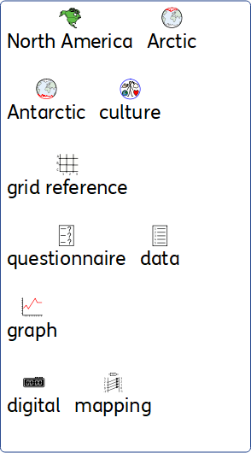
Year 6 geography vocabulary

