Slide 1
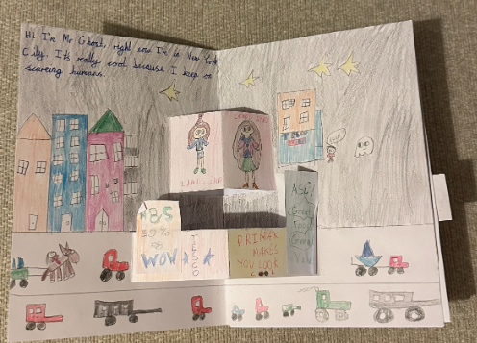
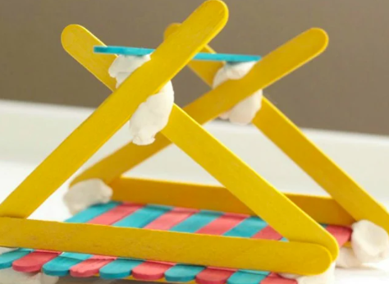
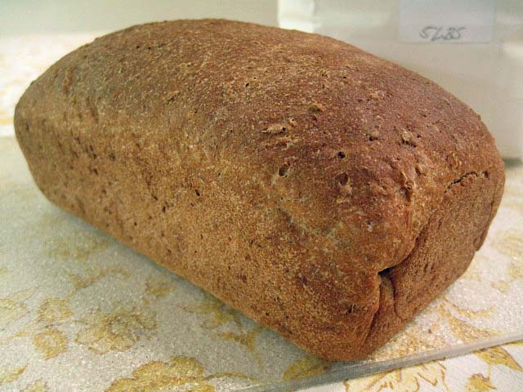
DT Year 1
Once upon a time around the world Make a pop-out book with slider. |  | Great Fire of London- SPRING 1 Make bread. | Bradley Barton Area Make a bridge.
Prior | Experiences with junk modelling and building with blocks. | Make a fruit salad. | Joining materials to make things.
Knowledge (substantive and disciplinary) | Lesson 1- Explore what a pop-up book is. What makes it appealing? Lesson 2- Create a design criteria for a pop-up page with a slider. Lesson 3- Design my own pop-up page with a slider. Lesson 4- Make a pop-up page with a slider. Lesson 5- Make a pop-up page with a slider. Add their own written story to their page. Lesson 6- Evaluate my pop-up page against the criteria. | Lesson 1- Taste test different kinds of bread (baguette, ciabatta, brown, multi grain) and identify what makes it appealing. Lesson 2- Order a bread recipe. Understand the term ‘recipe’ and use this to put a bread recipe in order. Lesson 3- Know how to be hygienic when making food. https://www.cieh.org/what-is-environmental-health/resources/school-materials/ Lesson 4- Design their bread. They can decide a flavour (sun-dried tomatoes/olives/sea-salt rosemary/garlic and herb) and how they want to present it (twisted/plaited/bun/loaf). Lesson 5- Make bread. (once made, take a feedback sheet home for their parents to fill out giving them constructive feedback). Lesson 6- Adapt their designs (based on feedback). | Lesson 1- Know what a bridge is and what makes it strong. (Re-tell story about using a bridge to get to school. Explain purposeful unit). Lesson 2- Select from a range of materials and design a bridge for a toy car to go over. Resources Pritt sticks, glue guns, thin card, paper, thick cardboard, lolly pop sticks, pipe cleaners Lesson 3- Justify design choices to a peer. Lesson 4- Create bridge. Lesson 5- Test and evaluate whether it meets the purpose. Lesson 6- Make model stronger, stiffer or more stable (to hold more load).
Skills | Cut cardboard. Stick cardboard together to make a slider. Folding cardboard. Design through drawing. | Combine ingredients. Sieve flour. Measure ingredients. Knead bread. Follow a recipe. How know to be hygienic (wash hands). | Selecting materials. Talk through design idea. Know how to cut. Know how to join with glue.
END POINT | Make a pop-out page with a slider for own story. | Design and make some bread. | Design and make a bridge.
Next | Make moon buggies with axel and wheels. | Make a soup. | Make a wooden bridge (Y4).
Yellow- mechanisms
Grey- junk modelling
Green- food tech
Orange- woodwork
Blue- textiles

Slide 2
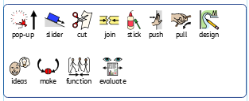
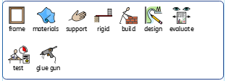
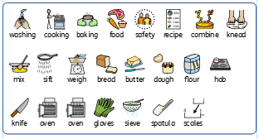
Year 1 DT vocabulary
Slider story book page
Make a bridge
Making bread

Slide 3
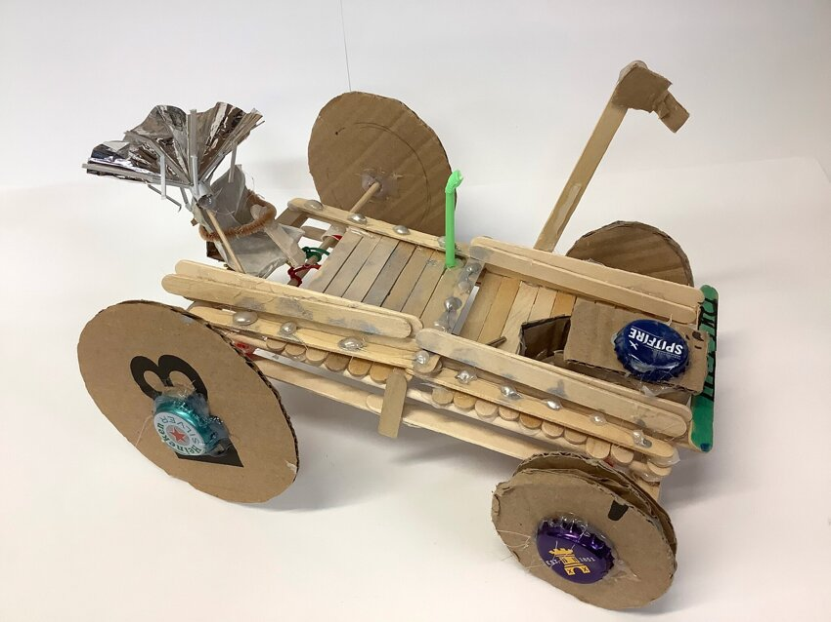

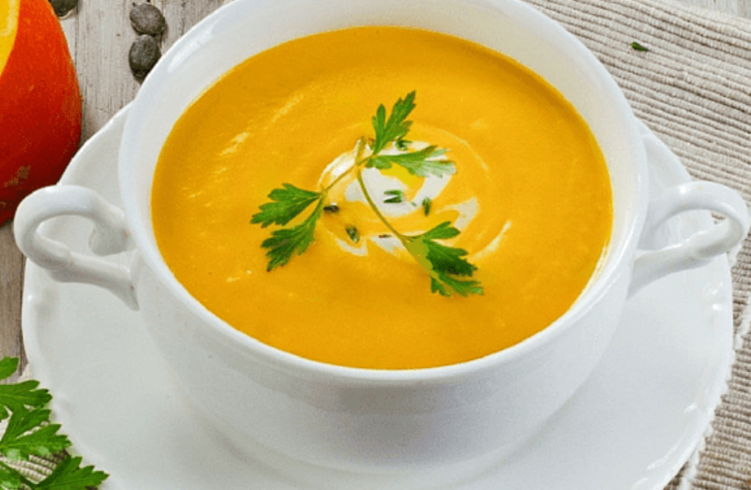

DT Year 2
Whatever the weather Make a seasonal soup. Autumn 1 |  | NASA- SPRING 1 Make moon buggies. | Newton Abbot Make a Devon flag.
Prior | Know how to make bread. | Creating bridges
Knowledge (substantive and disciplinary) | Lesson 1- Explore seasonal local crops and know where they come from. Lesson 2- Understand the importance of a healthy and varied diet. (Recognise bread is a carbohydrate). Lesson 3- Evaluate a range of different seasonal crops (taste testing). Lesson 4- Create a recipe based on evaluation. Lesson 5- Make an appealing soup. Lesson 6- Evaluate their product and suggest amendments. Food hygiene https://www.cieh.org/what-is-environmental-health/resources/school-materials/ | Lesson 1- Know what a moon buggy is and explain how an axel and a wheel work. Lesson 2- Select from a variety of materials and tools to make a prototype moon buggy. Give children access to different resources (cardboard circles, dowels, straws, lolly sticks, masking tape, celotape, PVA glue, glue guns) to experiment with to make a prototype moon buggy (focus on the moveable element). Lesson 3- Evaluate prototype moon buggy and design final product. Lesson 4- Create moon buggy based on design. Teachchildren on safe use of glue guns and let them use them to create models. Lesson 5- Evaluate a moon buggy and suggest ways it could be improved. Lesson 6- Improve model following feedback. | Lesson 1-Know about county and country flags and what they look like (relate Devon flag to Newton Abbott.) Lesson 2- Select patterns and materials and design their own flag. Lesson 3- Learn how to do a running stitch Lesson 4- make a flag Lesson 5- make a flag Lesson 6-Evaluate their flag/stitching
Skills | Know how to use a blender. Know how to weigh. Chop vegetables. Serve soup. Know how to make a product more appealing. | Know how to make a working axel and wheel Cutting, sticking, joining materials Selecting appropriate materials Evaluate a model | Cutting textiles Running stitch Thread a needle
END POINT | Make a seasonal soup. | Make a moveable vehicle axles and wheels. | Use a running stitch to make a Devon flag.
Next | Create a seasonal dish | Make a trailer with a pulley. | Make a tool bag.
Yellow- mechanisms
Grey- junk modelling
Green- food tech
Orange- woodwork
Blue- textiles

Slide 4
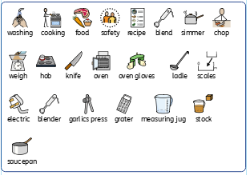
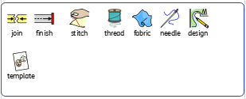
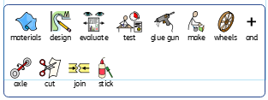
Year 2 DT vocabulary
Making soup
Make a flag
Make moon buggies

Slide 5
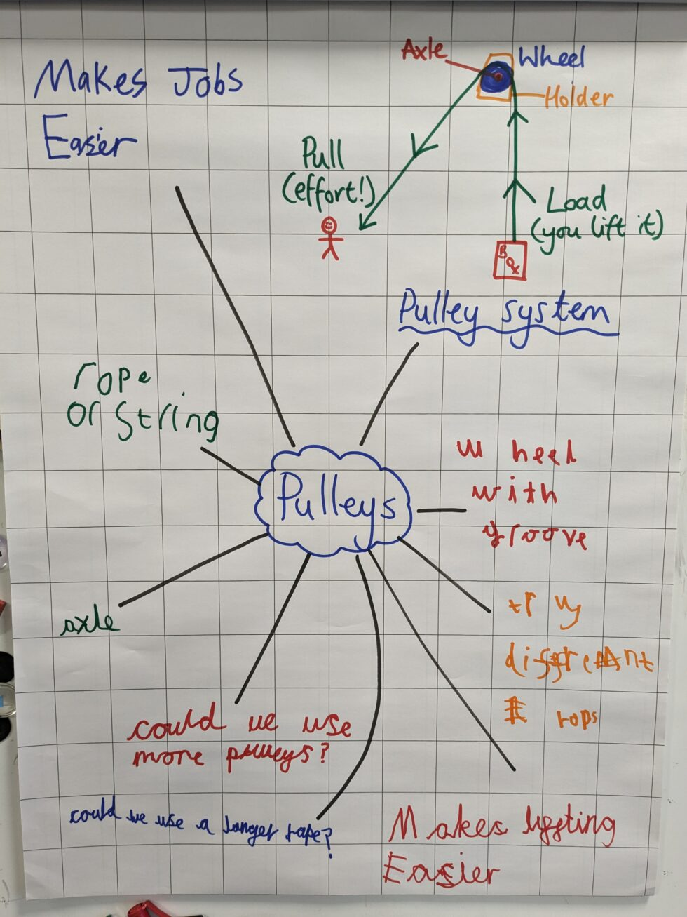
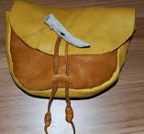
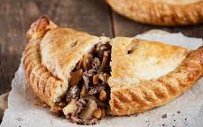
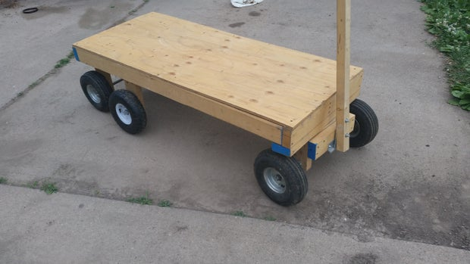
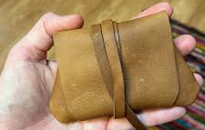
DT Year 3
Welcome to Devon! Create a seasonal savoury dish. AUTUMN 2 |  | Stone age to Iron age Make a satchel | Land use Make a model trailer for moving crops.
Prior | How to make bread How to make a seasonal soup | How to make a flag running stich | Make a moon buggy
Knowledge (substantive and disciplinary) | Lesson 1: Research what food children and adults would buy at a Christmas market. Lesson 2: Know how to prepare and cook meat safely, and how to use pastry and make it visually appealing. Lesson 3: Design your food using cross sectional diagrams and what ingredients it will have and what cooking techniques are needed Lesson 4: Make your food and receive feedback Lesson 5: Make amendments to your ingredients list to improve your food Lesson 6:Batch cook for Christmas market at school. (not on the same day as Christmas dinner) | Lesson 1: create a criteria of what a satchel should look like. To do this, children need to know what they would have used a satchel for, their main purpose and then create a success criteria. Lesson 2: practise different stitches. Children to recap running stitch and learn to backstitch. Children can then pull the material to test which stitch is stronger. Lesson 3:Design a satchel based on the criteria (set in lesson 1). (using exploding diagram for this). Provide children with samples of different materials for this for them to incorporate into their design. Lesson 4:Make a satchel. Lesson 5: Complete their satchels. Lesson 6: Evaluate their satchel against the criteria and suggest improvements. | Lesson 1:Research how farming equipment has changed over time Lesson 2: Research how pulleys work and why they are used Lesson 3: Research trailer designs with pulley system attached Lesson 4: Design trailer and what materials are needed. Learn about wood work safety and tools Lesson 5:Make trailer and pulley (Use Techcard) Lesson 6:Make trailer and pulley and evaluate product.
Skills | Learn how to make ingredients list, different cooking techniques Learn how to prepare and cook meat safely Learn how to use pastry and make it visually appealing Learn how to create appealing products | Learn how to backstitch Learn how to create a handle Learn how to make a purposeful/working product. Select materials and components needed Evaluate product against design criteria | Learn how to use wood work tools safely Learn how to make a pulley system Learn how to make a wooden wheel and axle. Select materials, tools and components Evaluate product in comparison to other existing products. Understand and use mechanical systems in their products
END POINT | Create a seasonal, locally- traditional dish- a pasty. | Create an iron age satchel using my sewing skills. | Create a model trailer for moving crops.
Next | Make a burger. | Make own clothes (Y6). | Make a wooden bridge.
Yellow- mechanisms
Grey- junk modelling
Green- food tech
Orange- woodwork
Blue- textiles

Slide 6
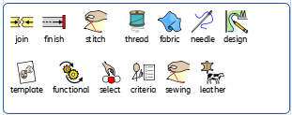
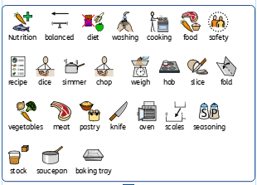
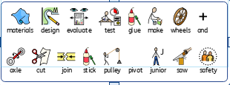
Year 3 DT vocabulary
Make leather bag
Make pasties
Make a model trailer

Slide 7
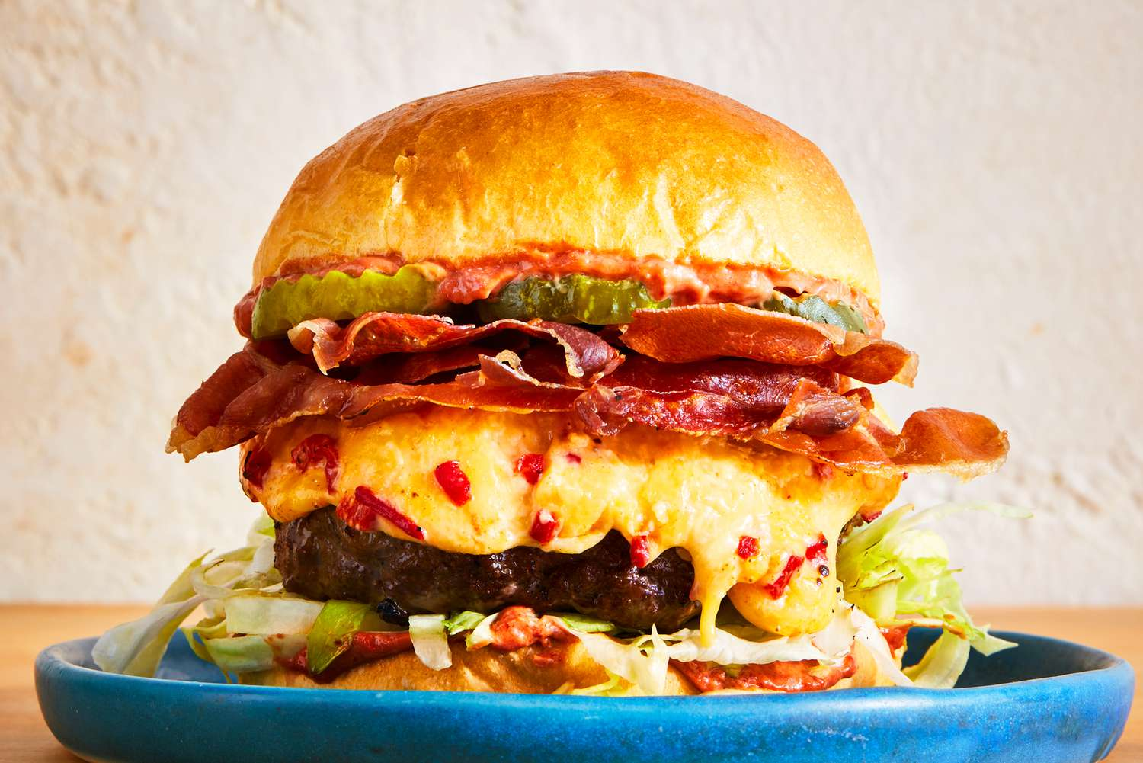
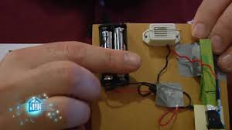
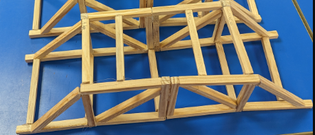
DT Year 4
Natural disasters Make a bridge which can withstand the elements. |  | Romans Spring 2 Make fast food (burger). | Ancient Greece Make an alarm.
Prior | Make a bridge to hold a toy car | Made bread Made soup Made pasties
Knowledge (substantive and disciplinary) | Lesson 1: Know how bridges have changed. Compare the first ever bridge (1300s) to modern bridges. Link to art work on Brunel. Compare materials used to make bridges and changes in this. Lesson 2:Design a bridge using an exploded diagram. Lesson 3: Replicate my bridge design using CAD. Children to copy their designs over on Ipads/Chrome Books to TinkerCAD. Lesson 4 and 5: Make a bridge from wood. Lesson 6: Test and evaluate it against withstanding elements. Children to decide how well their bridge met the purpose and reflect on improvements they could make. | Lesson 1: Know the food which the Romans bought to Britain. (Ensure children do not develop a misconception that the Romans created burgers. Explore the foods they bought to the UK and those they ate outside-fast food). Lesson 2: Recap nutrition and healthy diet. Link this to fast-food. Lesson 3: Design a burger. Lesson 4: Make burgers and receive feedback. Ensure children know that a burger must reach 71 degrees to be safe and model this when cooking using a probe. Lesson 5: Alter designs based on feedback. Lesson 6: Make burgers following feedback. | Lesson 1:Explain what an Ancient Greek alarm was like. Lesson 2: Research the purpose of different alarms. Within this focus on the use of security alarms as well as awakening alarms. Lesson 3: Investigate how to create a circuit with a variety of switches. Teach the word ‘feedback’ within this lesson (ideas on the TTS PDF page 3). Within this, learn about different switches. Lesson 4: Design an alarm system for a purpose. Due to not having a ‘clock’ element, the purpose should be rather on protecting something (push-to-make switch). Children to create detailed drawings. Lesson 5: Make an alarm system based on design. Lesson 6: Evaluate a peer’s product. By trying to move protected items and see if the alarm sounds.
SKILLS | Use technology Use software for computer aided design Design purposeful and functional products Learn how architects design structures Learn how to use woodwork tools: saws, vices, glue guns Select materials, tools and components | Design appealing products that are fit for purpose Select ingredients according to their functional properties of the product. Food hygiene Food preparation Combine ingredients Evaluate product against design | Use research to develop ideas Investigate and analyse a range of existing designs Understand and use electrical systems in their products.
End point | Make a bridge which can withstand the elements. | Create a savoury snack (a burger). | Create a working alarm with an electrical circuit.
Next | Incorporate woodwork to make a toy with gears. | Create a variety of savoury dishes. | Create robotic Mars Rover.
Yellow- mechanisms
Grey- junk modelling
Green- food tech
Orange- woodwork
Blue- textiles
Red- Electrical

Slide 8
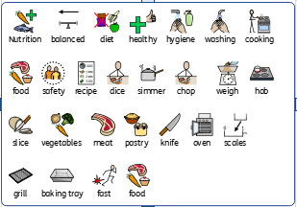
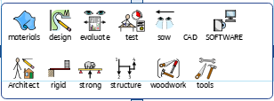
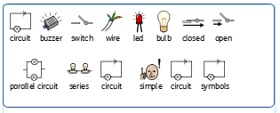
Year 4 DT vocabulary
Fast food burger
Make a bridge to withstand elements
Greek alarm

Slide 9
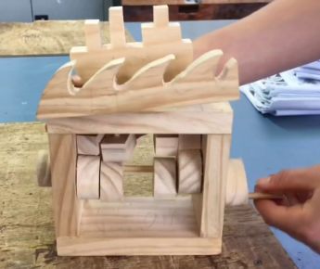
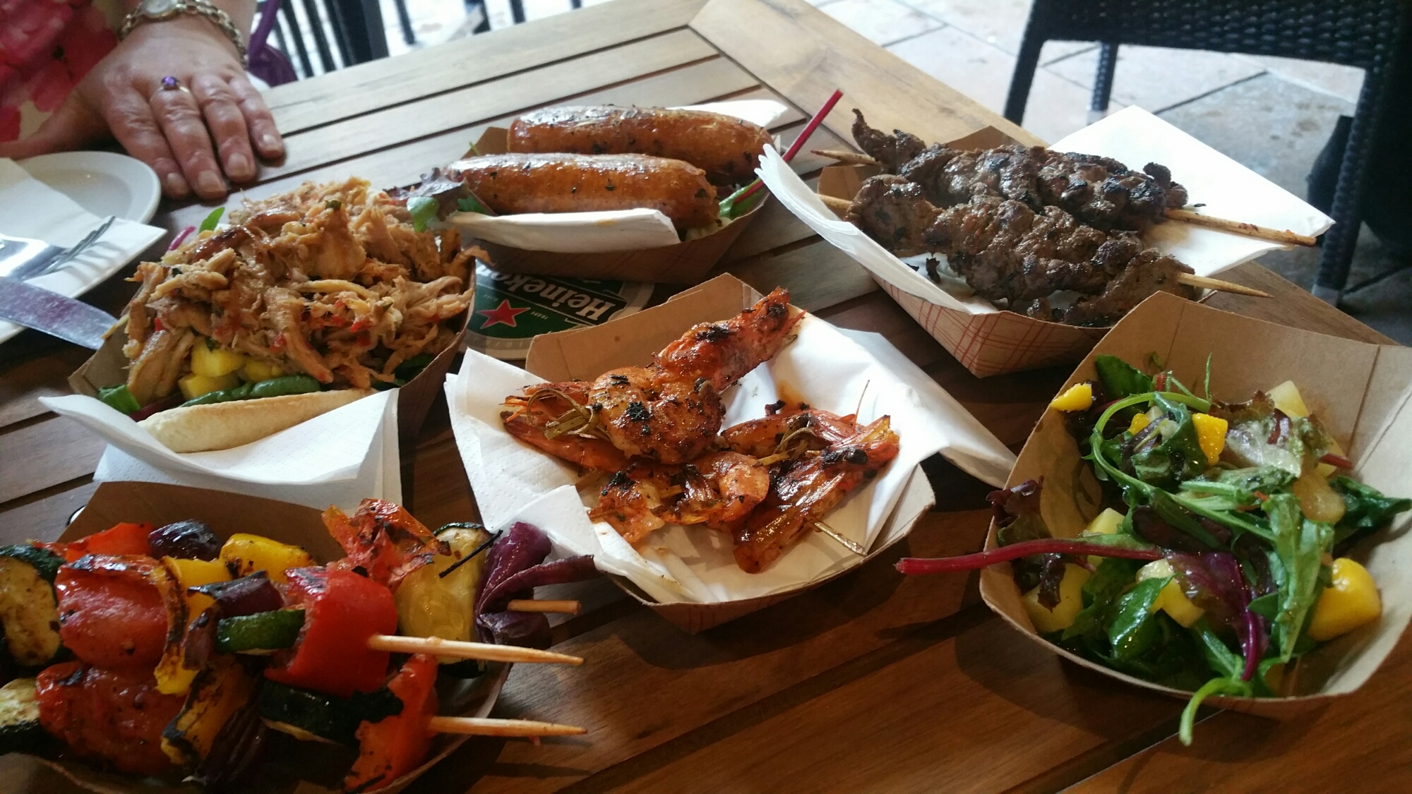
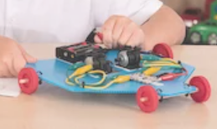
DT Year 5
Our Galaxy Mars Rover creation. |  | Invaders Make a Viking long boat and wave toy. | Mayans Summer 2 Create a food festival.
Prior | Know how to create an electrical circuit (Y4 science retrieval). | Know how to use sliders, axels, wheels, pulleys to make products with a mechanical element. | Understand seasonality and know how to make different savoury dishes.
Knowledge (substantive and disciplinary) | Lesson 1: Understand what a Mars Rover is. Know the uses of the Mars Rover, how it is controlled and what it has enabled scientists to learn about Mars. Lesson 2: Make a detailed annotated design sketch of a Mars Rover. Lesson 3: Practise making electrical circuits. Lesson 4: Create body of Mars Rover following design. Lesson 5: Create circuit and programme Mars Rover (with Crumble software on Chrome Books). Lesson 6: Evaluate Mars Rover. Resource- Crumble Robotics Set and Chrome Books. Teacher note- would be useful to have a prototype of each stage on display which children could refer to when making. | Lesson 1:Know what a cam is. Within the lesson, learn about how cam works and why they are used. Lesson 2: Research different cam toys and use this to decide on design criteria. Show the model Viking long boat toy during this lesson (ask Stacey for this). Lesson 3: Apply understanding of a cam to design a cam toy. Use an exploded diagram to design. Lesson 4: Make Viking longship and wave toy. Lesson 5: Continue to make Viking long boat and wave toy. Lesson 6: Evaluate own cam toy against design criteria (created in lesson 2). | Lesson 1: Know typical Mayan food. Teach the terms ‘Milpa’ and ‘rearing’ within this lesson. Children could taste test the ‘Three Sisters’ of Mayan food: maize (tortillas), squash and beans. Lesson 2: Explain Mayan influence on food today. Lesson 3: Create a Mayan inspired menu for the food festival. Focus on savoury dishes and find recipes with Mayan influences. Lesson 4:Make prototypes to evaluate. Ensure children follow good personal hygiene practises. Ensure children wash any fruit or veg. Lesson 5: Adapt recipes based on feedback. Lesson 6: Put on a Mayan inspired food festival for parents.
Skills | Use Ict skills to research key events Design Programming Joining Making axles Folding Reinforcing Making levers and pulleys | Use research to design Annotate plans Select materials and tools | Use ICT skills to research Design appealing products that are fit for purpose Select ingredients according to their functional properties of the product. Food hygiene Food preparation Chopping, peeling Presentation of food
End point | Create a product with an electrical component. | Create a moving toy with a cam. | Create a variety of savoury dishes.
Next | Create a stop motion set. | Create a stop motion set with gears. | KS3 food tech.
Yellow- mechanisms
Grey- junk modelling
Green- food tech
Orange- woodwork
Blue- textiles
Red- electrical systems
Purple-Computer controlled product

Slide 10
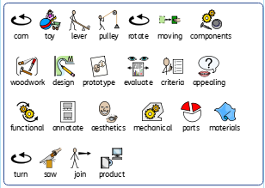
Year 5 DT vocabulary
Viking long boat and wave cam toy

Slide 11
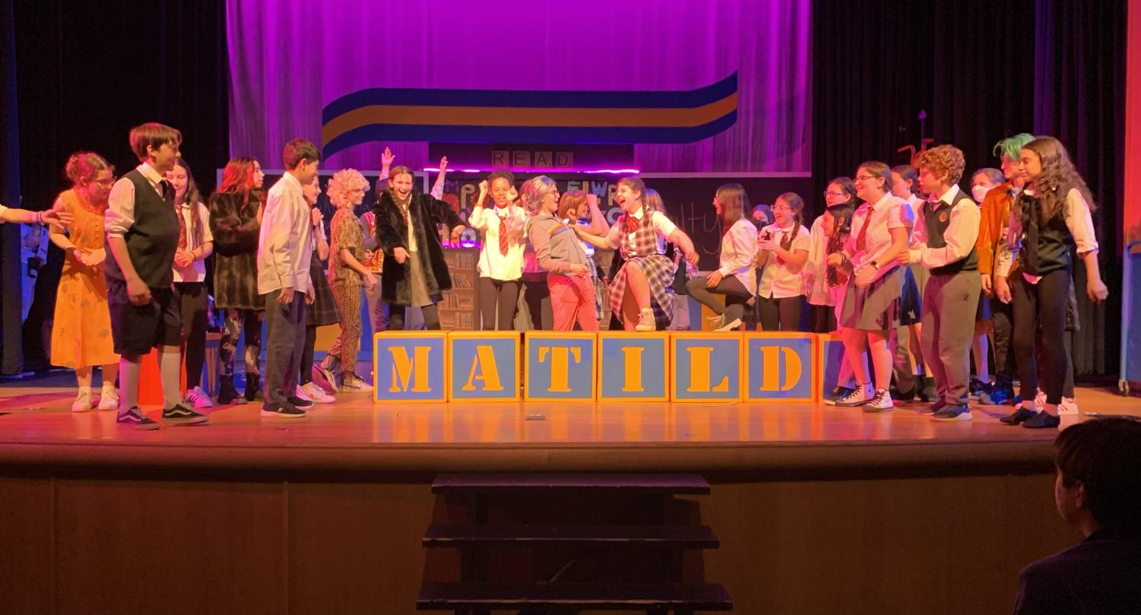
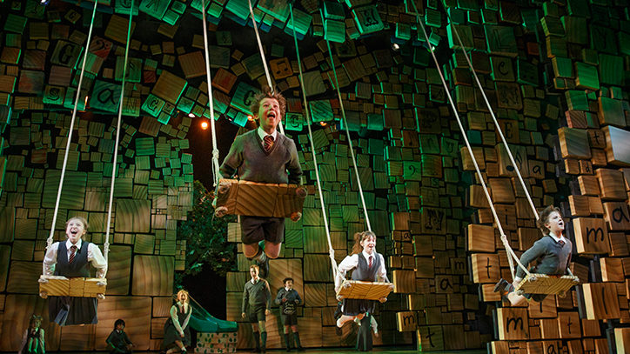
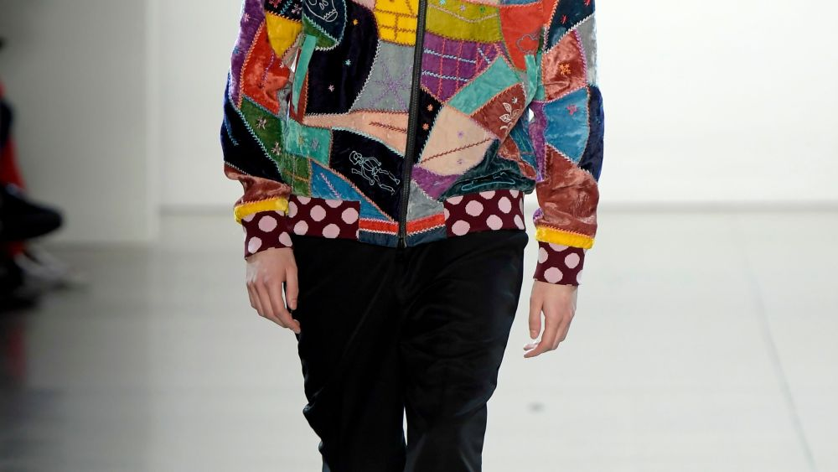
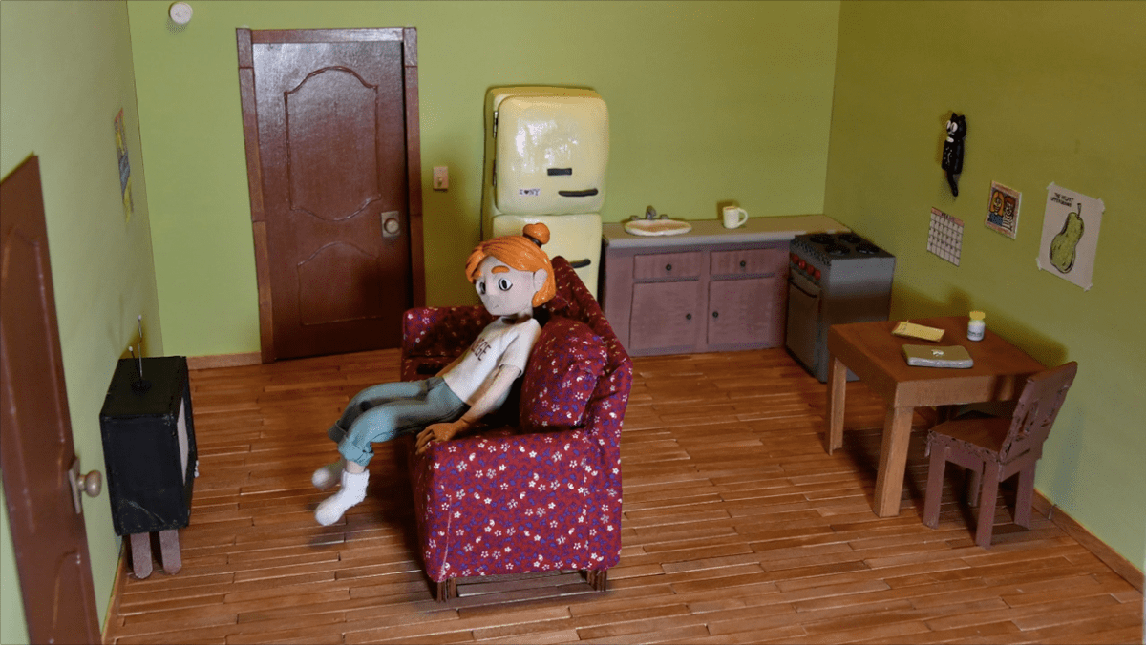
DT Year 6
Cultural Create clothing |  | Blitz Create a set (for a stop-motion) | Show Create a set.
Prior | Know how to do a running stitch and back stitch. | Know how to use sliders, axels, wheels, pulleys, cams to make products with a mechanical element.
Knowledge (substantive and disciplinary) | Lesson 1: Understand the timeline of Western fashion. Recall key fashions in the Western world at different periods over the last 100 years. Include iconic movements like the 1926 little black dress and the mod influence of the 1960s. Lesson 2: Revisit previously learnt stiches. Lesson 3:learn to tack and applique Lesson 4:Design an outfit for a fashion show. Lesson 5: Create an applique Lesson 6: Model their individual pieces. | Lesson 1: Understand how gears work. Within this, children to understand why gears are used to control and move components (consider how gears could be used to control movements on set and curtain movement.) Lesson 2: Plan a stop motion animation. (ensure at least one set has a moveable part which can be controlled by a gear). As a year group, decide the story of the Blitz which will be shown within the animation. Lesson 3: Design set. As a year group, decide how many ‘scenes’ there will be in the stop motion and work in groups to design the sets (ensure they include a moveable element). Lesson 4 and 5: Make set. Different joins could be useful to help them make stronger: https://www.bbc.co.uk/bitesize/articles/z9pms82#zk6jp9q Ensure children have a range of materials (wood planks, dowels, fabric, newspaper) and a range of things to join with (glue guns, glue, tacks and hammers). Lesson 6: Evaluate against design. | Design and create set for show.
SKILLS | Select materials based on properties Cut material accurately and precisely Select best stitch for the purpose Use a sewing machine | Know how to use gears Know how to join gears
END POINT | Create a piece of clothing to show my views and opinions. | Create a set for a motion picture. | Create set for whole school show.
NEXT | KS3 textiles. | KS3 woodwork. | KS3 drama.
Yellow- mechanisms
Grey- junk modelling
Green- food tech
Orange- woodwork
Blue- textiles
Red- Electrical systems

Slide 12
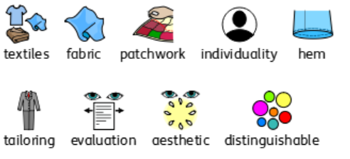
Year 6 DT vocabulary
Making clothes

